Slide 1
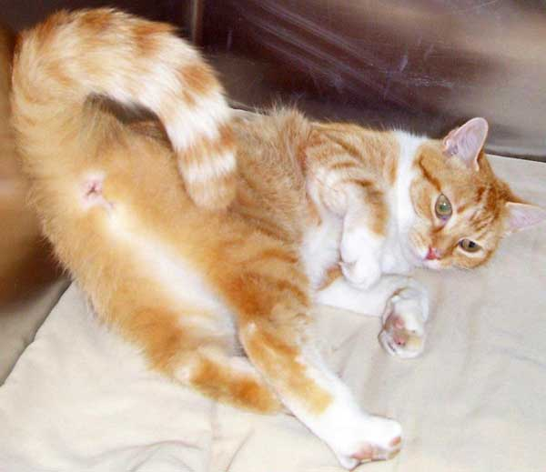
The last, final, all-you-can eat, tail-end
Drill and Practice

Slide 2
What’s my compound class ?
= pcc
1º
=pyridinium chlorochromate
aldehyde
K₂Cr₂O₇
H₂SO₄
1º
What’s my compound class ?
Carboxylic acid

Slide 3
Product’s class ?
An ester
Reaction’s name ?
Fischer esterification
Note !!
pyridine
What’s my compound class?
An Acid chloride

Slide 4
O₃/in freon
Zn/H+
2
HgSO₄/
H₂SO₄
H₂O₂
/OH⁻
Hint: keto-enol and Markovnikoff
BH₃/neat or in THF
Name of reaction ?
H.C. Brown’s 2 step hydroboration/oxidation

Slide 6
2º
2º
My compound class ?
ketones
NR…K₂Cr₂O₇ not strong enough to oxidize 3º ROH
3º

Slide 7
Liº
neat
₊
KHSO₄
heat
HCl
Then:
Alkyl sulfonate synthesis
Reaction’s name ?_______________________________

Slide 8
Mg/dry ether
CO₂(g)
H⁺/H₂O
NaCN in ethanol

Slide 12
Mg/ dry ether
H⁺/H₂O
Dry ether
AlCl₃ neat
N₂H₄/OH-
Reaction name ?
or Zn-Hg/HCl
heat
Wolff-Kishner reduction
Reaction name ?
Clemmensen reduction
NBS/light
KOH
In ethanol
What’s my name?
styrene

Slide 13
Name of this reaction ?
Corey-House reaction
Li(Al-tBuO)₃
In ether or neat
SOCl₂/pyridine or PCl₃ neat

Slide 14
NaBH₄
methanol, then H₂O
Supply a moderately strong reducing agent/solvent different than H₂ that does these two conversions
NaBH₄
methanol, then H₂O
LiAlH₄
In ether, then H₂O
Supply a strong reducing agent/solvent different than NaBH₄ that does these two conversions
LiAlH₄
In ether, then H₂O

Slide 15
Mg/ dry ether
H⁺/H₂O
Dry ether
AlCl₃ neat
N₂H₄/OH-
Reaction name ?
or Zn-Hg/HCl
heat
Wolff-Kishner reduction
Reaction name ?
Clemmensen reduction
NBS/light
KOH
In ethanol
What’s my name?
styrene

Slide 16
Name the three major of diene addition reactions
1)Addition of HX
2)Addition of X₂
3)Addition of dienophiles
Addition of dienophiles go by at least 3 different names. What are they ?
1,3-cycloaddition
2+4 cycloaddition
Diels-Alder reaction
heat
A reaction condition
Who is the dienophile above ?

Slide 17
Aromatic-aliphatic and synthesis drill and practice (cont.)
Industrial route to styrene ???
ZnO/60 ºC
Order the reactivity of Br below from highest to lowest reactivity
A B C
A > C >B

Slide 18
H₂O
Example of Hell-Volhard-Zellinsky reaction
( not quite aldehyde or ketone but similar)
then…
Reaction name ? (You did one in lab…)
+H₂O
Aldol condensation (aldehyde to bigger alcohol→ bigger alkene)

Slide 19

Main product
+
H₂O
By-product

Slide 20
Route to peroxy acid
+
Name of the above oxidation ?
By-product
Product
Baeyer-Villiger
HCl
+
Weird name of product
ylide
Product By-product

Slide 21
HBr, H₂SO₄
reflux
Old school, classic route
PBr₃(g)
New school, modern route 1
SOBr₂
New school, modern route 2

Slide 22
NaCN
H⁺
2

Slide 23

Organic Chemistry makes me want to hide all day under a blanket….

