Slide 1
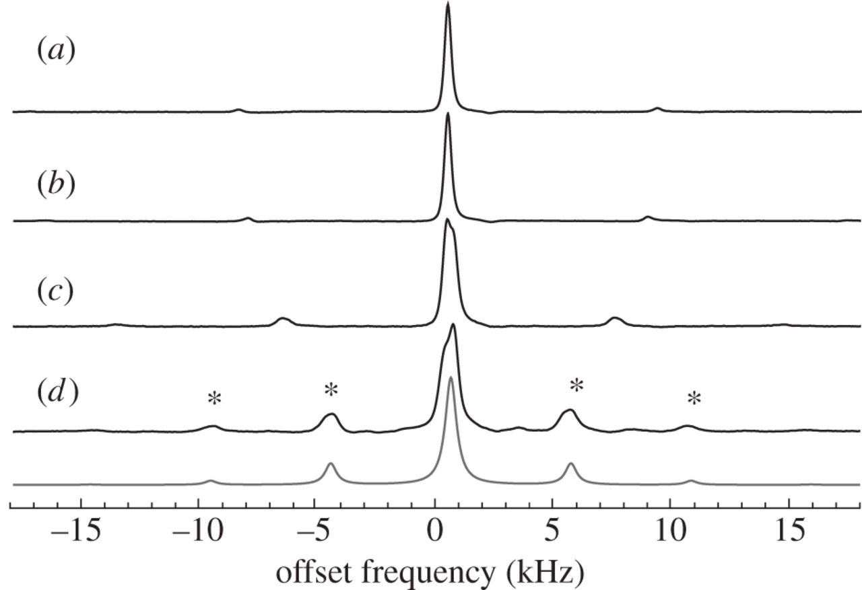
Spinning side bands (created by the need to rotate sample tube)

Slide 2
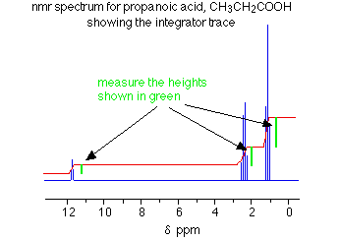
The ‘count’ of H is not always straightforward

Slide 3
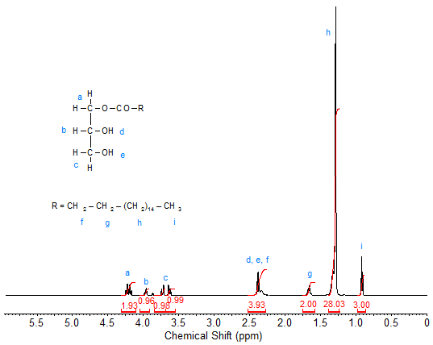
Sometimes you can’t figure out the splittings
Glycerol

Slide 4
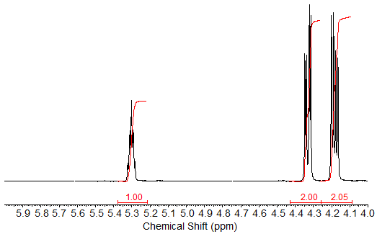
…even when you go to very high resolution

Slide 5
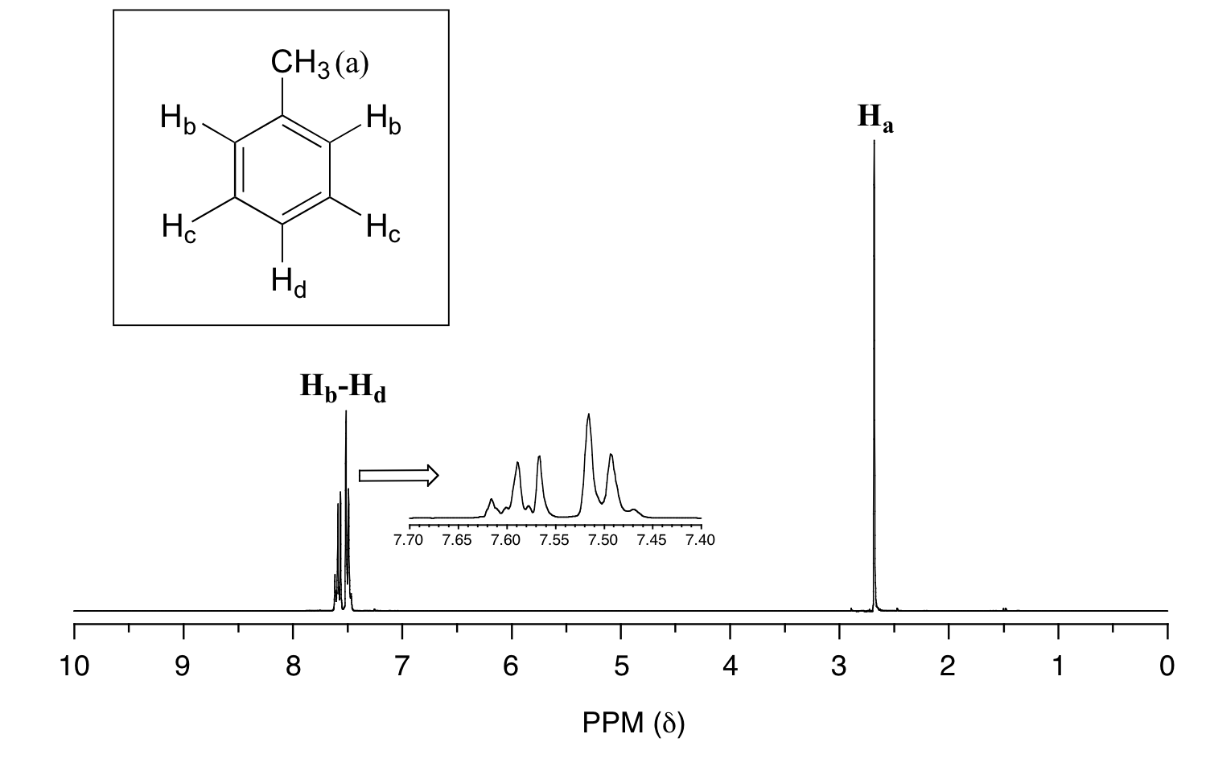
…and sometimes too much resolution is not a great thing

Slide 6
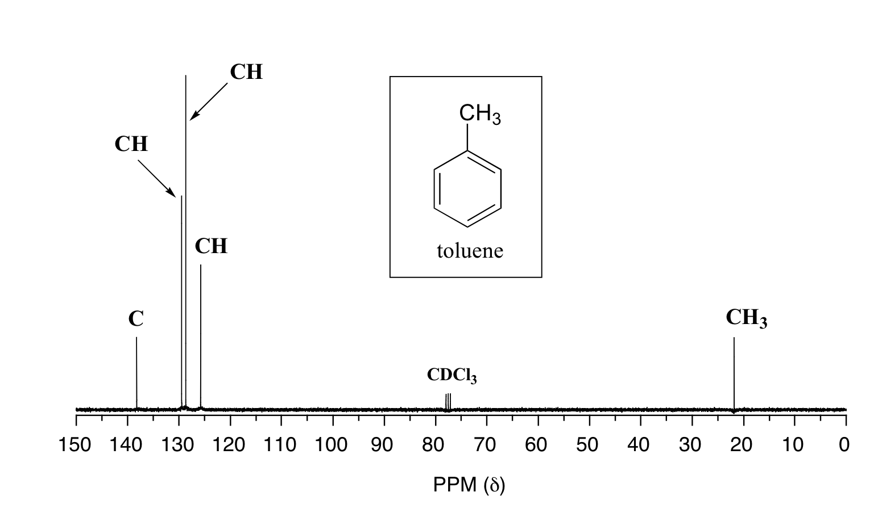
Examples of 13-C NMR…knowing how many different C provides lots of help in structure analysis
reference

Slide 7
In-class practice predicting aromatic spacings and splittings at very high resolution

Slide 8
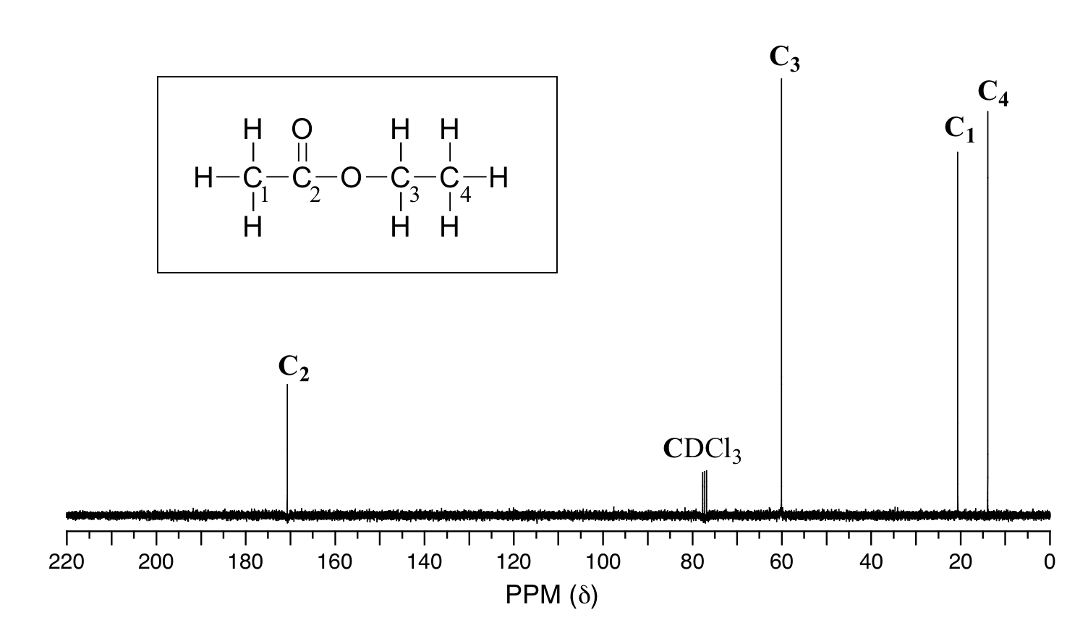

Slide 9
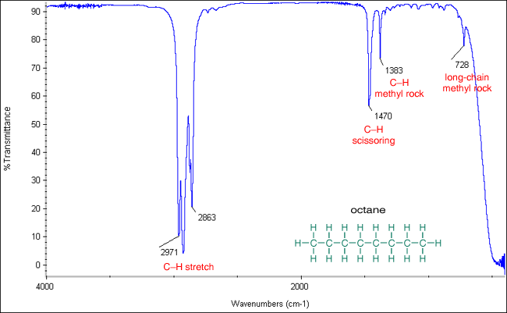
IR of alkane
3000 cm⁻¹

Slide 10
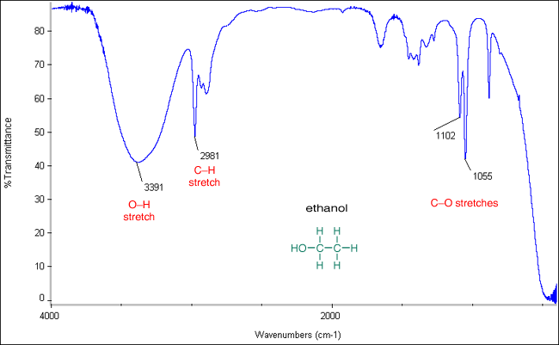
IR of alcohol…
Broad, strong band near 3400 => OH

Slide 11
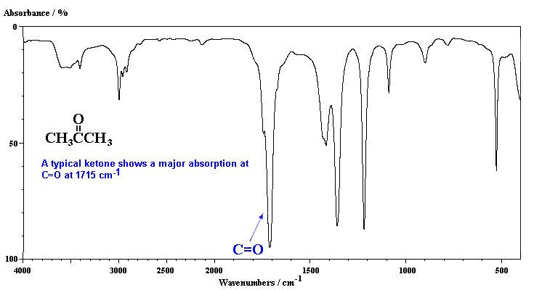
IR of Ketone (Acetone)
1700 cm⁻¹ very strong is C=O
3000 cm⁻¹

Slide 12
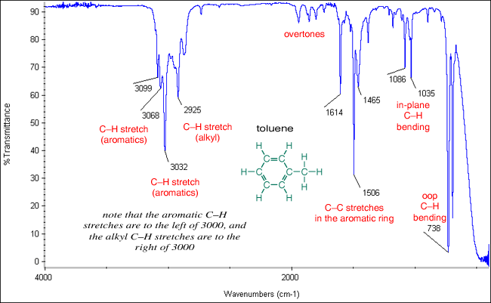
IR of Aromatic (toluene)
C=C ring breathing
overtones
Lines above 3000 cm⁻¹

Slide 13
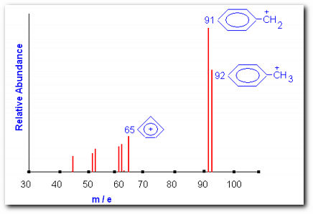
Mass spectrum of toluene
Parent mass= molecular weight

