Slide 1
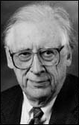
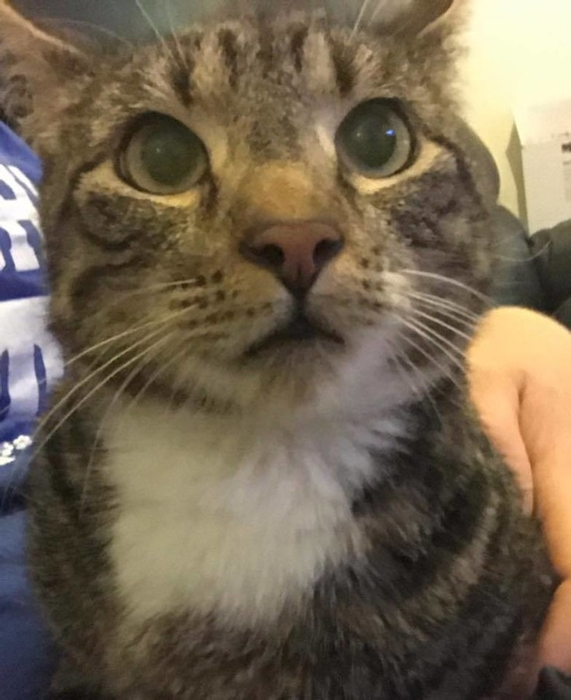
Kitty has a question: “Chemists aren’t even 1/100 th as cute as cats, so how come they be awarded Nobel Prizes and cats can’t , miaow????”
Nobel Laureate in Chemistry 1989
Cat

Slide 2
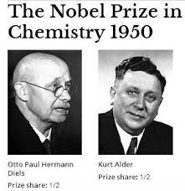
1950 Nobel Prize in Chemistry…for development of the 2+4 cycloaddition reaction
Chemistry Dept.
Kiel University
Germany
Director, I.G Farbenindustrie Labs
Chair Chemistry Dept.
Cologne University
Germany
Diel’s grad student

Slide 3
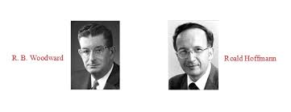
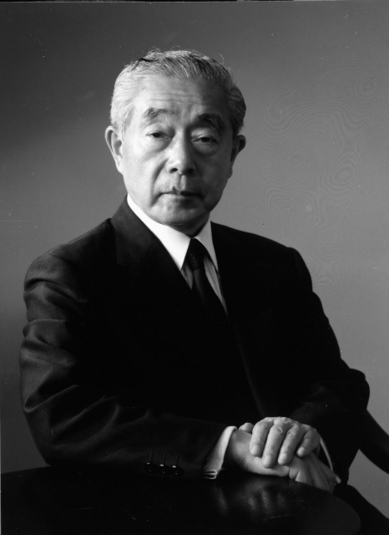
1981 Nobel Prize in Chemistry: “for their theories, developed independently, concerning the course of chemical reactions“ notably- explaining cycloadditions in terms of the conservation of orbital symmetry”
Harvard University
Cornell University
K. Fukui
Kyoto University

Slide 4
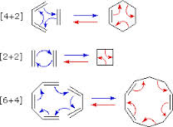
Woodward-Hoffman-Fukui Theory supports two (2) electron `pericyclic’ reactions (not one (1) electron exchanges)…but either way you can predict correct product. (The one (1) electron exchanges Doc presented is easier to use)
2e⁻ Pericyclic exchanges

Slide 5
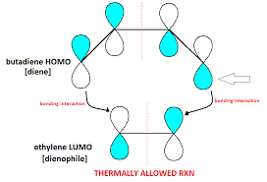
The key to the Woodward-Hoffman-Fukui model…the ene and dienophile have the right (marriage-compatible) orbital symmetries in the HOMO and LUMOs
HOMO=Highest Occupied Molecular Orbital
Lobes have same sign (color)=> bonding happens
LUMO=Lowest Unoccupied
Molecular Orbital

Slide 6
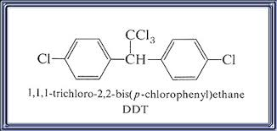

Magazine promo from 1952

Slide 7
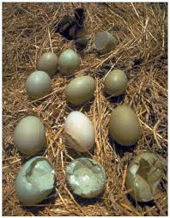
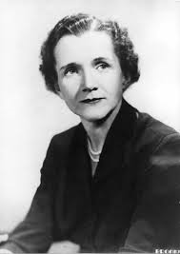
Rachel Carson: Field Biologist

Slide 8
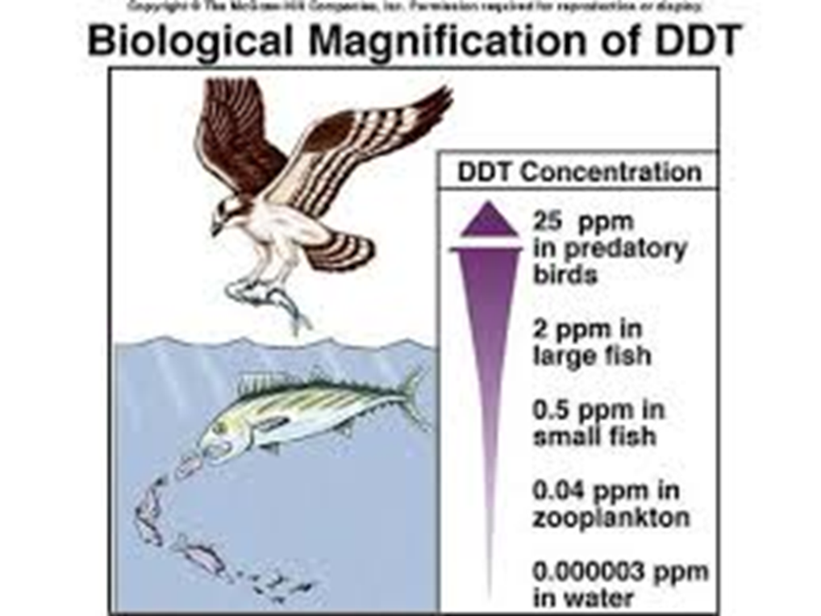


Slide 9
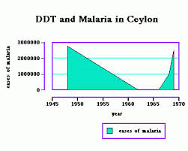
DDT discontinued

Slide 10

Sometimes, chemistry works but is bad…..

Slide 11
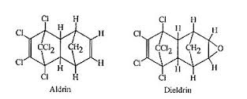
These replacements eventually get to market
Biodegrades in a few weeks
Lives forever…

Slide 12
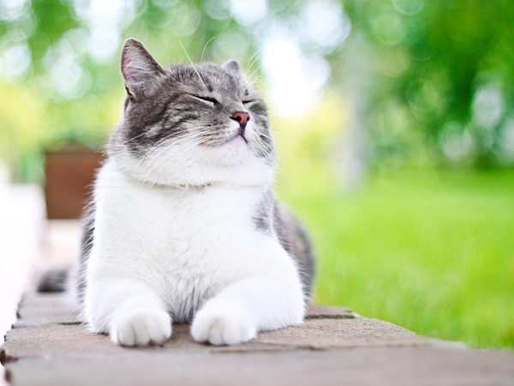
Happily, sometimes Chemists get things right….

