Slide 1

Aromatic Nomenclature Drill & Practice

Slide 2
Aromatic memories
phenol
Common name for:
Structure of meta-xylene
Common name of:
mesitylene
Structure of acetanilide

Slide 3
Aromatic memories (cont.)
Preferred name for methylbenzene
toluene
Structure for anisole
Common name me
Draw p- creosol
Benzyl alcohol
Who am I ?
m-phthalic acid

Slide 4
Aromatic memories (cont.)
Who am I ?
Draw benzoic acid
Draw styrene
o-salicylic acid
Who am I ?
Draw aniline
Who am I ?
napthalene
Anthracene

Slide 5
Aromatic name calling
5
1
3
1
Name me commonly
m-bromobenzoic acid
Name me IUPAC way
Name me the IUPAC way
1,5-diphenyloctane
3,3-diphenyl-1-hexanol

Slide 6

Suggest a common name for him ?
混蛋
Pigu yan

Slide 7
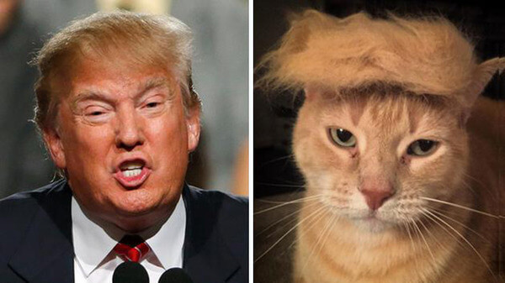
Still…Trump’s hair does inspire copy cats

