Slide 1
Making Alcoholic Memories Round Robin

Slide 2
Making Alcoholic Memories Round Robin (cont.)

Slide 3
Making Alcoholic Memories Round Robin (cont.)
NaBH₄
methanol, then H₂O
Supply a moderately strong reducing agent/solvent different than H₂ that does these two conversions
NaBH₄
methanol, then H₂O
LiAlH₄
In ether, then H₂O
Supply a strong reducing agent/solvent different than NaBH₄ that does these two conversions
LiAlH₄
In ether, then H₂O

Slide 4
Making Alcoholic Memories Round Robin (cont.)
No reaction;
NaBH₄ too weak to reduce -COOH
No reaction;
NaBH₄ too weak to reduce -COOR

Slide 5
Making Alcoholic Memories Round Robin (cont.)
mostly
Only
( fast with high yield)
NaBH₄ with NaOH (base)
Hg(OAc)₂ in THF
Name of above reaction ?
(Oxy)-mercuration/ de-mercuration
BH₃ /B₂H₆
H₂O₂/OH⁻
Name of above reaction ?
Only
( fast with high yield)
hydroboration/oxidation

Slide 6
Making Alcoholic Memories Round Robin (cont.)
Which reaction above is easier to run:
3º hydrolysis or 1º hydrolysis ?
3º way easier

Slide 7
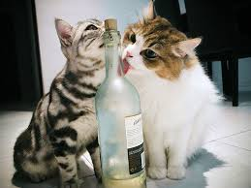
Alcohols are sooo good for you !

