Slide 1
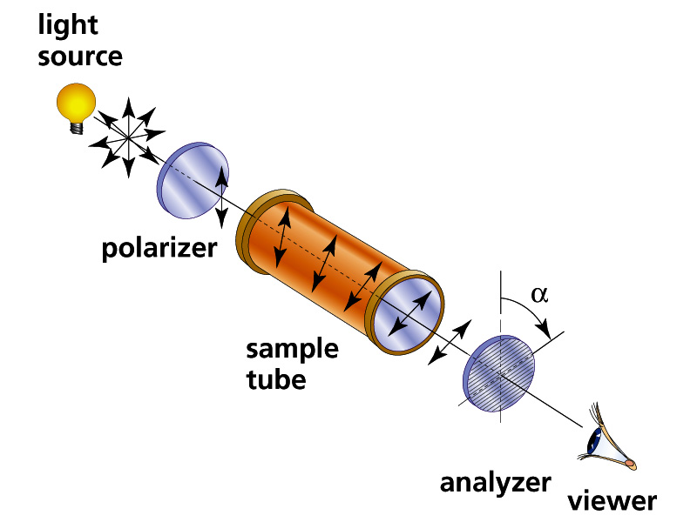
Experimentally Observing Optical Activity
L=sample tube length in dm
_{D} = observed optical rotation in
degrees using sodium D line
C= concentration of dissolved sample in tube in grams/100 mL
L
Schematic of Polarimeter
α_{D}º = specific rotation
= α_{D}
L*C

Slide 2

It all started because of wine….

Slide 3
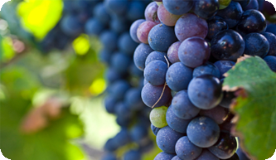
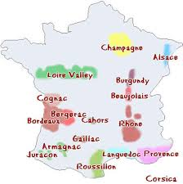
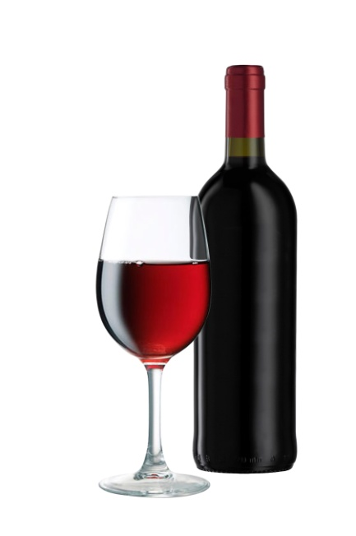
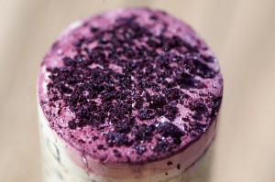
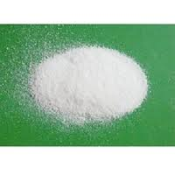
Wine growing regions in France
Purified Tartaric acid from cork

Slide 4
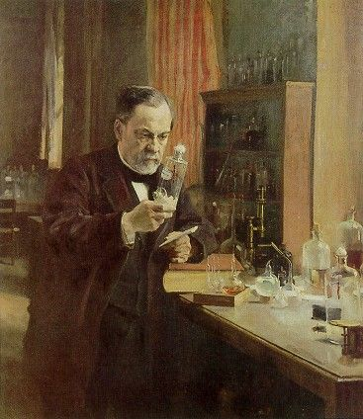
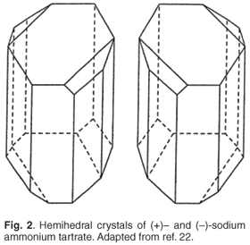
Louis Pasteur first to isolate and observe optically tartaric acid `enantiomers’
Mirror plane
α_{D}º = +12º
α_{D}º = -12º
Isolated two kinds of sodium tartrate crystals growing on wine bottle corks (+ and -)

Slide 5

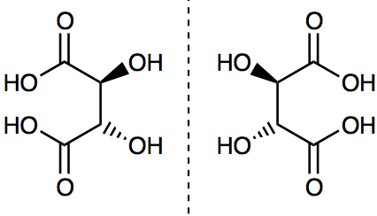
No one was able to reproduce Pasteur’s separation of + and - forms for decades…
“Chance favors the prepared mind.”
L Pasteur

Slide 6
What optical activity means in the lab….
-
+
-
+
Analyzer observation lens

Slide 7
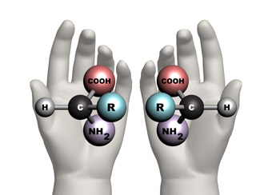
The presence of mirror image molecules with opposite optical rotation implies that carbon is tetrahedral
2-D amino acid mirror image is superimposable
Bonds on a plane (2D) ?
3-D amino acid mirror image not superimposable
Bonds in tetrahedron (3D)?

Slide 8
What makes a chiral molecule ?
Any tetrahedral center with 4 different
(nonequivalent) groups attached is in
principle chiral
(pronunciation: ki rel …rhymes with spiral)

Slide 9
A chiral molecule has
two non-superimposable mirror images called enantiomers
The existence of organic molecules that polarize light + and - `proves’ that the carbon centers therein are tetrahedral

Slide 10
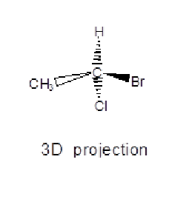
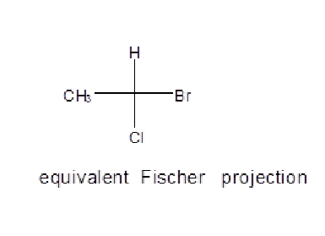
Ways to Designate or Draw Molecules with “Handedness” (Chirality) See also: Supplement 1
3D projection
Fischer projection
Experimental Polarization
light rotates (+) or (-)
4. D/L Fischer notation (yucky)
5. R/S (Cahn-Prelog-Ingold)
For sugars: D-(+) –sucrose
or for amino acids: L-(-)-Alanine
R-1-bromo-1-chloroethane

Slide 11
good thalidomide is Right handed (R)
bad thalidomide is Left handed (S)
Can you point to the `chiral’ center ?

Slide 12
Once thought to be of only `academic’ interest to chemists, chirality turns out to be a huge deal in biology
Natural sugars are all D-type
Natural amino acids are all L-type
Not paying attention to chirality in drug manufacture very bad !

Slide 13

Moderate defect examples of S thalidomide exposure in first trimester

Slide 14
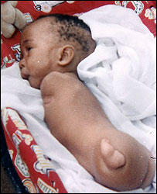
Serious limb loss and malformation from S thalidomide exposure in first trimester

Slide 15
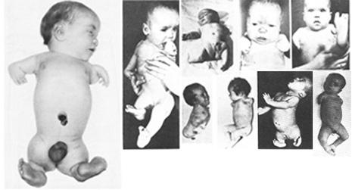
OTHER SOBERING EXAMPLES OF THE TERATOGENIC IMPACT OF WRONG HANDEDNESS IN THE THALIDOMIDE DEBACLE

Slide 16
D and L Rules for Sugars …Fischer Projection method
Chiral center of penultimate C drawn with H and OH projected out of plane towards you
`Penultimate’ carbon
OH on `penultimate C’
(C attached to terminal CH₂OH) on right=> D
OH on `penultimate C’
(C attached to terminal CH₂OH) on left=> L

Slide 17
D and L Rules for amino acids …the CORN rule
Rule of thumb for determining the D/L form of an amino acid is
the "CORN" rule.
The groups:
COOH, R, NH₂ and H (where R is a variant carbon chain)
are arranged around the chiral center carbon atom.
Starting with the hydrogen atom away from the viewer, if
these groups are arranged clockwise around the carbon atom,
then it is the D-form. If counter-clockwise, it is the L-form.
If H is drawn up and on vertical, it is assumed hidden from viewer
Clockwise=>D
Which is D
Which is L ??
Counterclockwise => L

Slide 18
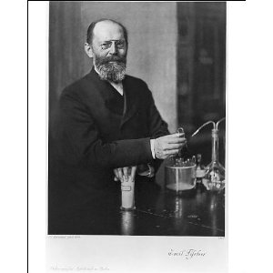

The sugar chemist and Nobel Prize winner Emil Fischer is responsible for the D and L system of assigning handedness to molecules…~1902
D and L system is confusing…
I Suck….
arbitrary ….
and only applied to sugars and amino acids…
Painful to teach

Slide 19

FINALLY D and L……replaced in 1966
CAHN-INGOLD-PRELOG SEQUENCE RULES (R AND S)

