Slide 1
Representative alkyne addition mechanisms
√= ones you should know (for mechanism orals)
√
1) `formation of E-only alkenes from alkynes (Ch. 9, Fig. 9.4)
E only
√
2) Hg²⁺ catalyzed Hydration of alkynes: the keto-enol tautomer mechanism
(Ch. 9, Fig 9.3 )
enol
keto
☹
3) Formation of gem dihalide formation from reaction of alkyne from 2HX (section 9.3 sort of )
Glacial acetic acid
Gem-only addition

Slide 2
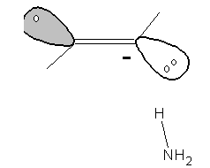

1)formation of E-only alkenes from alkynes ( Fig 9.4)
Overall reaction
Step 1: trans alkenyl radical anion formation*
E-alkene only
Driven by stabilization of Na to Na⁺
-
+ Na⁺
Pi bond converts to lone pair
Trans character arises from repulsion of sp² lobes
Step 2: transfer of H from NH₃ to form alkenyl radical
*Text shows concerted 1 e transfers w/ lone pair formed by radical Na.
Base
(proton acceptor)
Alkenyl radical anion is much stronger base than NH₃, so NH₃ acts as an acid
NH₃=Acid (proton donor)

Slide 3
Step 3: second transfer of electron from second Na to make second alkenyl radical anion
Step 4: transfer of second H from second NH₃ to make final trans-alkene

Slide 4
2) Hg²⁺ catalyzed Hydration of alkynes: the keto-enol tautomer mechanism (page 259-260, fig 9.3)
Overall reaction: hydration of alkyne
Enol form
Keto form
preferred
Step 1: the usual Hg⁺ bridgehead carbocation forms on more substituted side
CH₃ and H flex away from Hg⁺

Slide 5
Step 2: hydration of carbocation bridge structure
i) Lone pair on water moves to form bond with to C(+)
δ+
ii) In response, H-OH bond is dissolved and the electrons given to O to replace lone pair used in (i). This creates (+) on H as it breaks off. The H₂O here is what adds across alkyne
iii) H+ is set free, Hg+ bonds temporarily to alkene ; SO₄²⁻ still loosely attracted to Hg+; CH₃ and H pushed away

Slide 6
Step 3,4: attack of H₃O+ and ejection of Hg²⁺ to form enol
C-Hg⁺ bond transfers electrons to make C-H on alkenyl cation with H⁺ created in step 2 returning Hg⁺→Hg²⁺ , dissolving the Hg-C bond
enol
⁺H
Step 5: acid-catalyzed keto shift (p. 370 Carey…not in McMurry)
1) π electrons are attracted to H⁺ (supplied by H₂SO₄) and form C-H; pi bond begins to dissolve;
(+) H
δ+
δ+
Final keto form
2) + on OH carbon migrates to H of OH and returning H+, allowing transfer of O-H electrons to form C=O π bond (or…lone pair on O forms pi bond and H-O bond compensates by breaking)

Slide 7
3) Formation of gem dihalide formation from reaction of alkyne from 2HX: an `incomplete’ one ???
( from 9.3 , McMurry side steps the dihalide mechanism )
Overall reaction
Step 1a: vinyl carbocation forms (text)
Step 1b: lone pair from Br- forms C-Br bond to carbocation side (text)

Slide 8
To keep the carbocation approach going and put a (+) on the halogenated side means making (somehow)
?????...the bromine is electron-withdrawing and destabilizing
McMurry wishy washes his way out of explaining second addition of Br to same side as first thusly…
“…Thus, many alkyne additions occur through more complex mechanisms…”

Slide 9
For Organic `sickos…’ can look at a more definitive and alternative mechanism of gem-dihalide formation on next two slides… (Carey proposes an unusual double termolecular route….)

Slide 10
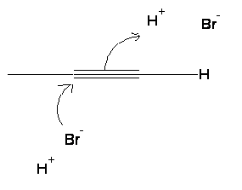
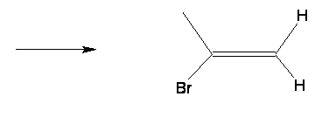
3) Formation of gem dihalide formation from reaction of alkyne from 2HX
(model 2 from pg 369 Carey 9th edition )
Overall reaction
Possible Step 1: termolecular (3 molecule) electrophilic addition
Two HBr attack alkyne simultaneously on opposite sides*; (H+) attack preferably done to put transient δ+ on more substituted side which attracts other HBr’s Br(-)
δ+
+ HBr
*Opposite side attack lowers repulsion of HBr with each other vs syn attack.
Both HBr attack at same time forming incipient Br-C and C-H bonds

Slide 11
Step 2: second termolecular addition- anti attack again (only Carey explains)
A repeat of the three molecule interaction in step 1 occurs, and with same directional character; H on HBr goes to less substituted side; Br on other HBr goes to more substituted side
Intermediate favors Br attack on more substituted side where in incipient (+) from H is stabilized by CH₃ despite presence of electronegative Br…or it may be that the H attack on the rh side is simply faster and sterically less hindered….

Slide 12
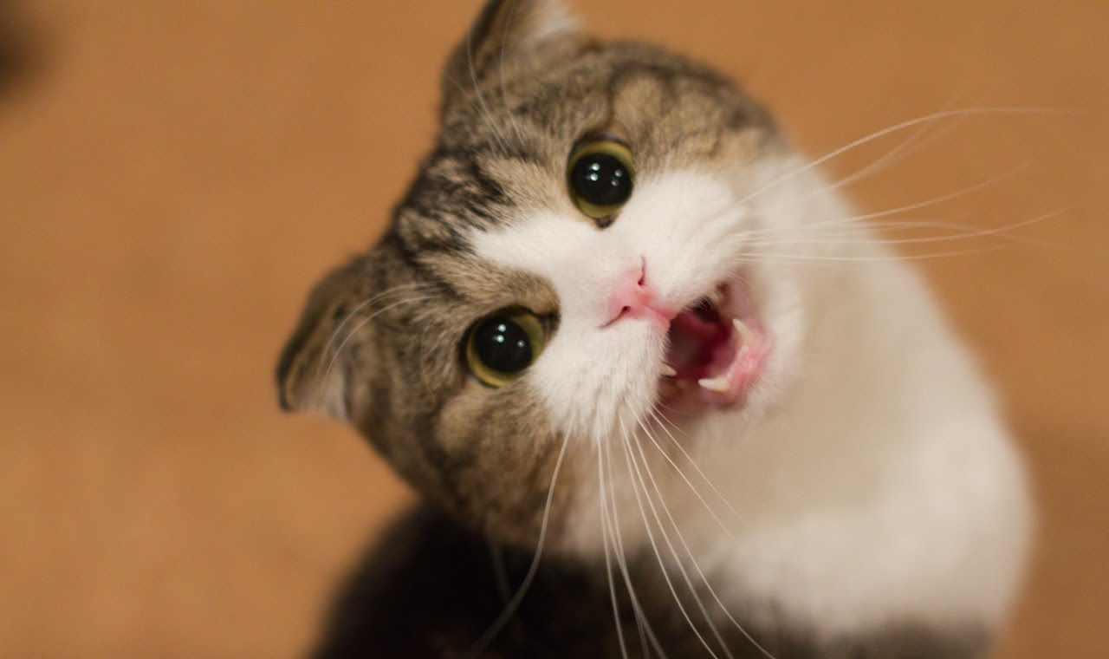
1)`formation of E-only alkenes from alkynes(Fig. 9.4)
2) Hg²⁺ catalyzed Hydration of alkynes: the keto-enol tautomer mechanism (Fig 9.3 )
Know these mechanisms,maggots !

