Slide 1

Drill & Practice Making Ketones and Aldehydes
pcc
K₂Cr₂O₇
H₂SO₄
K₂Cr₂O₇
H₂SO₄

Slide 2
Drill & Practice Making Ketones and Aldehydes (continued)
O₃/in freon
Zn/H+
2
HgSO₄/
H₂SO₄
H₂O₂
/OH⁻
Hint: keto-enol and Markovnikoff
BH₃/neat or in THF
Name of reaction ?
H.C. Brown’s 2 step hydroboration/oxidation

Slide 3
Drill & Practice Making Ketones and Aldehydes (continued)
O₃/in freon
Zn/H+
2
Cl₂/neat
H₂O
Name of this reaction ??
Friedel-Crafts Acylation

Slide 4
Drill & Practice Making Ketones and Aldehydes (continued)
Name of this reaction ?
Corey-House reaction
Li(Al-tBuO)₃
In ether or neat
SOCl₂/pyridine or PCl₃ neat

Slide 5
Drill & Practice Making Ketones and Aldehydes (continued)
Side exercises on making carboxylic acids and acid chlorides
Mg/dry ether
CO₂(g)
H⁺/H₂O
NaCN in ethanol

Slide 6
Side exercises on making carboxylic acids and acid chlorides (cont.)
Hot KMnO₄
or K₂Cr₂O₇
In H₂SO₄
SOCl₂
In a solvent
PCl₃(g)
neat

Slide 7
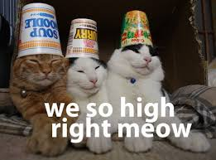
on Organic Chemistry!

