Slide 1

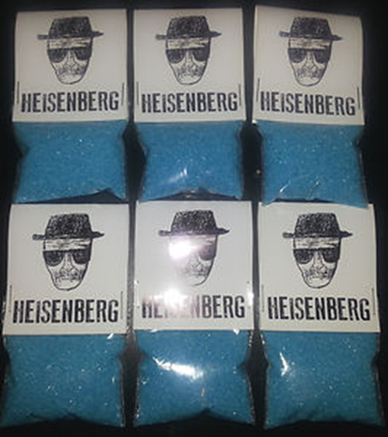
Who am I, really ?
Our first day’s first organic molecule…
IUPAC name:
N-methylphenyl-2-propan-2-amine :
Common name: methamphetamine
Street name: crystal meth
MW 149.2 mp 170-175ºC
A white to off white crystal

Slide 2
Stereochemistry note:
Meth has a Chiral center: D form active, L form inactive =>50% of synthesized meth is inert !!
Solubility is high:
In water(1 gm: 2ml),
In ethanol ( 1gm:3ml)
in chloroform (1 gm:5ml)
C3
Medical note:
The methyl group (C3) facilitates the compound’s transport across the blood-brain barrier.
=> Easy to absorb and deliver to human body

Slide 3
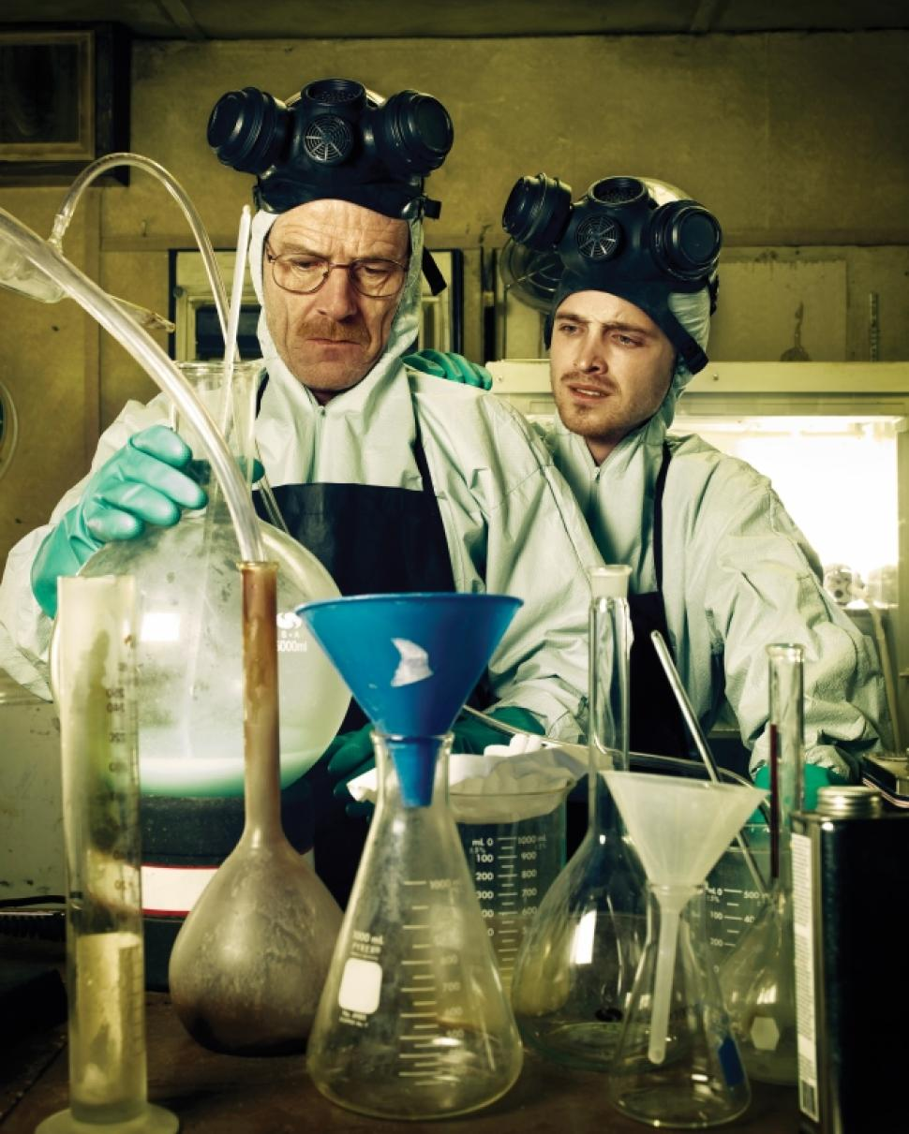
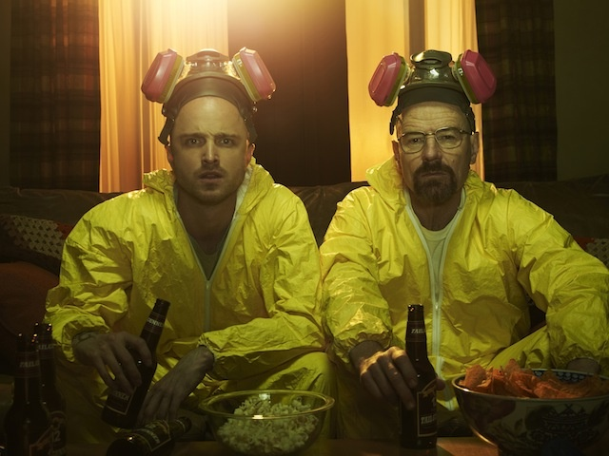
Let’s cook !

Slide 4
Ways to Make Crystal Meth…using stuff you learned in O. Chem
Crystal meth
1) Grignard synthesis
The Grignard piece
2-phenylethanal
Class of compound ???
C=N- acts like C=O
when reacting with RMgX …
immine

Slide 5
Problem areas for manufacture ???
For mole $: can you make MeMgI=CH₃-MgI starting from methanol?
Grignard route to crystal meth

Slide 6

2-phenylethanal
Key Starting material for Grignard route to Meth
Often, the starting material is controlled by the DEA to prevent large scale synthesis of meth.
However, you can buy benzene and ethanol in unlimited quantities legally and now know enough to make the key starting material above.

Slide 7
2-phenylethanal from benzene and ethanol: method 1

Slide 8
Not the only way to 2-phenylethanal…Grignard route (method 2) better
The Grignard piece…
pcc neat
2-Phenylethanal precursor

Slide 9
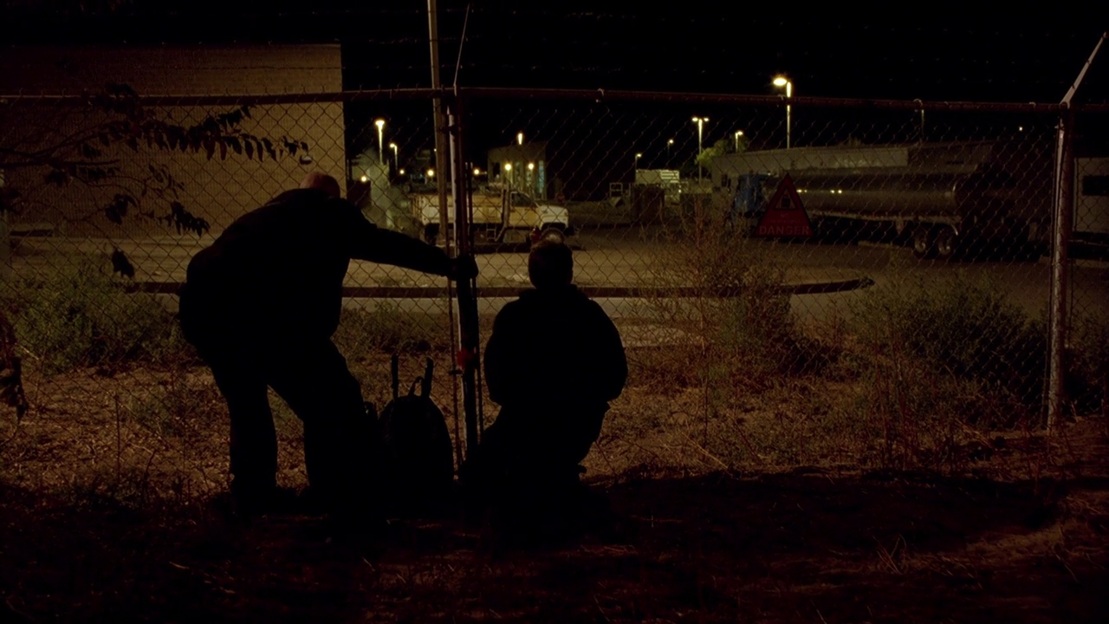
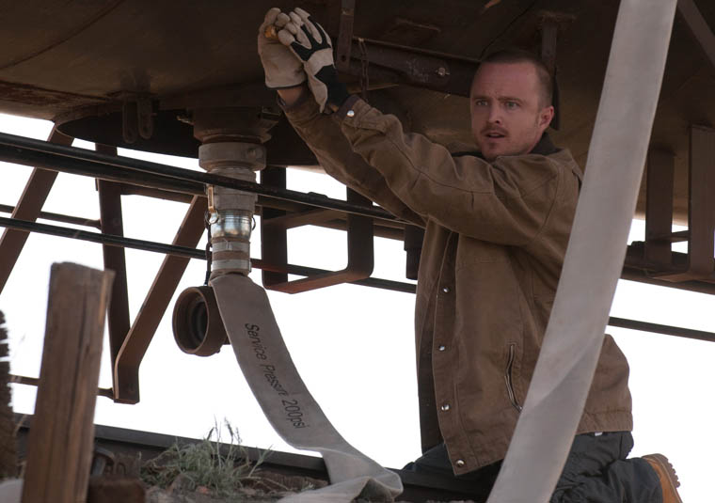
√
??
Many episodes were focused on stealing methyl amine (MeNH₂)

Slide 10
What if the Feds try to control NH₂CH₃ (methyl amine) ?
√
No problemo…just run:
CH₃Cl + NH₃→ CH₃-NH₂ + HCl
CH₃-Cl
Methanol
not controlled
Table salt and
battery acid

Slide 11
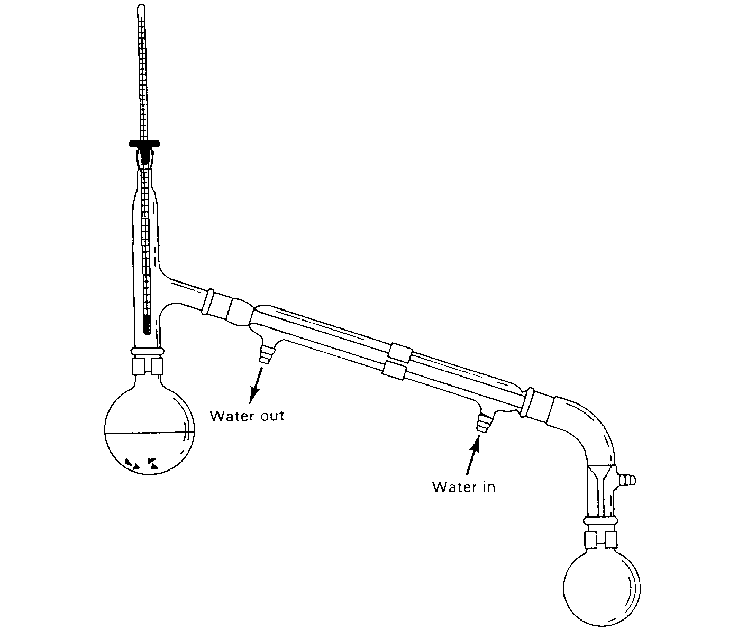
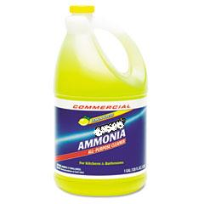
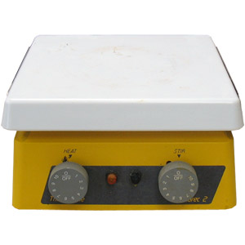
√
??
√
CH₃Cl + NH₃→ CH₃-NH₂ + HCl
From CRC handbook 76th
boiling point of H₂O=100 C boiling point of NH₃ =-33 C
70-90% w/v NH₃
Any ideas ???
1.89$/gallon
Walmart’s
(~5-10% w/v NH₃)
Dry ice (-44 C)

Slide 12
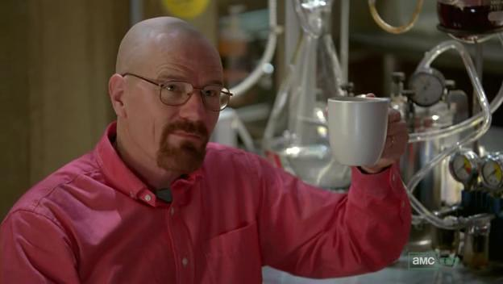
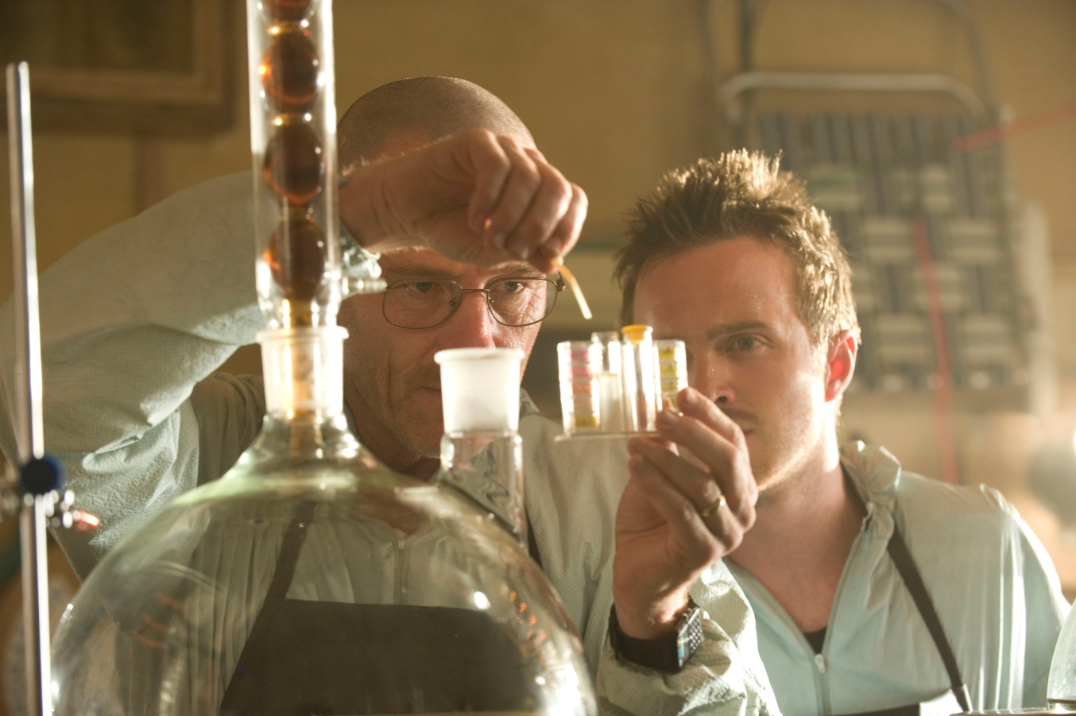
Route 2 to Crystal Meth:
Biker’s Meth synthesis (Walter White’s synthetic route)
DVD season 1 episode 2
Stealing P2P

Slide 13
“Biker’s meth” two-step route
Step 1
P2P
Step 2
Immine again….
Da stuff…
Crystal meth
Breaking Bad uses Rh reduction (expensive)

Slide 14
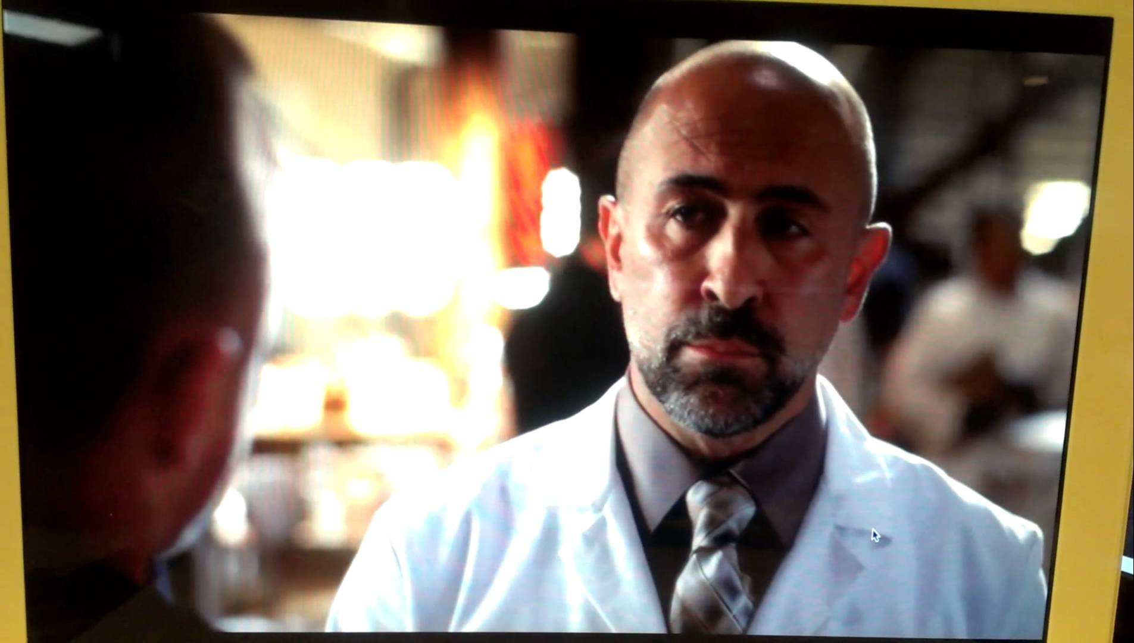
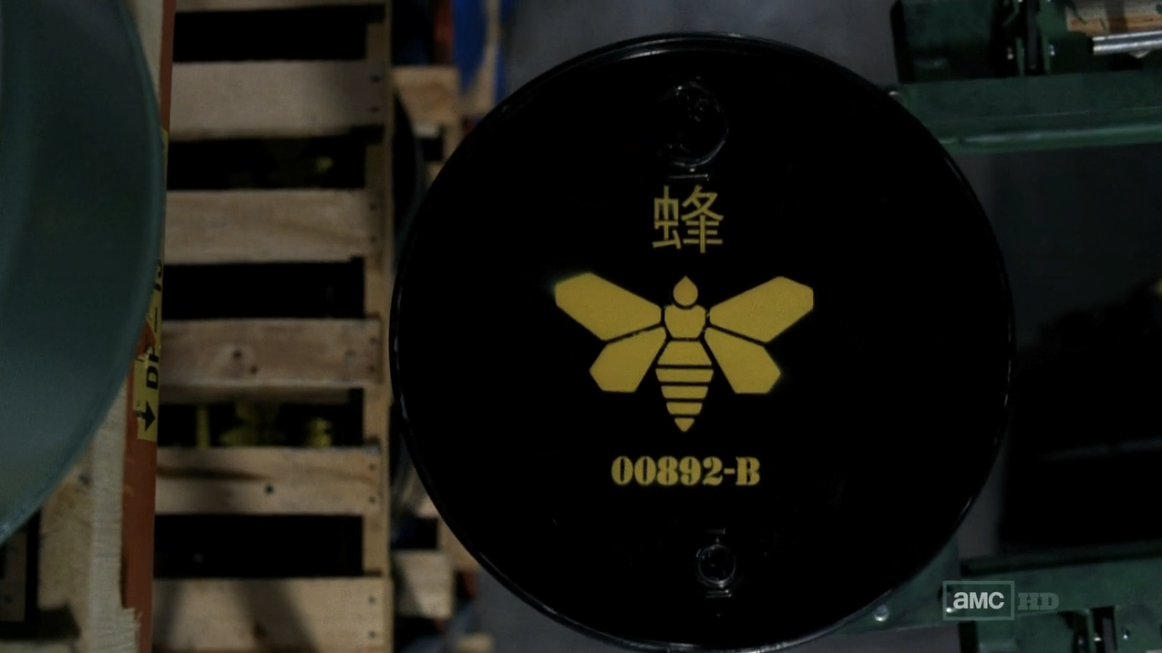
The phenyl acetic acid scene…does it make sense in terms of Walter White’s synthesis ?
https://www.youtube.com/watch?v=XyK2Z6aTPSg
Jesse Pinkman facing off
with the cartel chemist.
The stuff in question: phenyl acetic acid

Slide 15
Phenyl acetic acid scene…does it make sense in terms of Walter White’s synthesis ?
phenyl acetic acid
Step 1 of
Walter’s synthesis
Not on the face of it… need CH₃ not OH at C2. But you can make P2P from phenyl acetic acid
FYI… you `sophomores’ know enough to make phenyl acetic acid

Slide 16

Making P2P from phenyl acetic acid:
why the Mexican cartel lab wants phenyl acetic acid
Phenyl acetic acid
P2P
FYI…this is a messy reaction that can auto condense to dibenzyl ketone….because of OH⁻ . Doc wouldn’t do it this way. (Details on next two slides)

Slide 17
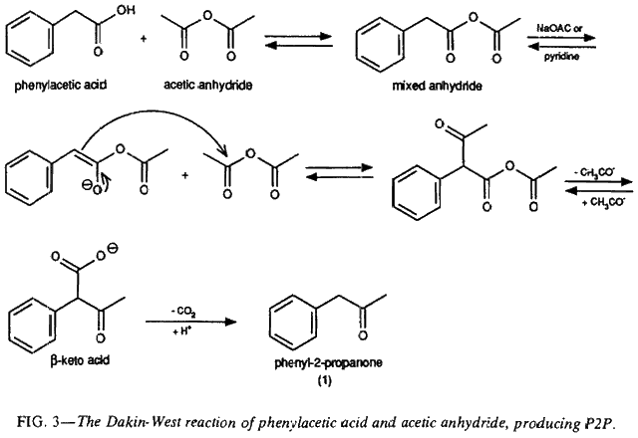
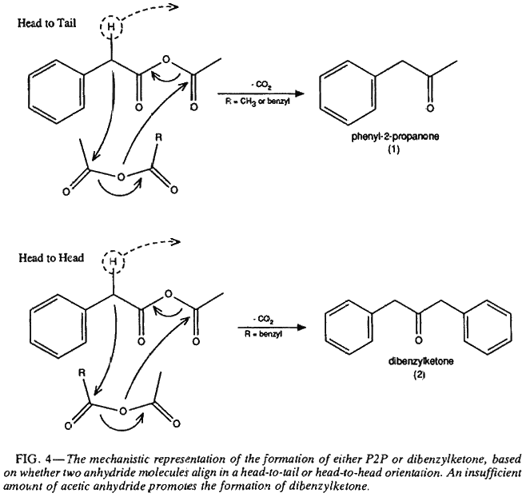
http://www.sciencemadness.org/talk/viewthread.php?tid=10919
https://erowid.org/archive/rhodium/chemistry/p2p.phenylacetic.html
Proposed Mechanism of conversion of phenylacetic acid to P2P
OH- driven side reaction to dibenzylketone

Slide 18
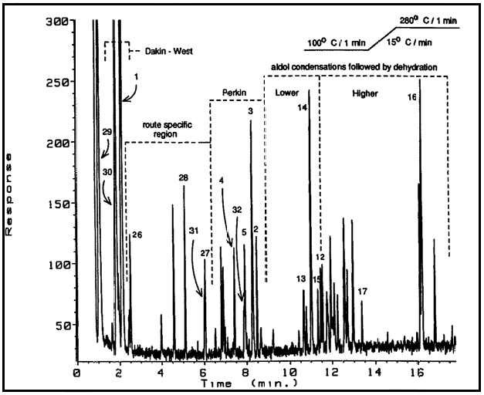
GC of Final Product Pot : phenyl-2-propanone from phenyl acetic acid
prior to work up
https://erowid.org/archive/rhodium/chemistry/p2p.phenylacetic.html

Slide 19
Making phenyl acetic acid precursor: route 1
Still…challenge accepted: routes to phenyl acetic acid
Phenyl acetic acid

Slide 20
phenyl acetic acid precursor: route 2
Ag₂O
/NH₃
Tollen’s reagent
Phenyl acetic
acid
Hint: use weakest oxidizer you know to convert >C=O to COOH and avoid “vasectomy at `G spot.’

Slide 21

FYI…there are a lot of simpler routes to get to phenyl-2-propanone (P2P) than through phenyl acetic acid.
Bite me, señor chemist cartel guy.

Slide 22
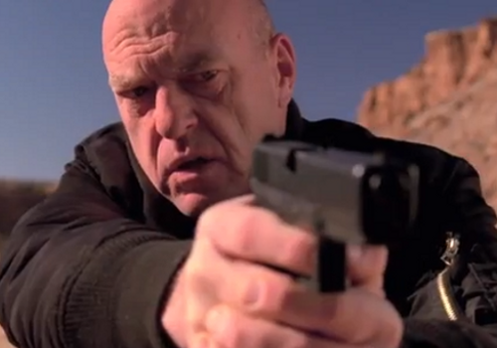
The real prize is `P2P’ (phenyl-2-propanone) which is high on the DEA controlled substance list
A final mole buck opportunity : Routes to P2P you can do with what you know…
+ Bonus round….do-able routes to Ephedrine (If time…)
You’re going down, Fong…

Slide 23
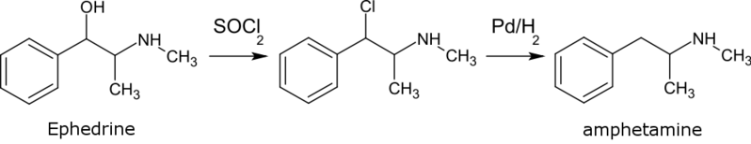
The classic `ephedrine’ route….why pharmacies watch your purchases of Sudafed…

Slide 24
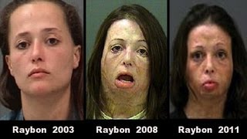
BEFORE VERSUS AFTER CRYSTAL METH USE

Slide 25
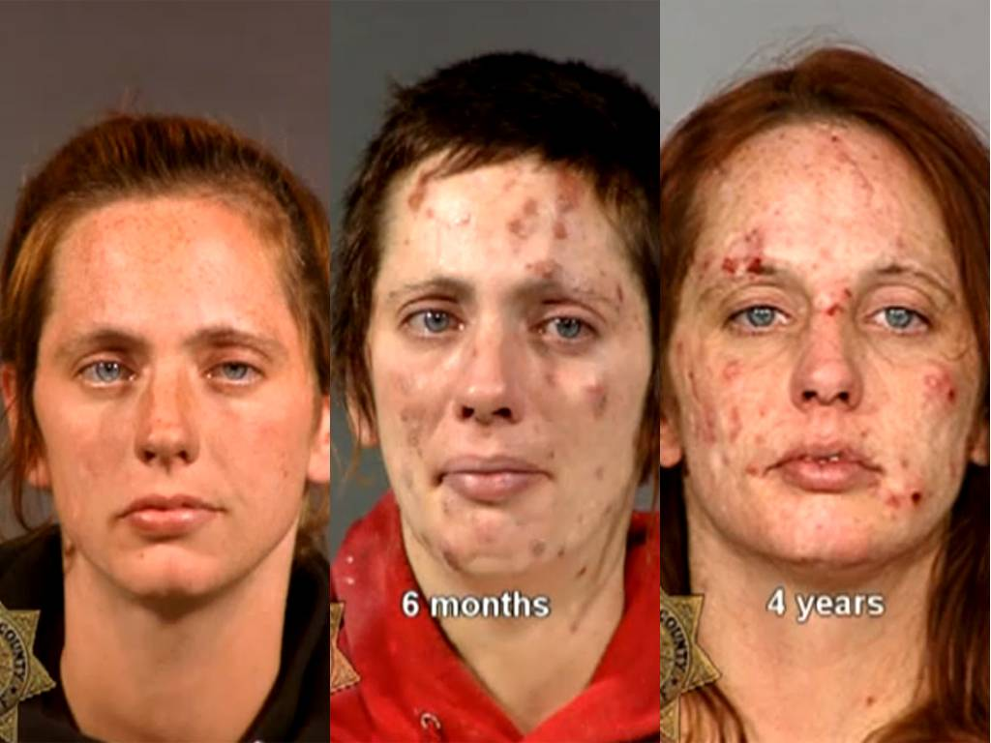
BEFORE VERSUS AFTER CRYSTAL METH USE (cont.)

Slide 26
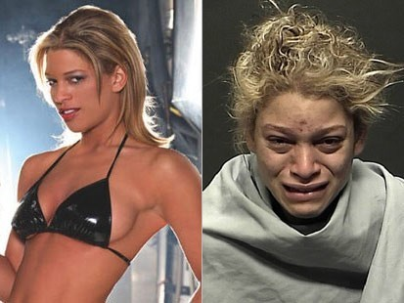

Slide 27
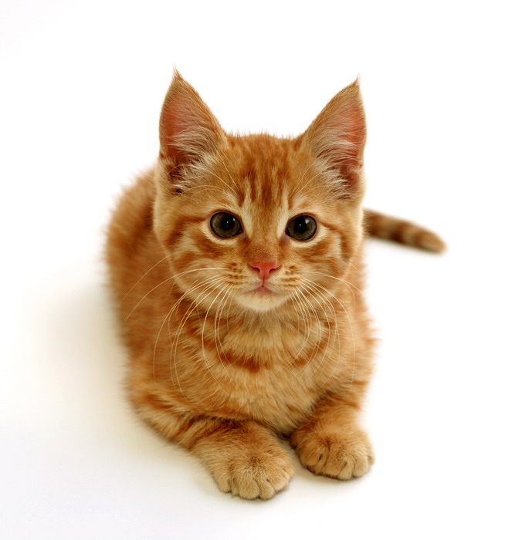
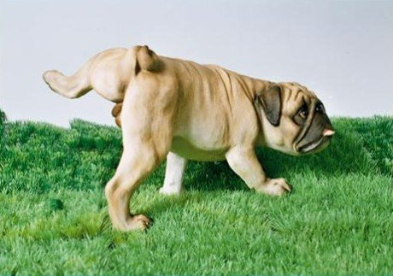
Before crystal meth use
After crystal meth use

Slide 28

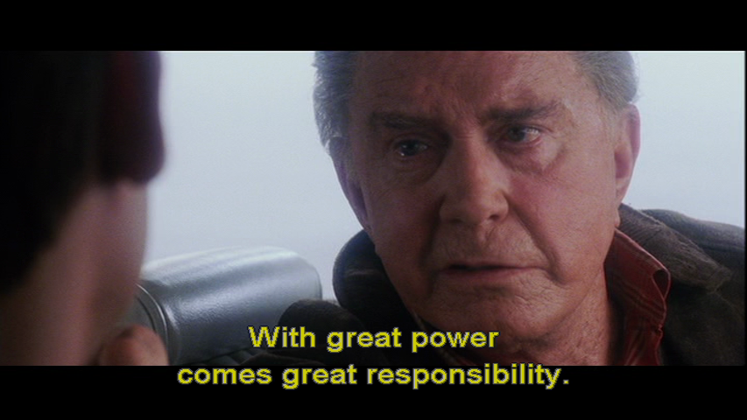
Moral ?

