Slide 1
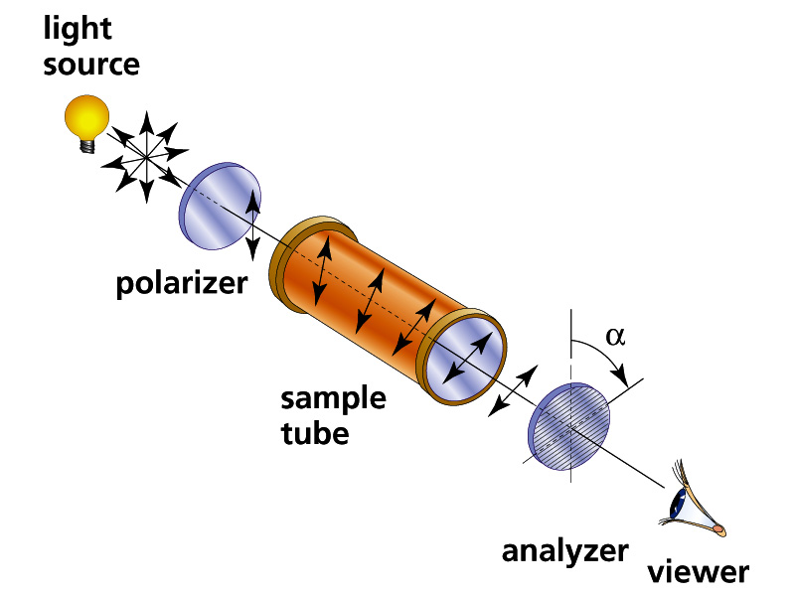
Experimentally Observing Optical Activity
L=sample tube length in dm
_{D} = observed optical rotation in
degrees using sodium D line
C= concentration of dissolved sample in tube in grams/100 mL
L
Schematic of Polarimeter
α_{D}º = specific rotation
= α_{D}
L*C

Slide 2
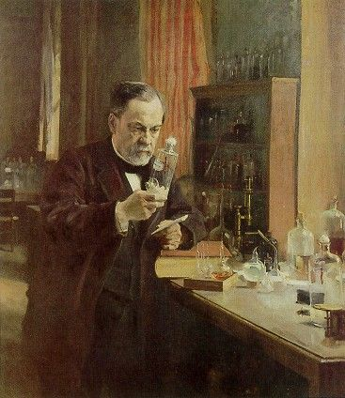
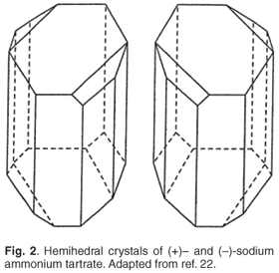
Louis Pasteur first to isolate and observe optically active pairs of isomers
Mirror plane
α_{D}º = +12º
α_{D}º = -12º
Isolated two kinds of sodium tartrate crystals growing on wine bottle corks.

Slide 3
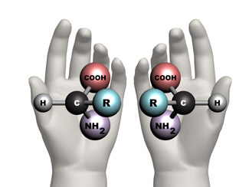
The presence of mirror image molecules with opposite optical rotation implies that carbon is tetrahedral
2-D amino acid mirror image is superimposable
Bonds on a plane (2D) ?
3-D amino acid mirror image not superimposable
Bonds in tetrahedron (3D)?

Slide 4
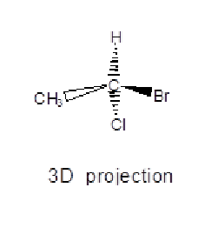
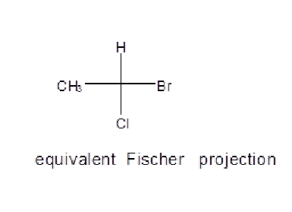
Ways to Designate or Draw Molecules with “Handedness” (Chirality)
3D projection
Fischer projection
Experimental Polarization
light rotates (+) or (-)
4. D/L Fischer notation (limited)
5. R/S (Cahn-Prelog-Ingold)
For sugars: D-(+) –sucrose
or for amino acids: L-(-)-Alanine
R-1-bromo-1-chloroethane

Slide 5
From supplement 1…
What makes a chiral molecule ?
Any tetrahedral center with 4 different
(nonequivalent) groups attached is in
principle chiral
(pronunciation: ki rel …rhymes with spiral)

Slide 6
good thalidomide is R type
bad thalidomide is S type
Can you point to the `chiral’ center ?

Slide 7
Once thought to be of only `academic’ interest to chemists, chirality turns out to be a huge deal in biology
Natural sugars are all D-type
Natural amino acids are all L-type
Not paying attention to chirality in drug manufacture very bad !

Slide 8

Moderate defect examples of S thalidomide exposure in first trimester

Slide 9
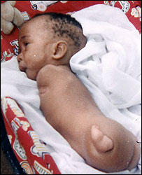
Serious limb loss and malformation from S thalidomide exposure in first trimester

Slide 10
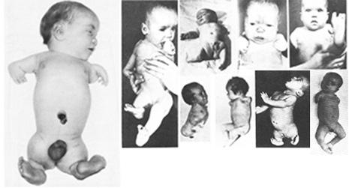
OTHER SOBERING EXAMPLES OF THE TERATOGENIC IMPACT OF WRONG HANDEDNESS IN THE THALIDOMIDE DEBACLE

Slide 11
D and L Rules for Sugars …Fischer Projection method
Chiral center of penultimate C drawn with H and OH projected out of plane towards you
`Penultimate’ carbon
OH on `penultimate C’
(C attached to terminal CH₂OH) on right=> D
OH on `penultimate C’
(C attached to terminal CH₂OH) on left=> L

Slide 12
D and L Rules for amino acids …the CORN rule
Rule of thumb for determining the D/L form of an amino acid is
the "CORN" rule.
The groups:
COOH, R, NH₂ and H (where R is a variant carbon chain)
are arranged around the chiral center carbon atom.
Starting with the hydrogen atom away from the viewer, if
these groups are arranged clockwise around the carbon atom,
then it is the D-form. If counter-clockwise, it is the L-form.
If H is drawn up and on vertical, it is assumed hidden from viewer
Clockwise=>D
Which is D
Which is L ??
Counterclockwise => L

Slide 13
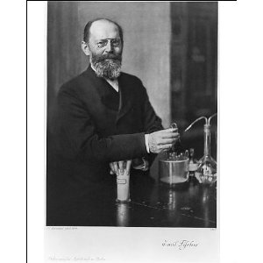

The sugar chemist and Nobel Prize winner Emil Fischer is responsible for the D and L system of assigning handedness to molecules…~1902
D and L system is confusing…
I Suck….
arbitrary ….
and only applied to sugars and amino acids…
Painful to teach

Slide 14

FINALLY D and L……replaced in 1966
CAHN-INGOLD-PRELOG SEQUENCE RULES (R AND S)

