Slide 1
comparison of cyclohexene vs benzene properties
property cyclohexene benzene
reactivity to Br₂/CCl₄ quantitative addition NR
reactivity to H₂/Ni adds easily at 25ºC/1 atm with difficulty at 100-200ºC/100 atm
reactivity to cold KMnO4* quantitative diol formation at 25oC NR
C-C bond length two kinds: 13.3 nm & 15.4 nm only one kind: 14.0 nm
heat of hydrogenation/H₂ 29 kcal/mol 17 kcal/mol*
NMR signals* H @ 1.2 ppm; H at 5 ppm (vinyl) H at 7.2 ppm
IR* 3050, 2950 3100, overtones @ 2000, 1600, 1500
Why are 3 double bonds less reactive than 1 double bond ???????

Slide 2
Possible structures for C₆H₆ : Benzene
Original Kekule structure
Dewar
structure

Slide 3



Chemical problem with original Kekule structure
Consequences of the original Kekule model:
Compound A
1,2-dibromo-1,3,5-cyclohexatriene
Compound B
1,6-dibromo-1,3,5-cyclohexatriene
=> 2 different properties for 2 different 1,2 dibromo products
2 different 1,2-dibromobenzenes predicted
Experiment: just one set of physical properties observed
mp=1.8 ºC ; bp= 221-2 ºC ; d=1.956²⁰ g/cm³ n_{d} =1.6155

Slide 4
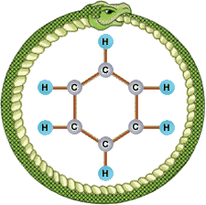
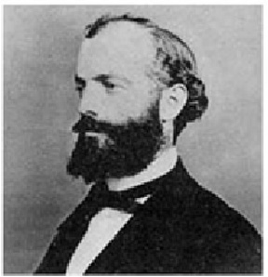
Kekule’s Big Breakthrough
“There I sat and wrote for my textbook; my mind was occupied with other matters. I turned the chair towards the fireplace and began to doze. Once again the atoms danced before my eyes. This time smaller groups modestly remained in the background. My mental eye, sharpened by repeated apparition of similar kind, now distinguished larger units of various shapes. Long rows, frequently joined more densely; everything in motion, twisting and turning like snakes. And behold, what was that ? One of the snakes caught hold of its own tail and mockingly whirled round before my eyes. I awoke, as if by lightning; this time, too, I spent the rest of the night working out the consequences of this hypothesis… Let us learn to dream, then perhaps we shall find the truth.”
August Kekule, Chemist, 1891
???

Slide 5

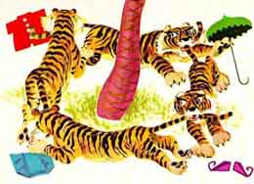
Pictures from children’s story about the tigers, clothes and buttermilk (or pancakes…)
Little Sambo and the Tigers

Slide 6
Criteria for appearance of aromatic behavior
1) strict planarity¹
2) alternate double/single bonds
3) 4n +2 π electrons perpendicular to the plane
(n=0,1,2...)
¹essentially restricts aromatics to rings

Slide 7
But pi electrons don’t flow freely after rotation around C2-C3
1,3-butadiene and strict planarity
Pi electrons flow in this configuration
Propene and strict planarity
Allyl carbocation and strict planarity
No free p orbital to move electrons to
∴Strict planarity means any aromatic structure
must be a ring
Free p orbital exists in plane only sometimes…no free circulation

Slide 8
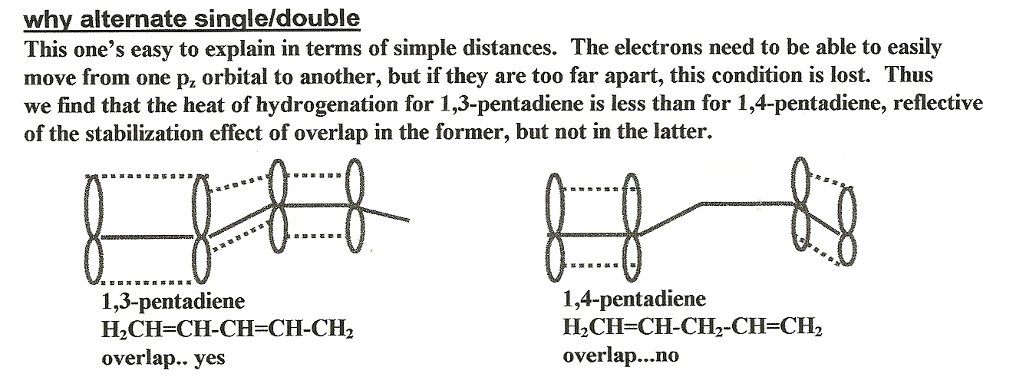

Slide 9
4n +2 rule explained
How many pi (π) electrons in …..
sp²
sp³
+
-
sp²
6
4
6
What is the `hybridization’ of …
4n +2 = #π electrons; n=0,1,2…(an integer)
n = 0
1
2
π count allowing aromaticity =
4*0+ 2=2
4*1+ 2=6
4*2+ 2=10
Notes:
ACD/Labs0328082056
12 13 0 0 0 0 0 0 0 0 1 V2000
11.9574 -5.7777 0.0000 C 0 0 0 0 0 0 0 0 0 0 0 0
9.3215 -5.0714 0.0000 C 0 0 0 0 0 0 0 0 0 0 0 0
11.2511 -3.1418 0.0000 C 0 0 0 0 0 0 0 0 0 0 0 0
6.6855 -5.7777 0.0000 C 0 0 0 0 0 0 0 0 0 0 0 0
5.3211 -8.1411 0.0000 C 0 0 0 0 0 0 0 0 0 0 0 0
2.9577 -6.7766 0.0000 C 0 0 0 0 0 0 0 0 0 0 0 0
4.3222 -4.4133 0.0000 C 0 0 0 0 0 0 0 0 0 0 0 0
11.9574 -0.5058 0.0000 H 0 0 0 0 0 0 0 0 0 0 0 0
13.8871 -7.7074 0.0000 H 0 0 0 0 0 0 0 0 0 0 0 0
3.6159 -1.7773 0.0000 H 0 0 0 0 0 0 0 0 0 0 0 0
0.3218 -7.4829 0.0000 H 0 0 0 0 0 0 0 0 0 0 0 0
6.0273 -10.7770 0.0000 H 0 0 0 0 0 0 0 0 0 0 0 0
2 1 2 0 0 0 0
3 1 1 0 0 0 0
2 3 1 0 0 0 0
4 2 1 0 0 0 0
5 4 2 0 0 0 0
6 5 1 0 0 0 0
7 6 2 0 0 0 0
4 7 1 0 0 0 0
8 3 1 0 0 0 0
9 1 1 0 0 0 0
10 7 1 0 0 0 0
11 6 1 0 0 0 0
12 5 1 0 0 0 0
M END

Slide 10
4n+2 rule
valence bond theory description of C₃H₃ ⁺
^{(more picture than math)}
Framework is sp²
extra p electrons
= π electrons above & below plane of framework
Explains circulation and resonance…
But can’t explain 4n +2 rule

Slide 11
MO description of C₃H₃⁺
^{(more math than picture)}
Basic process:
Collect all the atomic orbitals (AO) ofrecombine as molecular orbitals (MO) with #AO= #MO
MO(1) = c1*AO(1) + c₂AO(2) + c₃AO(3) +….
Optimize the c_{k} for all the MO simultaneously to minimize the computed energy of the molecule (quantum chemical calculation )
2) Put in the number of electrons starting from bottom and working up (fill the MO)
Results are energy levels of the molecule which lie either above or below the original energy sum of all the separate atoms

Slide 12
1 positive overlap and 2 anti-overlaps (destabilized)
Separate unconnected p orbital energies
How many pi electrons in system produces maximum stability ?
WHAT `MO’ THEORY REVEALS
Overlap is all positive=> all bonds (stabilized)

Slide 13
What simple MO Theory Predicts for the more complex case of C₆H₆ (benzene)
An anti-bonding arrangement of 6 p_{z} orbits of C not involved in sp² frame
De-stabilizing anti-bonding MO predicted
Z axis
Energy of original p_{z}
Stabilizing bonding MO predicted; max stabilization with 6 electrons
A bonding arrangement of 6 p_{z} orbits of C not involved in sp² frame

Slide 14
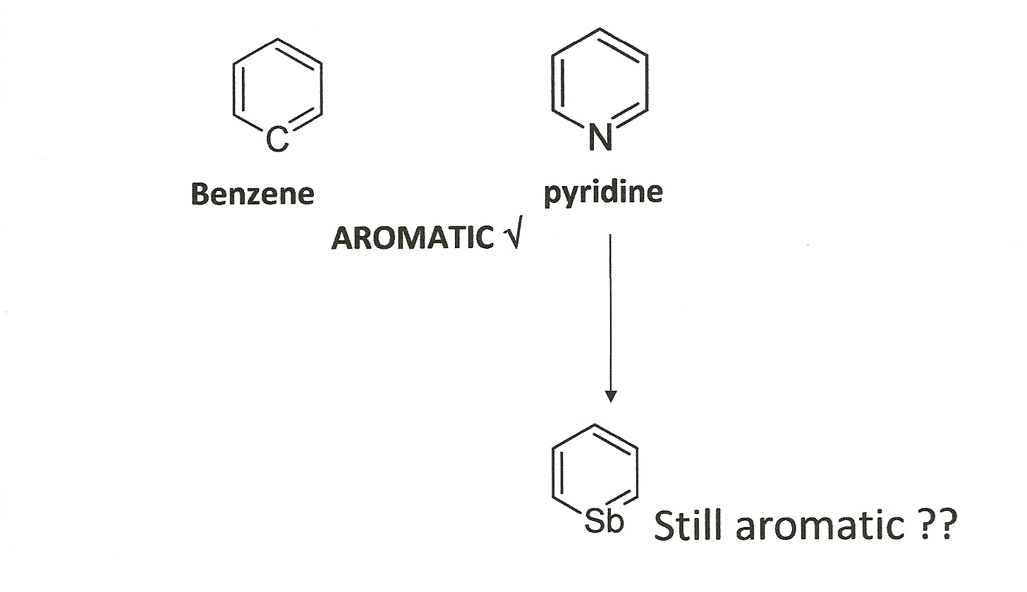
Unusual Examples of Aromaticity: It’s More Than Just Benzene
Case 1: Heterobenzenes

Slide 15
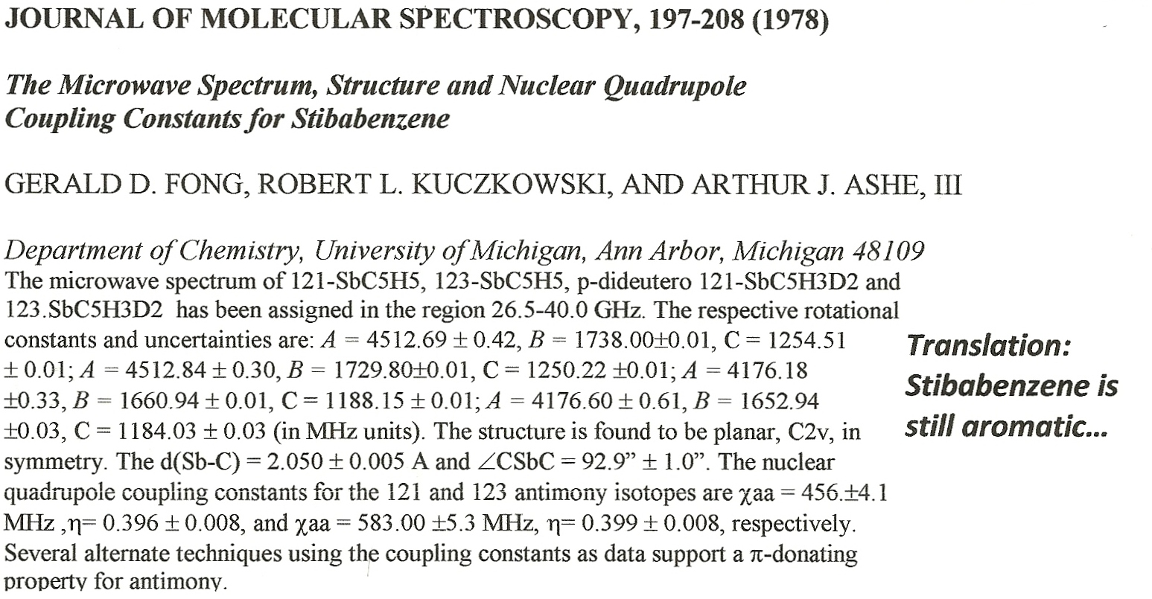
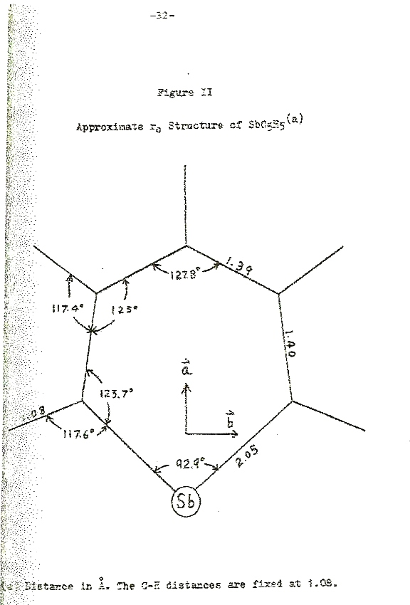
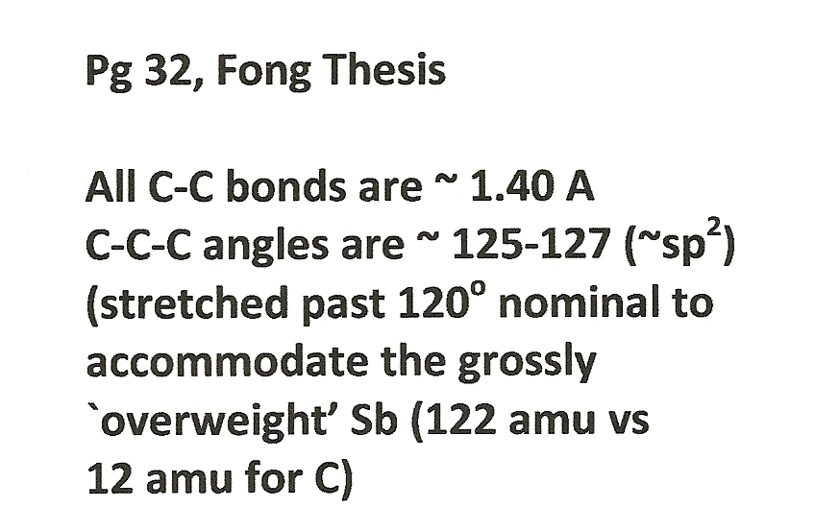
TRANSLATION:
Stibabenzene is still aromatic

Slide 16
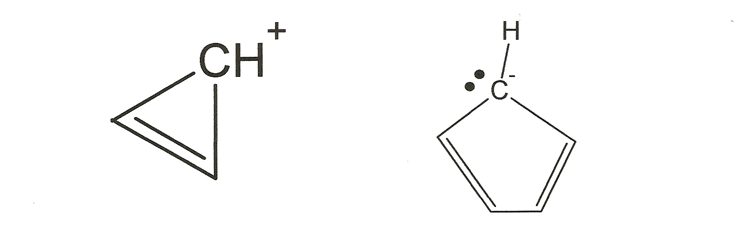
Case 2: voltammetrically created stable, small cation and anion rings
Both satisfy aromaticity criterion
Both survive for hours in solution once generated

Slide 17
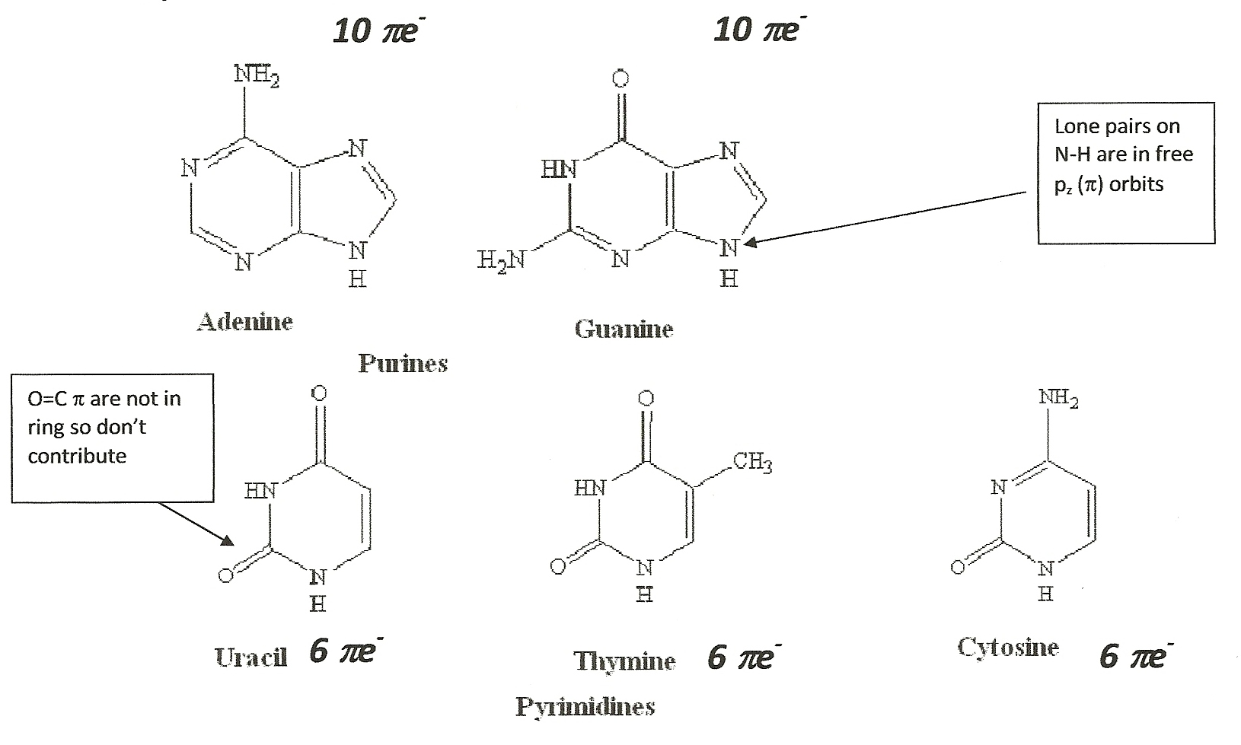
Case 3: At the heart of everything living….
Recognize these ???
The critical DNA base units A,T,G, U and C are all aromatic !!!!

Slide 18
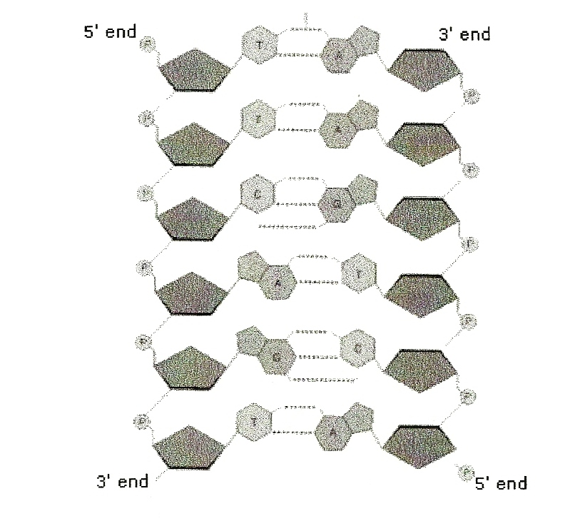
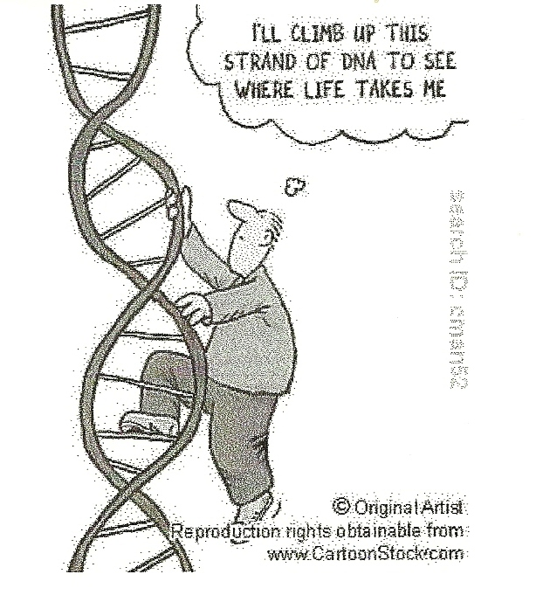
The heart of DNA:
aromatic base pairs A-T & G-C
Much of the incredible stability of DNA is due to it’s aromatic core.
FYI…Jurassic age DNA has been reportedly found intact !!

