Slide 1
π chemistry: the big picture so far
π system
Main reaction character
Classic Example
C=C
alkene
Easy electrophilic addition across π system
~ 100% in < 1s
Vinyl site unreactive
allylic site highly reactive
towards substitution
C=C-C
Aliphatic allyl
allylic-only attack; fast > 60%
Aromatic (on-ring) sites
are resistant to substitution
On-ring: poor yields (< 30%)
Off-ring allylic sites are far more reactive towards substitution than pure aliphatic allyls
Aromatic-aliphatic combo
Allylic off ring: facile, high yield (~80%)

Slide 2
All the π systems so far have been symmetric C=C
Carbonyls: an asymmetric polar π system
carbonyl group

Slide 3
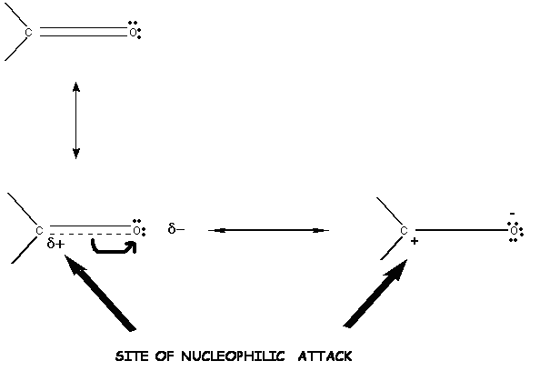
σ
sigma (σ)/ pi (π) images of carbonyl
π
Carbocation
(acidic)
2π electrons shift to become lone pair
Alkoxide anion (basic)

Slide 4
γ δ β α
Old school site naming in carbonyls
α=alpha
β = beta
δ =delta
γ = gamma
FROM MORRISON AND BOYD....
CHAPTER 20 PAGE 799 6th edition
“From the standpoint of synthesis, acid-strengthening (at the α site) by carbonyl groups is probably the single most important structural effect in organic chemistry .” !!!!

Slide 5
FIELD GUIDE TO RELATIVE ACIDITIES AND BASICITIES
AROUND THE CARBOXYLIC CARBONYL
α-proton
CH₂-c=O
Cautionary Notes
Bigger => more reactive but can vary with attacking base or medium
H
O
The α proton is more organically compatible than the carboxyl proton (hence the purple rather than red hue)
carboxyl proton
The carboxyl proton is occasionally ignored as an acid and the carboxyl OH expelled, as in Fischer esterification

Slide 6
Key to α-H enhanced acidity:
keto-enol shift
- ..
:O-H
..
α H
+
δ-
-
..
δ-
Base attack on acidic α H
Initial (unstable)
keto-carbanion
shift to more stable enol carbanion
…which `stores’ the extra electron on the electronegative O.

