Slide 1

The curious case of C₆H₆
(Chapter 15)
“Benzene weirds me out, MAN !”

Slide 2
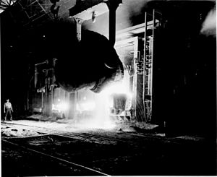
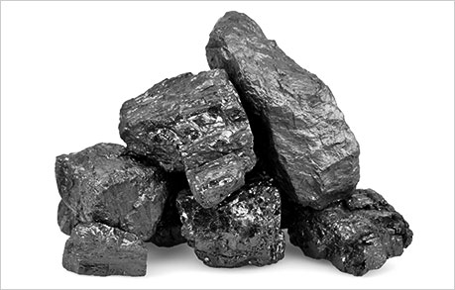
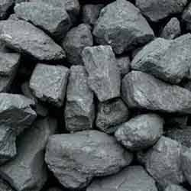
The coal and steel connection to benzene: how C₆H₆ appeared in the 19th century
19th century Pittsburg steel plant used `coked (metallurgical) coal’ to heat iron to molten state
Raw coal
Coked (purified) coal
+ by products

Slide 3
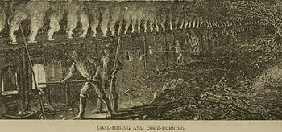
19th century `coking’ furnace
By-products include coal tars, oils and benzene (C₆H₆)

Slide 4
Possible structures envisioned for C₆H₆ : Benzene
Original Kekule structure
Dewar
structure

Slide 5
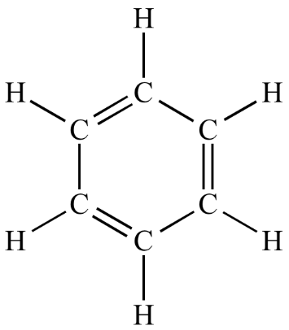
The leading structural model for benzene in the 19th century: August Kekule’s model

Slide 6
Why benzene represented a major challenge to chemists in the 19th century
comparison of cyclohexene vs benzene properties
Chemistry cyclohexene (1 double bond) benzene (3 double bonds)
Br₂/CCl₄ quantitative addition NR
H₂/Ni adds easily at 25ºC/1 atm barely @ 100-200ºC/100 atm
cold KMnO₄ diol formation at 25º C NR
They would have been even more weirded out by 20th century data
Physical properties cyclohexene benzene
C-C bond length 13.3 nm & 15.4 nm 14.0 nm
heat of hydrogenation 29 kcal/mol bond 17 kcal/mol bond
¹H NMR signals 1.2 ppm; 5 ppm H at 7.2 ppm
IR (cm⁻¹) 3050, 2950 3100, overtones @ 2000,
1600, 1500
Why are 3 double bonds less reactive than 1 double bond ???????
Why only one C-C bond length in benzene ?

Slide 7



Chemical problem with Kekule structure
Consequences of the original Kekule model:
Compound A
1,2-dibromo-1,3,5-cyclohexatriene
Compound B
1,6-dibromo-1,3,5-cyclohexatriene
=> 2 different properties for 2 different 1,2 dibromo products
2 different 1,2-dibromobenzenes predicted
Experiment: just one set of physical properties observed: mp=1.8 ºC ; bp= 221-2 ºC ; d=1.956²⁰ g/cm³ n_{d} =1.6155

Slide 8
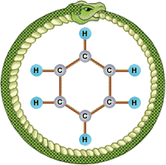
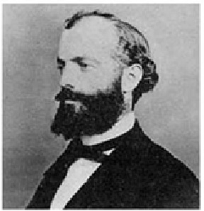
Kekule’s Big Breakthrough
“There I sat and wrote for my textbook; my mind was occupied with other matters. I turned the chair towards the fireplace and began to doze. Once again the atoms danced before my eyes. This time smaller groups modestly remained in the background. My mental eye, sharpened by repeated apparition of similar kind, now distinguished larger units of various shapes. Long rows, frequently joined more densely; everything in motion, twisting and turning like snakes. And behold, what was that ? One of the snakes caught hold of its own tail and mockingly whirled round before my eyes. I awoke, as if by lightning; this time, too, I spent the rest of the night working out the consequences of this hypothesis… Let us learn to dream, then perhaps we shall find the truth.”
August Kekule, Chemist, 1891
???

Slide 9
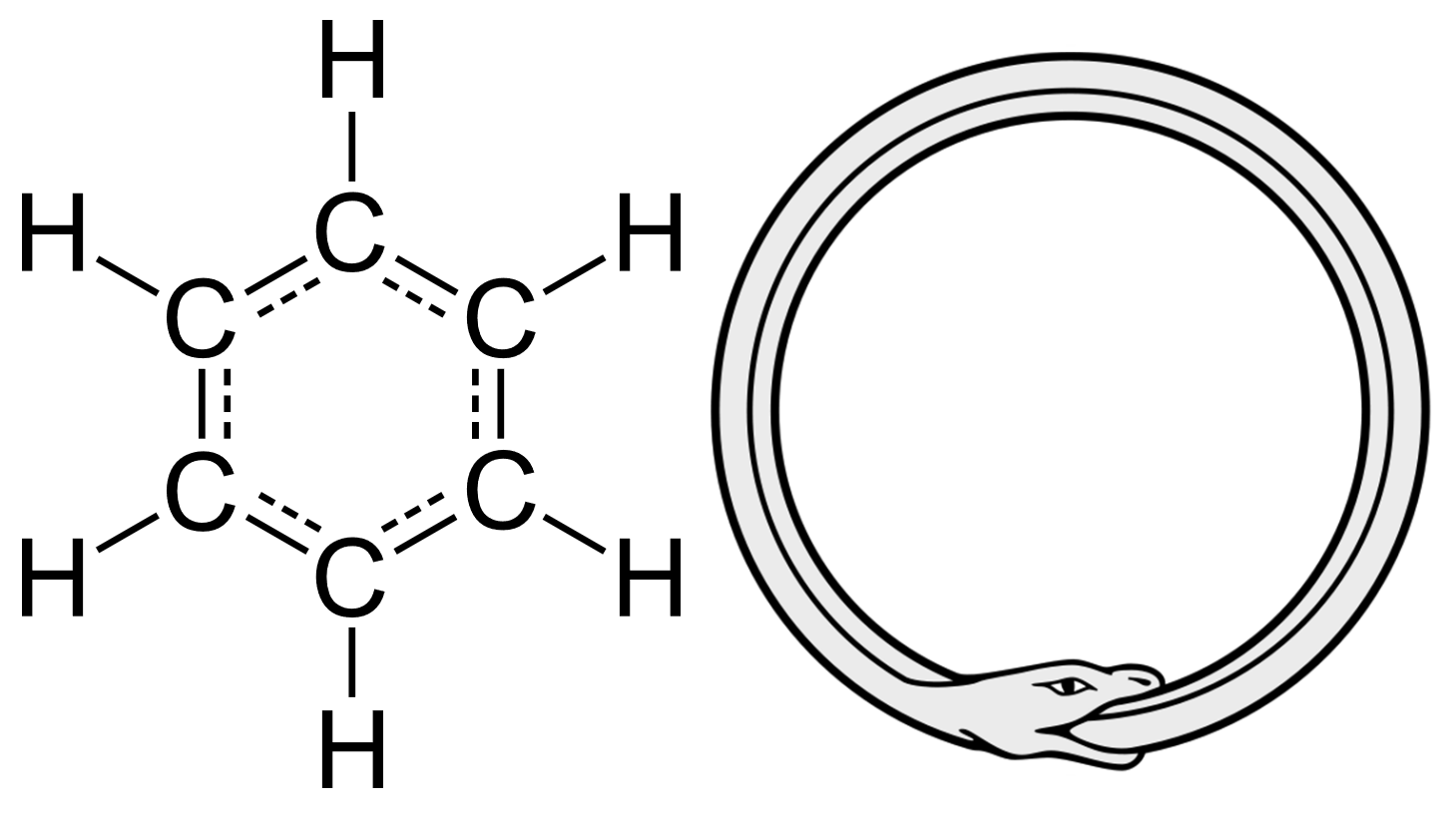
The pi system of benzene is completely delocalized

Slide 10

Key feature of aromatic compounds like benzene is it’s extraordinary lack of reactivity despite the presence of 3 double bonds.
Aromaticity as a property is defined as an extreme resistance to reaction. It’s akin to attempting to walk a stubborn cat….

Slide 11
Criteria for appearance of aromatic behavior
1) strict planarity¹
2) alternate double/single bonds
3) 4n +2 π electrons perpendicular to the
plane (n=0,1,2...)
¹essentially restricts aromatics to rings

Slide 12
But pi electrons don’t flow freely after rotation around C2-C3
1,3-butadiene and strict planarity
Pi electrons flow in this configuration
Propene and strict planarity
Allyl carbocation and strict planarity
No free p orbital to move electrons to
∴Strict planarity means any aromatic structure
must be a ring
Free p orbital exists in plane only sometimes…no free circulation

Slide 13
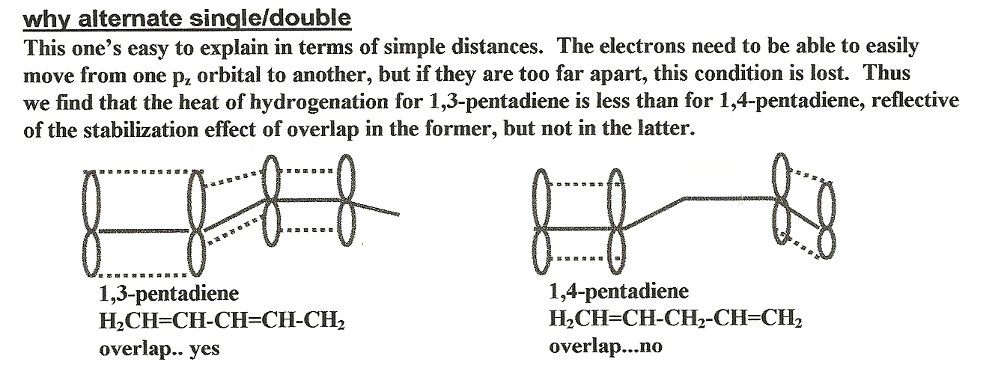
Also: think back to alkadiene and allyl chemistry… resonance motion of electrons constrained to one carbon jumps

Slide 14
4n +2 rule explained
How many pi (π) electrons in …..
sp²
sp³
+
-
sp²
6
4
6
What is the `hybridization’ of …
4n +2 = #π electrons; n=0,1,2…(an integer)
n = 0
1
2
π count allowing aromaticity =
4*0+ 2=2
4*1+ 2=6
4*2+ 2=10
Notes:
ACD/Labs0328082056
12 13 0 0 0 0 0 0 0 0 1 V2000
11.9574 -5.7777 0.0000 C 0 0 0 0 0 0 0 0 0 0 0 0
9.3215 -5.0714 0.0000 C 0 0 0 0 0 0 0 0 0 0 0 0
11.2511 -3.1418 0.0000 C 0 0 0 0 0 0 0 0 0 0 0 0
6.6855 -5.7777 0.0000 C 0 0 0 0 0 0 0 0 0 0 0 0
5.3211 -8.1411 0.0000 C 0 0 0 0 0 0 0 0 0 0 0 0
2.9577 -6.7766 0.0000 C 0 0 0 0 0 0 0 0 0 0 0 0
4.3222 -4.4133 0.0000 C 0 0 0 0 0 0 0 0 0 0 0 0
11.9574 -0.5058 0.0000 H 0 0 0 0 0 0 0 0 0 0 0 0
13.8871 -7.7074 0.0000 H 0 0 0 0 0 0 0 0 0 0 0 0
3.6159 -1.7773 0.0000 H 0 0 0 0 0 0 0 0 0 0 0 0
0.3218 -7.4829 0.0000 H 0 0 0 0 0 0 0 0 0 0 0 0
6.0273 -10.7770 0.0000 H 0 0 0 0 0 0 0 0 0 0 0 0
2 1 2 0 0 0 0
3 1 1 0 0 0 0
2 3 1 0 0 0 0
4 2 1 0 0 0 0
5 4 2 0 0 0 0
6 5 1 0 0 0 0
7 6 2 0 0 0 0
4 7 1 0 0 0 0
8 3 1 0 0 0 0
9 1 1 0 0 0 0
10 7 1 0 0 0 0
11 6 1 0 0 0 0
12 5 1 0 0 0 0
M END

Slide 15
4n+2 rule
valence bond theory description of C₃H₃ ⁺
^{(more picture than math)}
Framework is sp²
extra p electrons
= π electrons above & below plane of framework
Explains circulation and resonance…
But can’t explain 4n +2 rule

Slide 16
MO description of C₃H₃⁺
^{(more math than picture)}
Basic process:
Collect all the atomic orbitals (AO) ofrecombine as molecular orbitals (MO) with #AO= #MO
MO(1) = c1*AO(1) + c₂AO(2) + c₃AO(3) +….
Optimize the c_{k} for all the MO simultaneously to minimize the computed energy of the molecule (quantum chemical calculation )
2) Put in the number of electrons starting from bottom and working up (fill the MO)
Results are energy levels of the molecule which lie either above or below the original energy sum of all the separate atoms

Slide 17
1 positive overlap and 2 anti-overlaps (destabilized)
Separate unconnected p orbital energies
How many pi electrons in system produces maximum stability ?
WHAT `MO’ THEORY REVEALS
Overlap is all positive=> all bonds (stabilized)

Slide 18
What simple MO Theory Predicts for the more complex case of C₆H₆ (benzene)
An anti-bonding arrangement of 6 p_{z} orbits of C not involved in sp² frame
De-stabilizing anti-bonding MO predicted
Z axis
Energy of original p_{z}
Stabilizing bonding MO predicted; max stabilization with 6 electrons
A bonding arrangement of 6 p_{z} orbits of C not involved in sp² frame

Slide 19
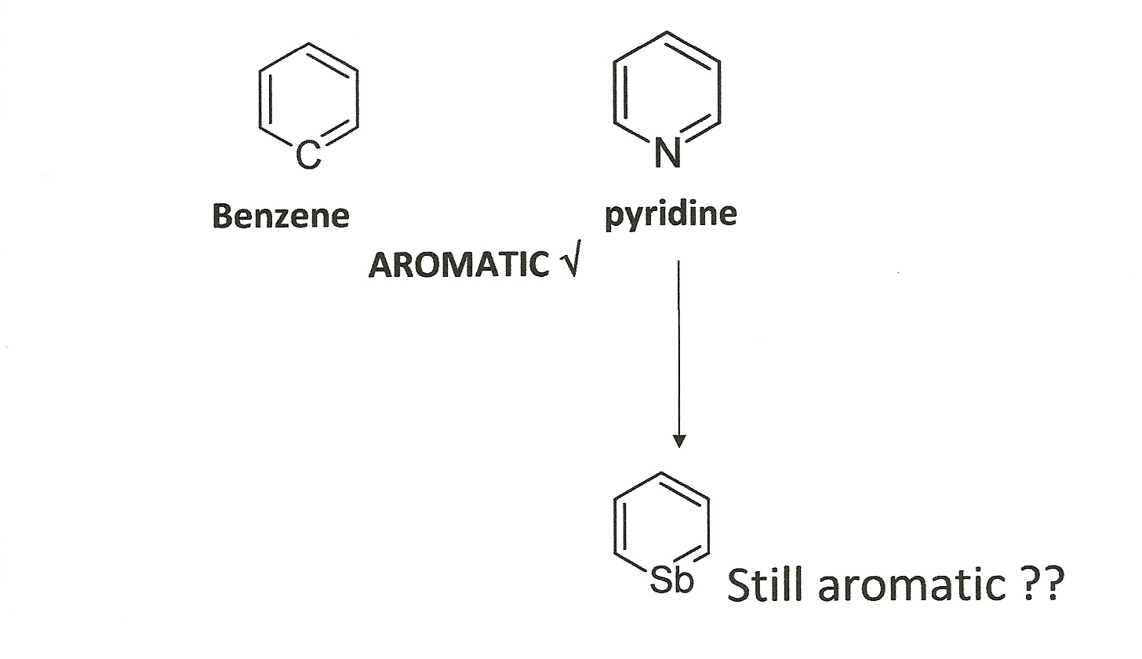
Unusual Examples of Aromaticity:
It’s More Than Just Benzene
Case 1: Heterobenzenes

Slide 20
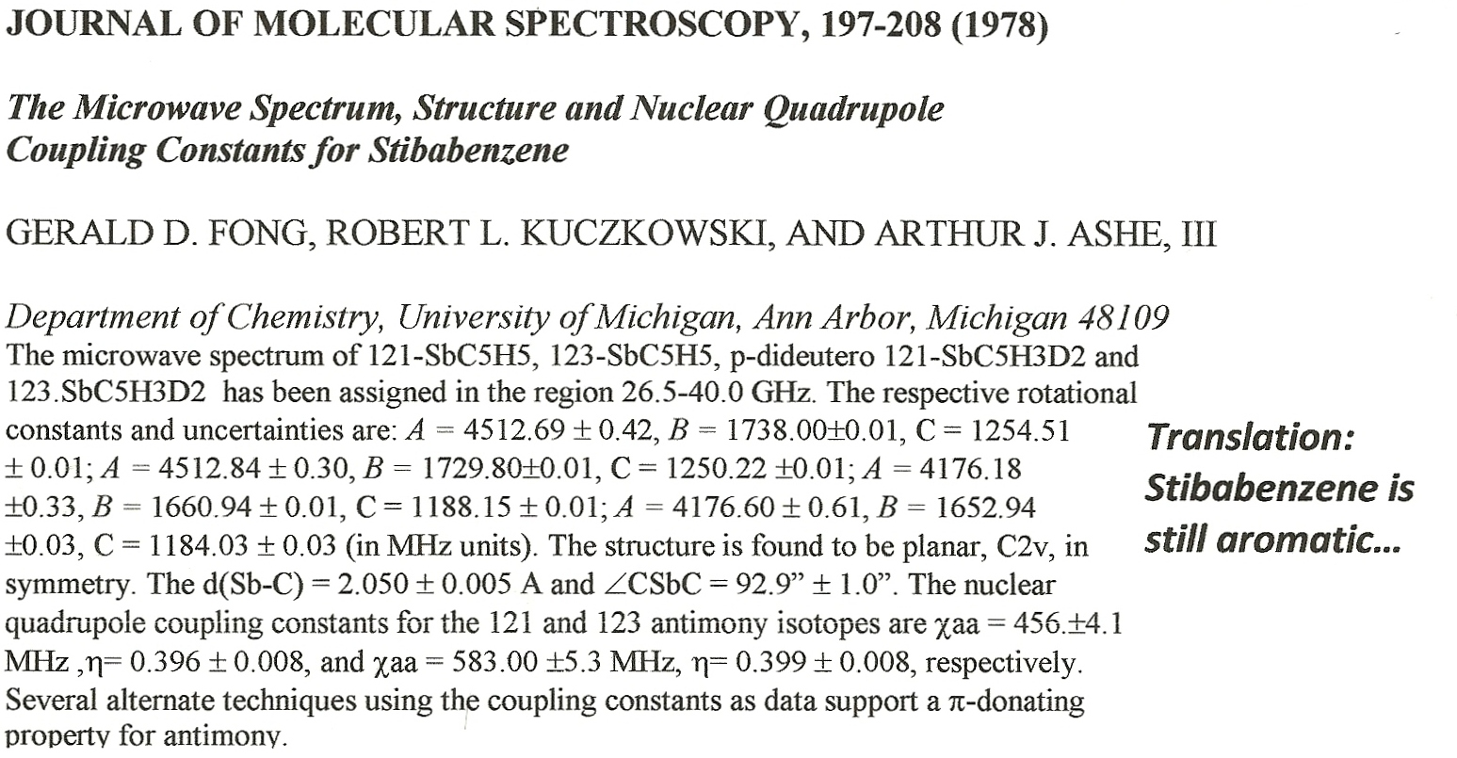
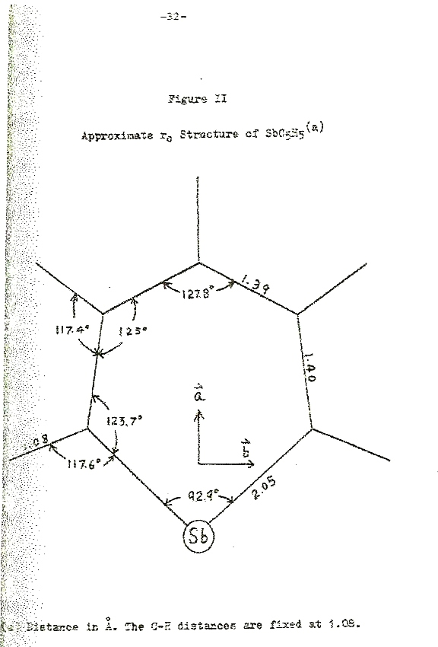
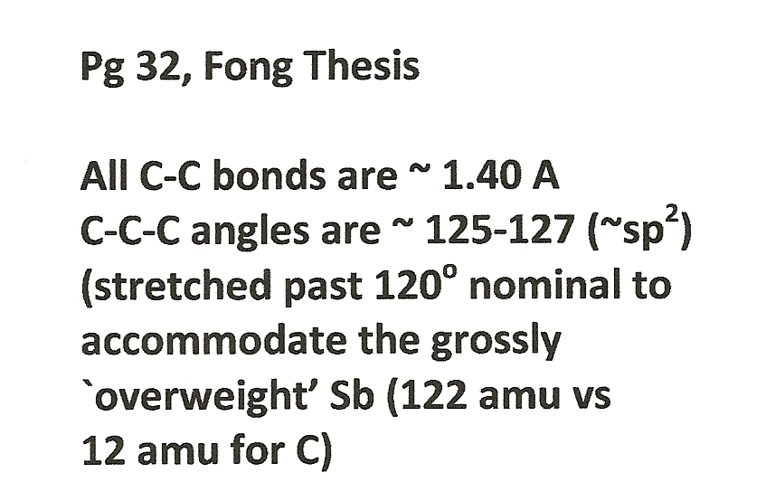
TRANSLATION:
Stibabenzene is still aromatic

Slide 21
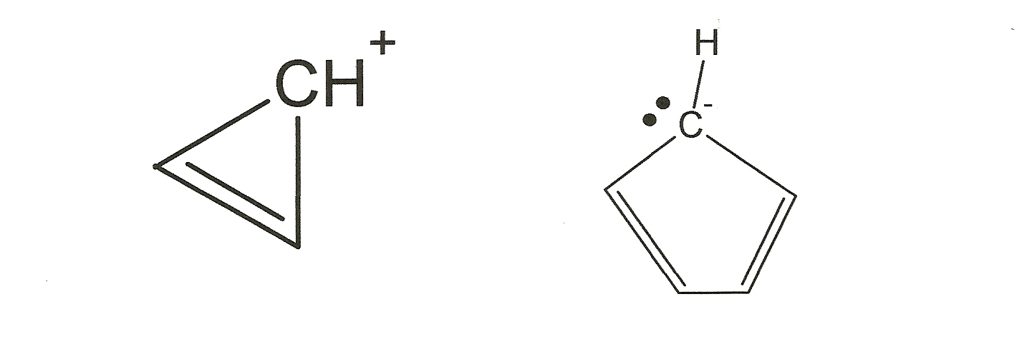
Case 2: voltammetrically created stable, small cation and anion rings
1) Both flat ?
2) Alternate double – single?
Yes
Yes
sp²
Lone pairs in p orbit
Can make pi
sp²
π e count
6
2
    Both satisfy 4n + 2 criterion ?
Both survive for hours in solution once generated

Slide 22
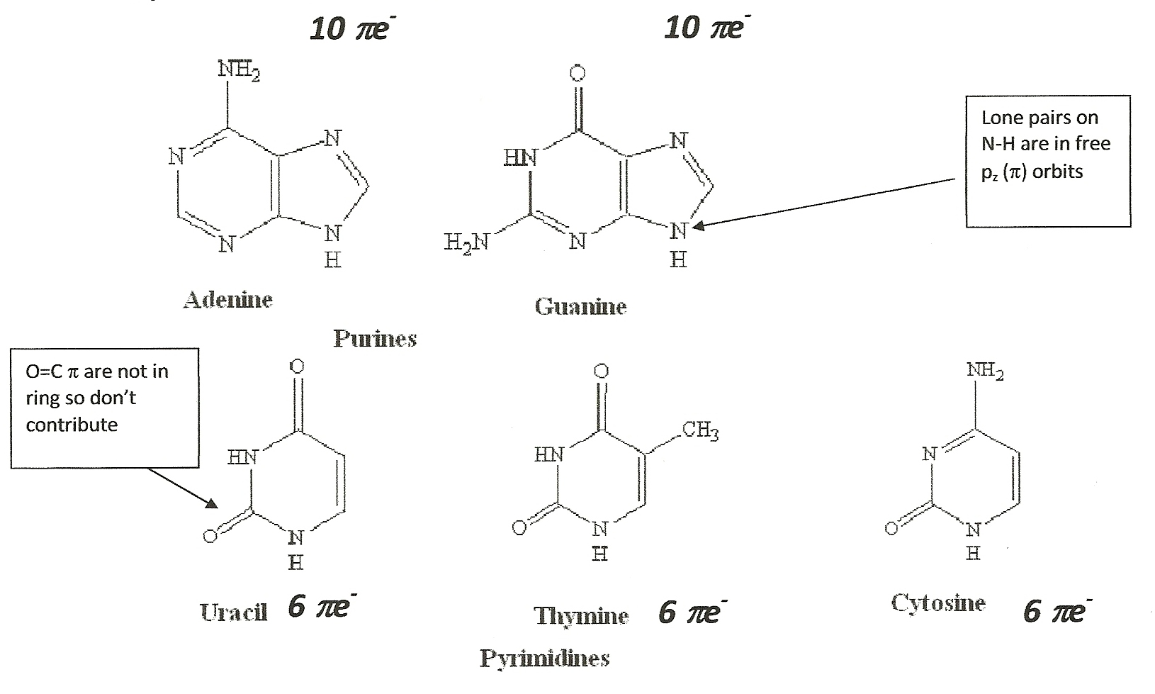
Case 3: At the heart of everything living….
Recognize these ???
The critical DNA base units A,T,G, U and C are all aromatic !!!!

Slide 23
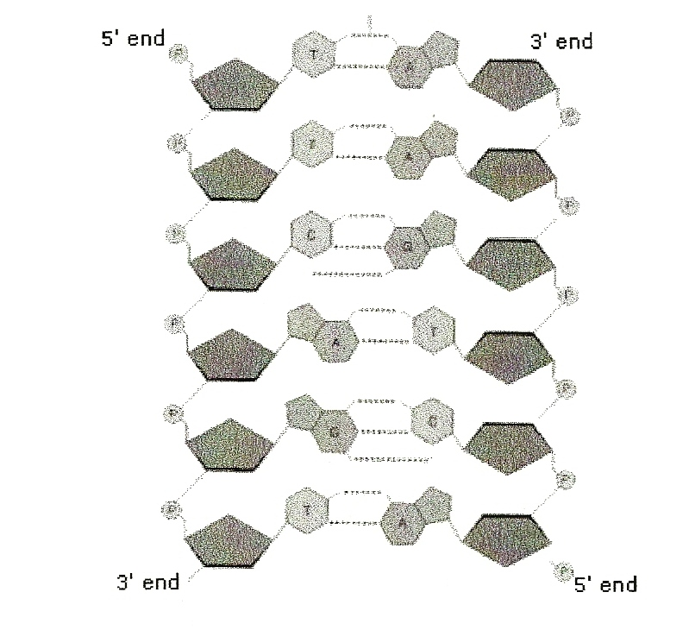
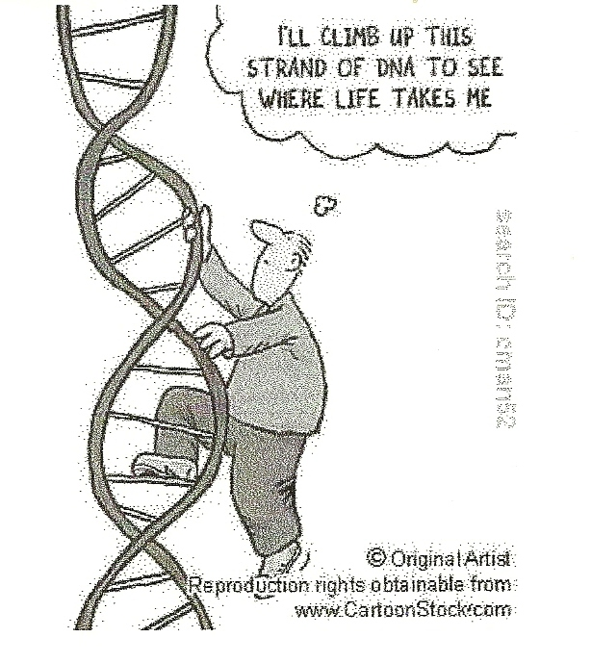
The heart of DNA:
aromatic base pairs A-T & G-C
Much of the incredible stability of DNA is due to it’s aromatic core.
FYI…Jurassic age DNA has been reportedly found intact !!

Slide 24

700,000-Year-Old Horse Genome Pushes Limits of DNA Survival
Genetic material suitable for sequencing could persist for as many as one million years, predict scientists.
http://www.technologyreview.com/

Slide 25
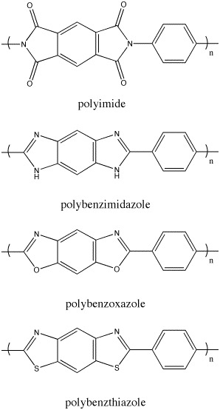
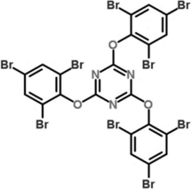
Typical Flame retardants: all aromatic-based

Slide 26
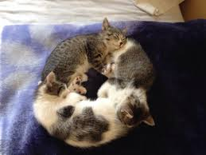
Cats can also exhibit aromatic resonance

