Slide 1

Reactions of Alkynes: Power Point Drill and Practice

Slide 2
Drill and practice: Alkyne chemistry part 2
Almost all reactions of alkynes are classified as ….
additions
What is the one reaction of alkynes that isn’t an addition ?
ozonolysis
Speaking of ozonolysis, what functional group do the product(s) of an ozonolysis belong to?
Carboxylic acids
What is/are the specific product(s) of the reaction:

Slide 3
Drill and practice: Alkyne chemistry part 2 (continued)
Pd black
Lindlar’s
catalyst
H₂(g)
+
only
Naº in NH₃(l)
NH₃(l)
only
+
Official name (and abbreviation) for stereochemistry of alkenes below (jawohl!):
Zusammen (Z)
(old name: cis)
Entgegen (E)
(old name: trans)

Slide 4
Drill and practice: Alkyne chemistry part 2 (continued)
Pt, Pd
H₂(g)
+
50:50
Acetic acid (conc.)*
Solvent ?
*=“glacial” acetic acid
CH₂Cl₂
Solvent ?
Indicate stereochemistry
Trans (E) only

Slide 5
Drill and practice: Alkyne chemistry part 2 (continued)
Glacial Acetic acid
Solvent ?
Markovnikoff or anti-Markovnikoff addition product ?
HgSO₄/H₂SO₄
H₂O
Name of `shift’ illustrated above ??
Initially…
…finally
enol
keto
Keto-enol shift
Which is which ?
Name for the pair together ?
Tautomeric pair (Tautomers)

Slide 6
Drill and practice: Alkyne chemistry part 2 (continued)
Carbonyl on anti-Mark side of alkyne
B₂H₆ neat or in THF
H₂O₂/OH⁻
What Nobel-Prize winning American chemist at Purdue University is associated with this two step process ?
H. C. Brown
(boron moron)
The last two reactions of alkynes to make carbonyls can be classed as…based on what was added across the triple bonds (see circled hint above)
hydration

Slide 7
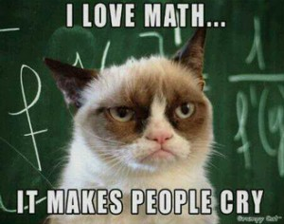
I LOVE ORGANIC CHEMISTRY

