Slide 1
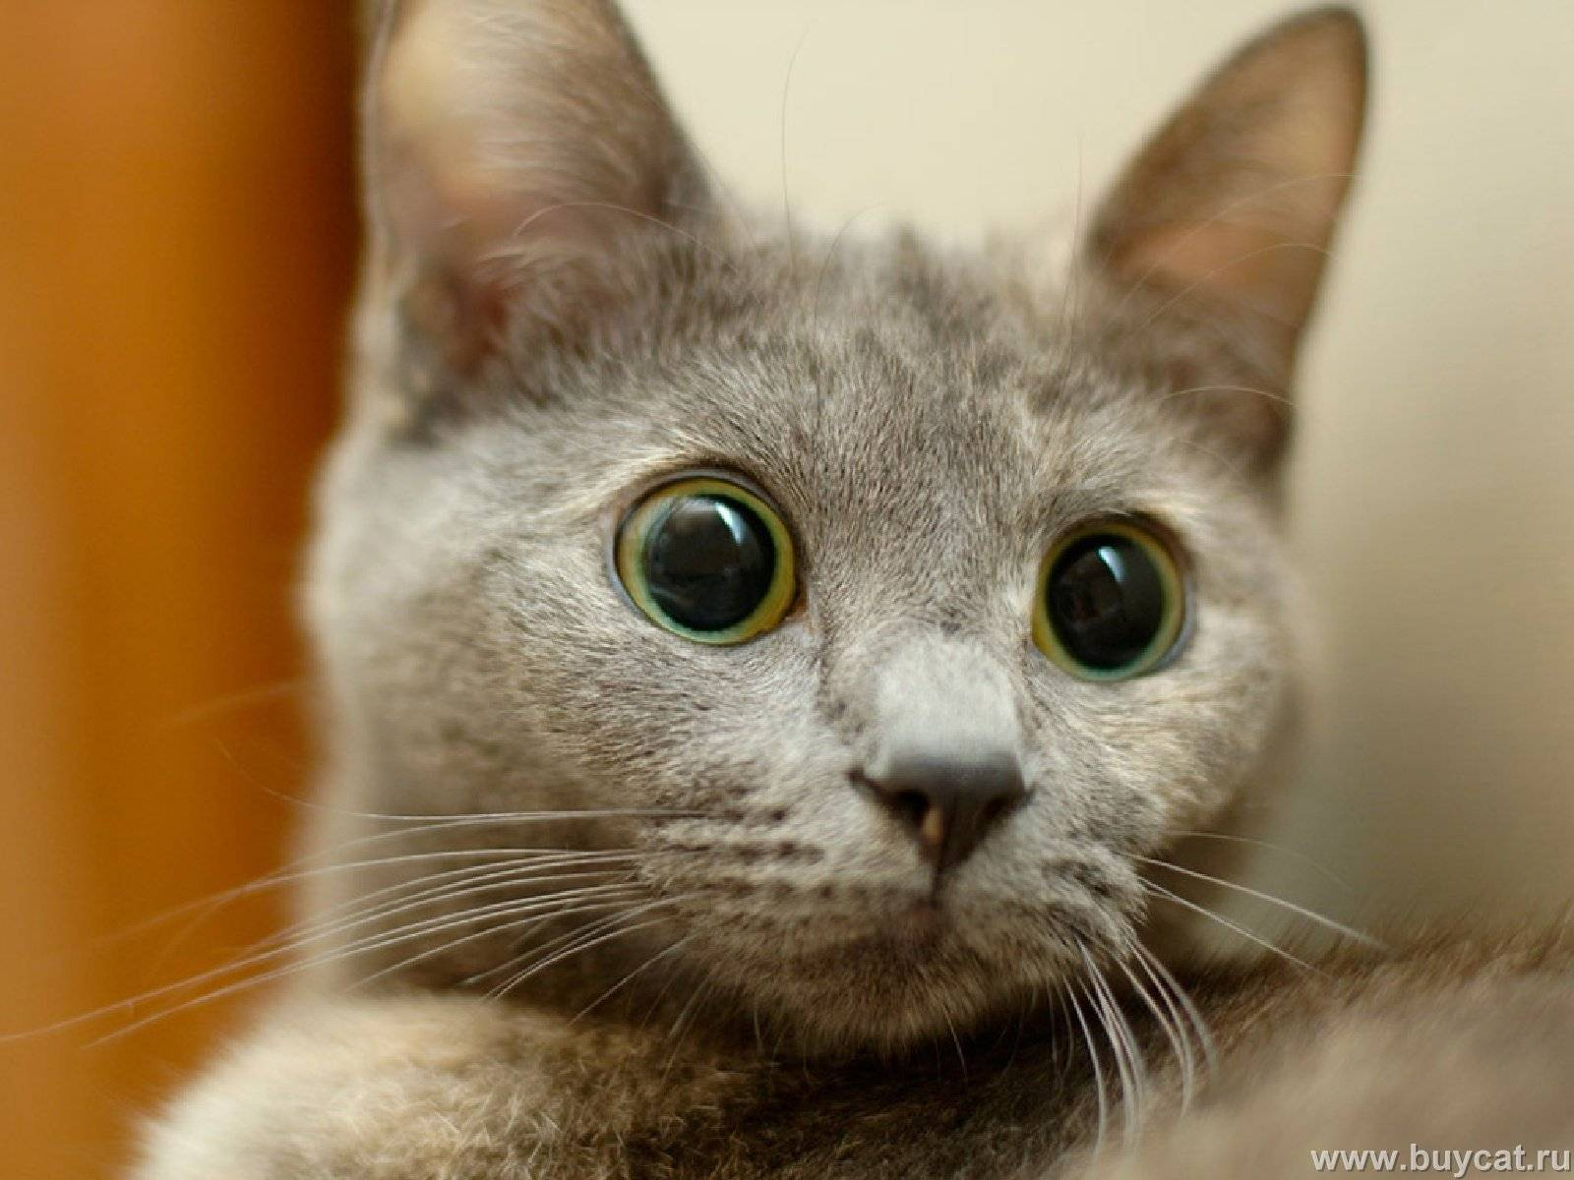
Drill & Practice Making Alkynes - the cat’s miaow

Slide 2
Drill and practice: Alkyne chemistry part 1
Name of original route to ethyne
Bertholet synthesis
What is the Bertholet synthesis path ? (on board)
CaO +3C→ CaC₂ +CO at 1800-2100 ºC
CaC₂ +2H2O → Ca(OH)₂ + HC≡CH
Which is the most acidic species:
CH₃-CH₃ CH₂=CH₂ CH₃-C≡CH HC≡CH
What is the base commonly used to create both terminal and disubstituted alkynes
Sodium amide Na⁺ NH₂⁻
Fill me in:
+

Slide 3
Drill and practice : Alkyne chemistry part 1 (cont.)
What two kinds of dihalides lead to terminal or disubstituted alkynes ?
Gem and vicinal dihalides
vicinal
Gem (geminal)
Which is a gem dihalide, which is a vicinal dihalide ?
What’s missing ?
NH₃(l)
solvent
NaCl
What is the main byproduct of the reaction above ?

Slide 4
Drill and practice : Alkyne chemistry part 1 (cont.)
Can this reaction make an alkyne ? If yes, which one. If no , what can it make ?
1)Alkyne ? Yes No
What is made?
+ 2
NaCl
+ 2
NH₃

Slide 5
