Slide 1
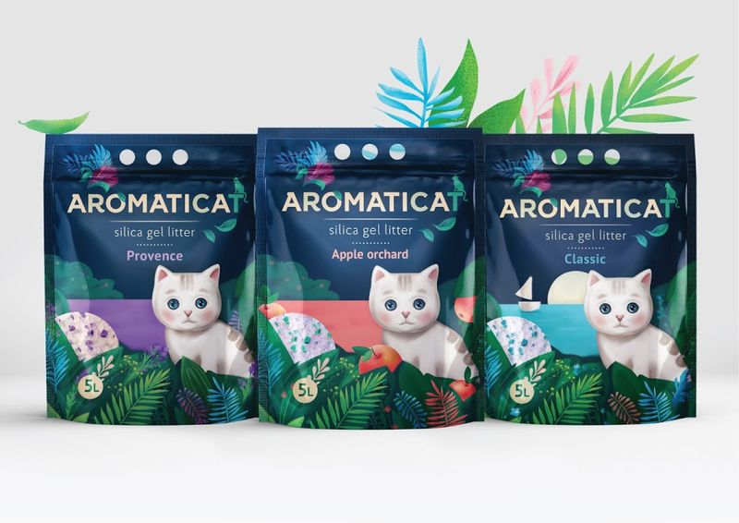
Aliphatic-Aromatic Reaction Chemistry Drill and Practice

Slide 2
Aromatic-aliphatic and synthesis drill and practice
Where is my most sensitive-to-reaction site ? (the chemical “G” spot)
KMnO₄ or K₂Cr₂O₇ or HNO₃ or HCrO₄
Cuts chain to stub => ‘vasectomy’
What are the Birch reduction reactants and product below?
Na/NH₃
in CH₃OH
Destroys aromaticity
=>lobotomy

Slide 3
Aromatic-aliphatic and synthesis drill and practice (cont.) DOING THINGS RETRO
Fe or FeBr₃ /Br₂
Mg/ dry ether
H⁺/H₂O
dry ether
80% H₂SO₄
reflux
NBS/light
80% H₂SO₄
reflux
CH₂N₂/Cu
light
Deerene?
☺

Slide 4
Aromatic-aliphatic and synthesis drill and practice DOING THINGS RETRO (cont.)
Mg/ dry ether
H⁺/H₂O
Dry ether
AlCl₃ neat
N₂H₄/OH-
Reaction name ?
or Zn-Hg/HCl
heat
Wolff-Kishner reduction
Reaction name ?
Clemmensen reduction
NBS/light
KOH
In ethanol
What’s my name?
styrene

Slide 5
Aromatic-aliphatic and synthesis drill and practice (cont.)
Industrial route to styrene ???
ZnO/60 ºC
Order the reactivity of Br below from highest to lowest reactivity
A B C
A > C >B

Slide 6

Organic Chemistry makes me want to hide all day under a blanket….

