Slide 1
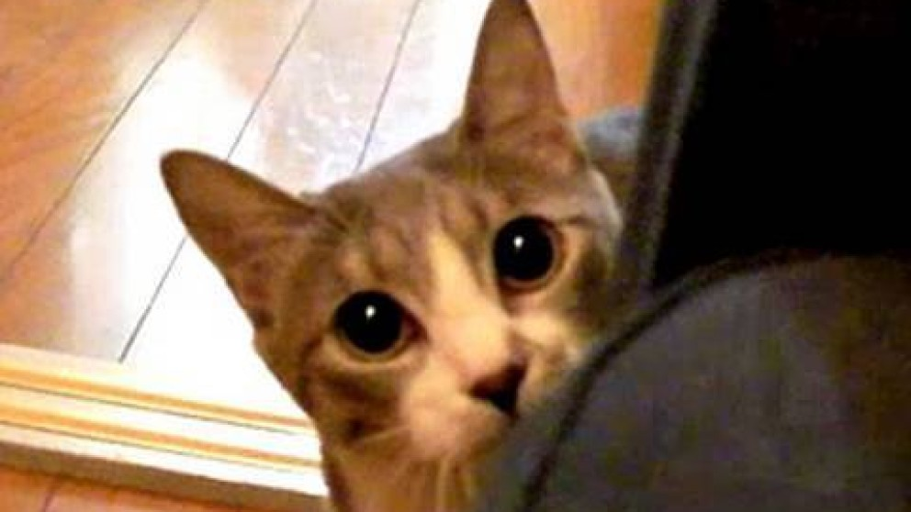
What happens in Organic Chemistry, stays in Organic Chemistry, right ???

Slide 2

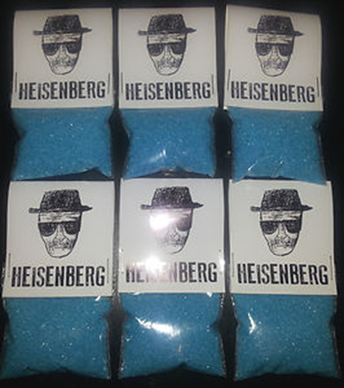
Who am I, really ?
Our first day’s first organic molecule…
IUPAC name:
N-methylphenyl-2-propan-2-amine :
Common name: methamphetamine
Street name: crystal meth
MW 149.2 mp 170-175ºC
A white to off white crystal

Slide 3
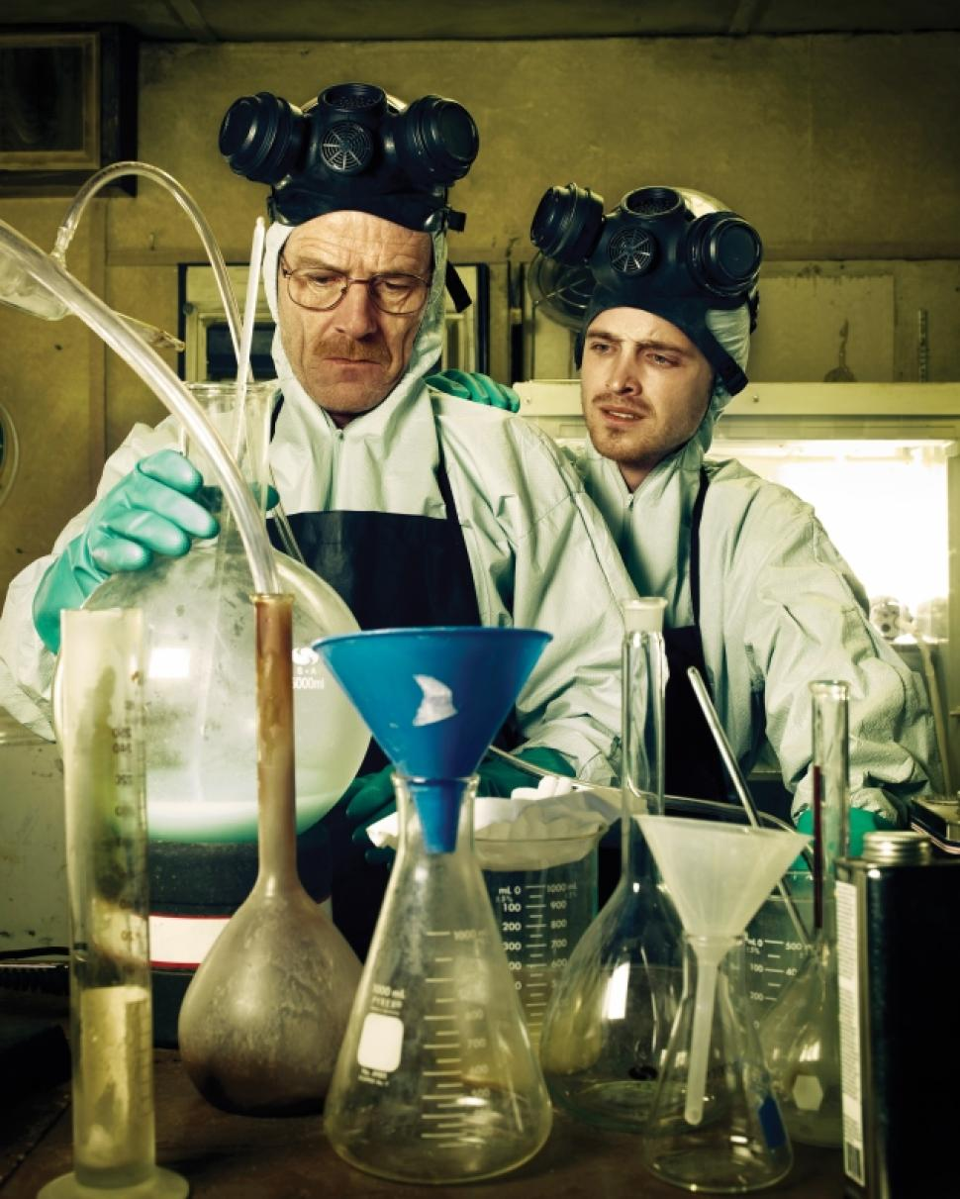
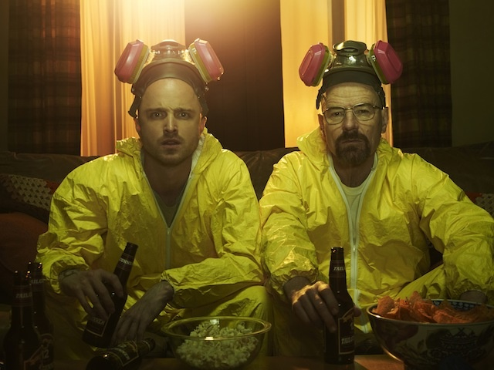
Let’s cook !

Slide 4
Stereochemistry note:
Meth has a Chiral center: D form active, L form inactive =>50% of synthesized meth is inert !!
Solubility is high:
In water(1 gm: 2ml),
In ethanol ( 1gm:3ml)
in chloroform (1 gm:5ml)
C3
Medical note:
The methyl group (C3) facilitates the compound’s transport across the blood-brain barrier.
=> Easy to absorb and deliver to human body

Slide 5
Ways to Make Crystal Meth…using stuff you learned in O. Chem
Crystal meth
1) Grignard synthesis
The Grignard piece
2-phenylethanal
Class of compound ???
C=N- acts like C=O
when reacting with RMgX …
immine

Slide 6
Problem areas for manufacture ???
For mole $: can you make MeMgI=CH₃-MgI starting from methanol?
Grignard route to crystal meth

Slide 7

2-phenylethanal
Key Starting material for Grignard route to Meth
Often, the starting materials are controlled by the DEA to prevent large scale synthesis of meth.
However, you can buy benzene and ethanol in unlimited quantities legally and now know enough to make the key starting material above.

Slide 8
2-phenylethanal from benzene and ethanol: method 1

Slide 9
Not the only way to 2-phenylethanal…Grignard route (method 2) better
The Grignard piece…
pcc neat
2-Phenylethanal precursor

Slide 10
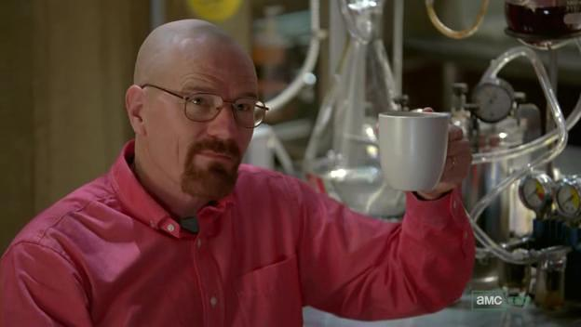
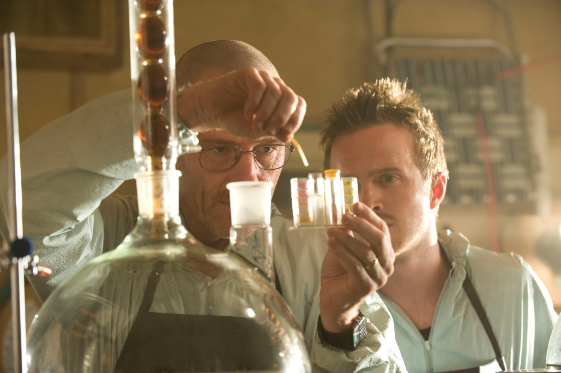
Route 3 to Crystal Meth:
Biker’s Meth synthesis (Walter White’s synthetic route)
https://www.youtube.com/watch?v=icm2UscmEdU
Stealing P2P

Slide 11
“Biker’s meth” two-step route
Step 1
P2P
Step 2
Immine again….
Da stuff…
Crystal meth
Breaking Bad uses Rh reduction (expensive)

Slide 12
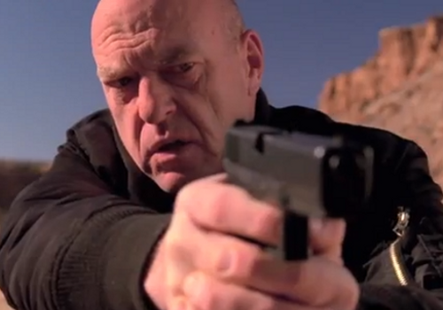
The key is `P2P’ (phenyl-2-propanone) which is high on the DEA controlled substance list
An(ethically iffy) exercise on how to make P2P from stuff the DEA can’t control
Routes to P2P you can do with what you know…
( The Final Exercise…)
You’re going down, Doc…

Slide 13
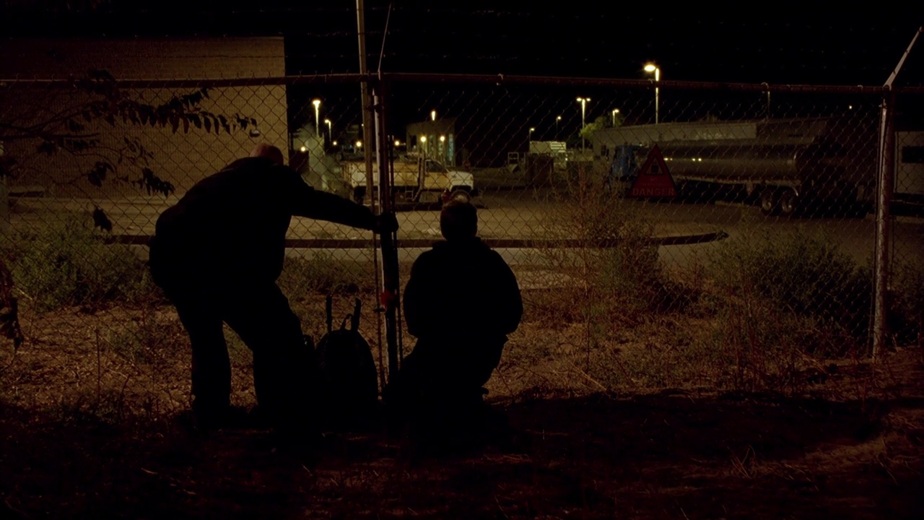
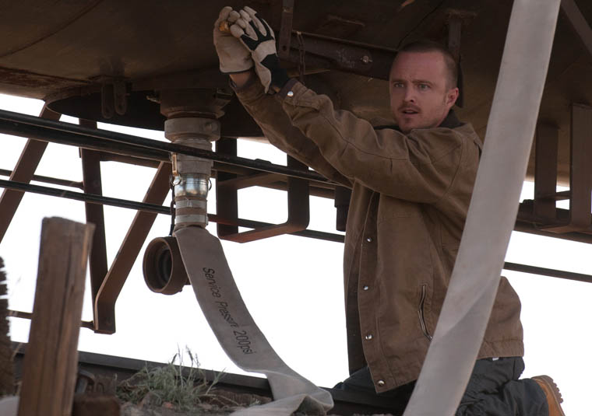
√
??
Many “Breaking Bad” episodes were focused on stealing methyl amine (MeNH₂)

Slide 14
What if the Feds try to control NH₂CH₃ (methyl amine) ?
√
No problemo…just run:
CH₃Cl + NH₃→ CH₃-NH₂ + HCl
CH₃-Cl
Methanol
not controlled
Table salt and
battery acid

Slide 15
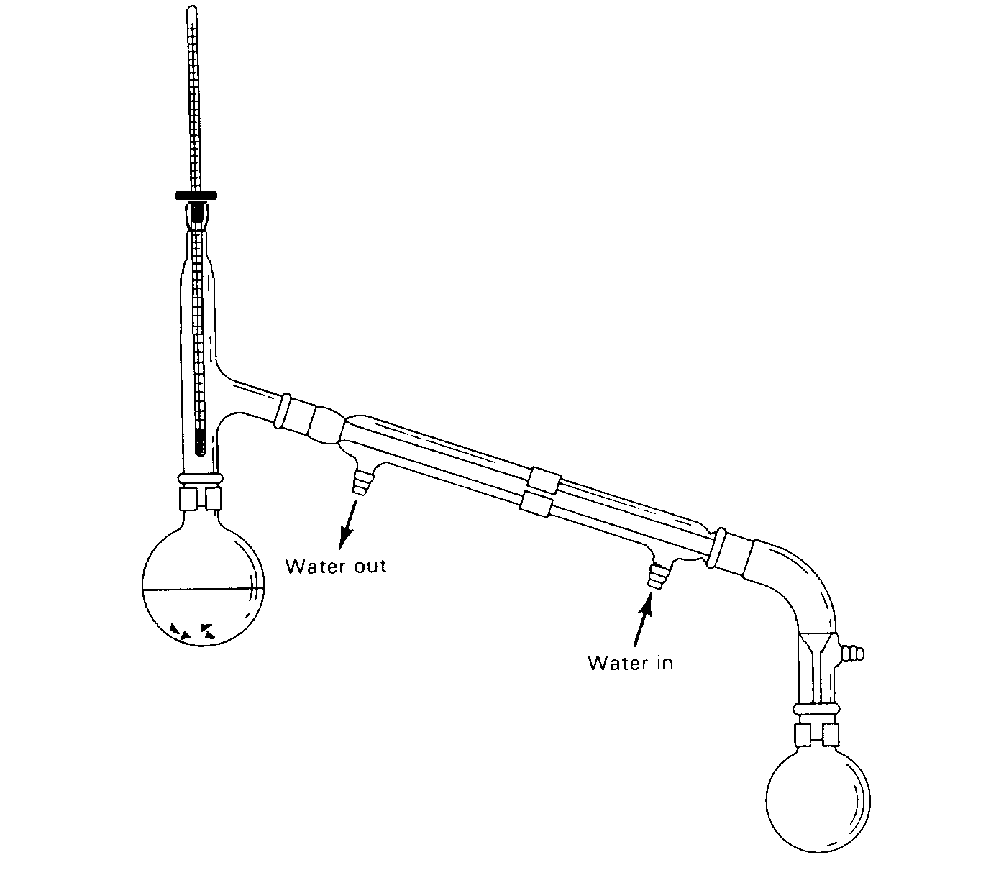
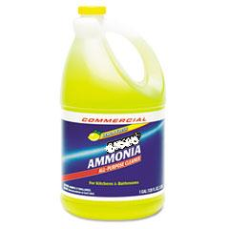
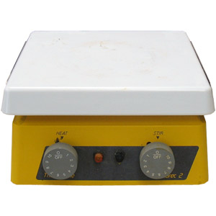
√
??
√
CH₃Cl + NH₃→ CH₃-NH₂ + HCl
From CRC handbook 76th
boiling point of H₂O=100 C boiling point of NH₃ =-33 C
70-90% w/v NH₃
Any ideas ???
1.89$/gallon
Walmart’s
(~5-10% w/v NH₃)
Dry ice (-44 C)

Slide 16
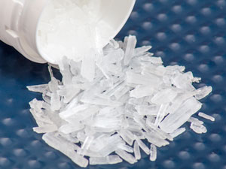
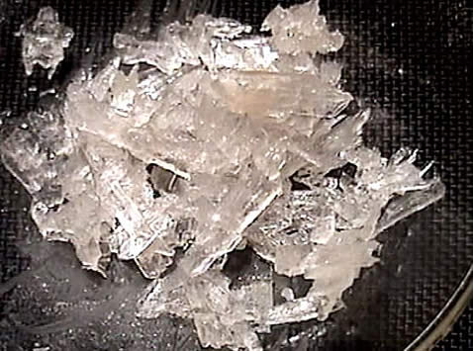
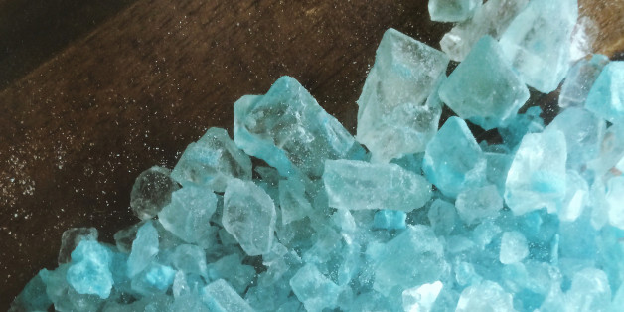
Meth
au-natural…colorless white crystals
Food coloring added versions

Slide 17

BEFORE VERSUS AFTER CRYSTAL METH USE

Slide 18
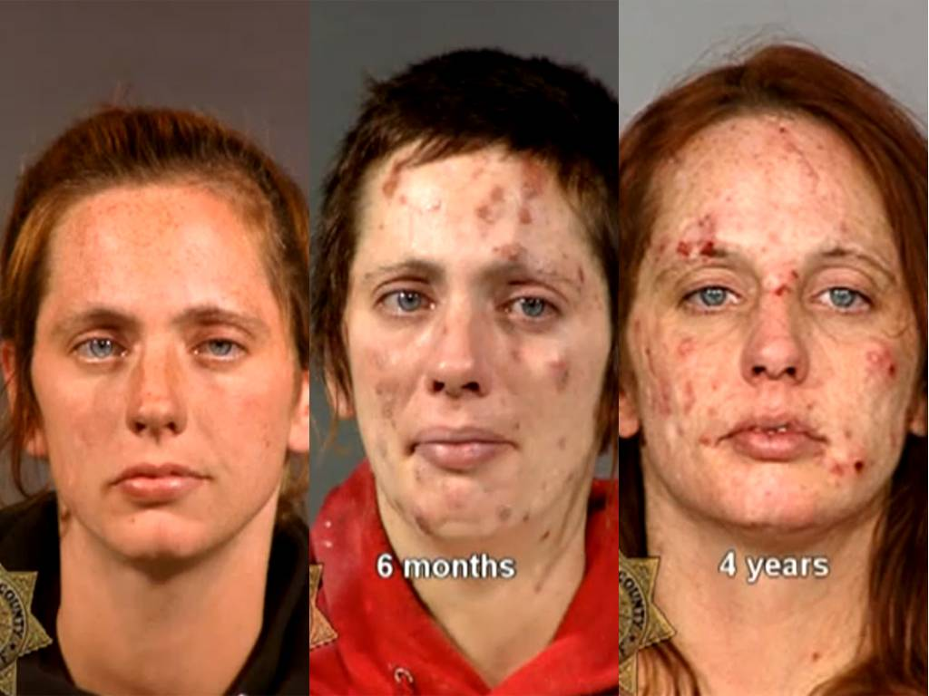
BEFORE VERSUS AFTER CRYSTAL METH USE (cont.)

Slide 19
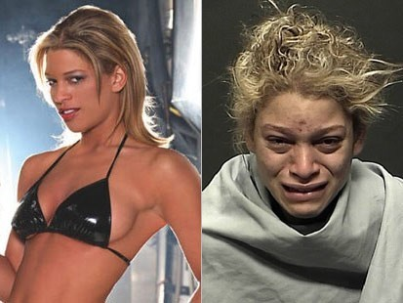

Slide 20
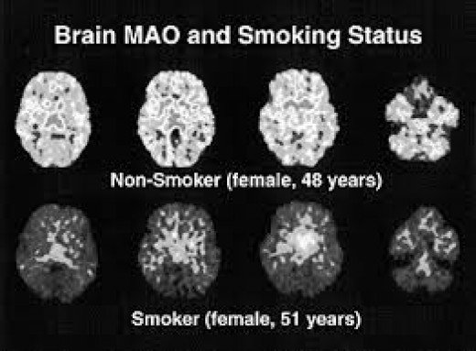

Slide 21

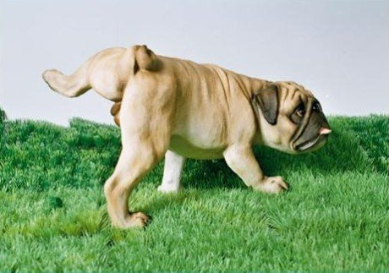
Before crystal meth use
After crystal meth use

Slide 22

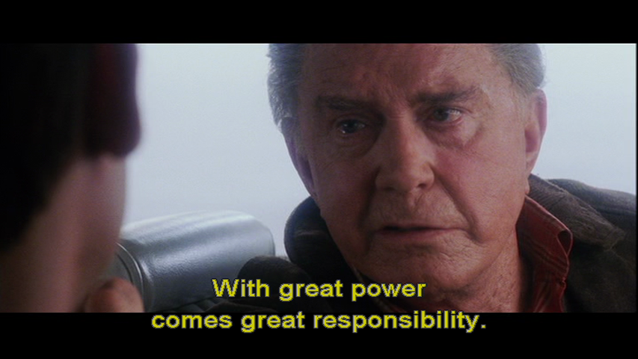
Moral ?

Slide 23

Organic is almost over!!

