Slide 1
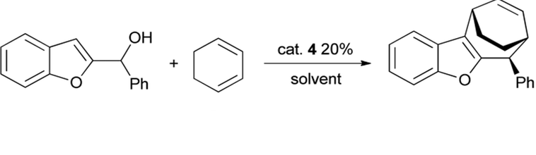

Example of a 1,3 cycloaddition reaction
Cats are a big part of cyclo addition !

Slide 2
1,3-Cyclo-additions =Diels-Alder reactions= 2+4 cyclo additions
a chemical love story (see also: text 14.4 and 30.5)
THE PLAYERS
dienes
ene=dienophile
1,3-butadiene
(object of dienophile’s love)
Has 2 π electrons
Has 4π electrons

Slide 3
Cycloaddition basics (cont.)
Enes and dienes can come fully accessorized:
Dienes can be rings

Slide 4
Cycloaddition basics (cont.)
The basic story…
They hook up
and…a discrete time later behind closed doors
with some coaxing (heat)*
+
dienophile
diene
dienes
Marriage and a ring
*…All 2+4 (=1,3) cyclo-additions are thermally driven (or catalyzed), e.g. they have to be `in heat’ ☺

Slide 5
Cycloaddition basics (cont.)
A cycloaddition can be thought of as simultaneous conversion of 3π bonds to 2σ + 1π
One (1) e⁻ donations from both ene and diene start to form two σ bonds between carbons 1,2 and 5,6 .
2
1
3
4
6
2a) the ene’s original π bond dissolves
5
2
1
3
2b) the diene’s two original two π bonds have only 1 electron each as the two σ new bonds emerge =>carbons 2 and 5 have more than 8 valence e-
4
6
5

Slide 6
Cycloaddition basics (cont.)
3a) The two lone e- left behind in the diene’s original π bonds migrate to form a new π bond between carbons 3 and 4.
2
1
3
4
6
5
3c) ….to complete the cyclo addition.
3b) erasing the remains of the original two π bonds …

Slide 7
Cycloaddition basics (cont.)
It is convenient to think about the exchange starting by pushing the initial ene π bond across to the diene .
This means the two π bonds of the diene must dissolve and push their electrons back to the ene to make up for its’ loss.
π
π
π
Almost σ
Almost π
Almost σ
The soon-to-be cycloaddition product after the diene dissolves to an `ene’
Done ! Ta Da !

Slide 8
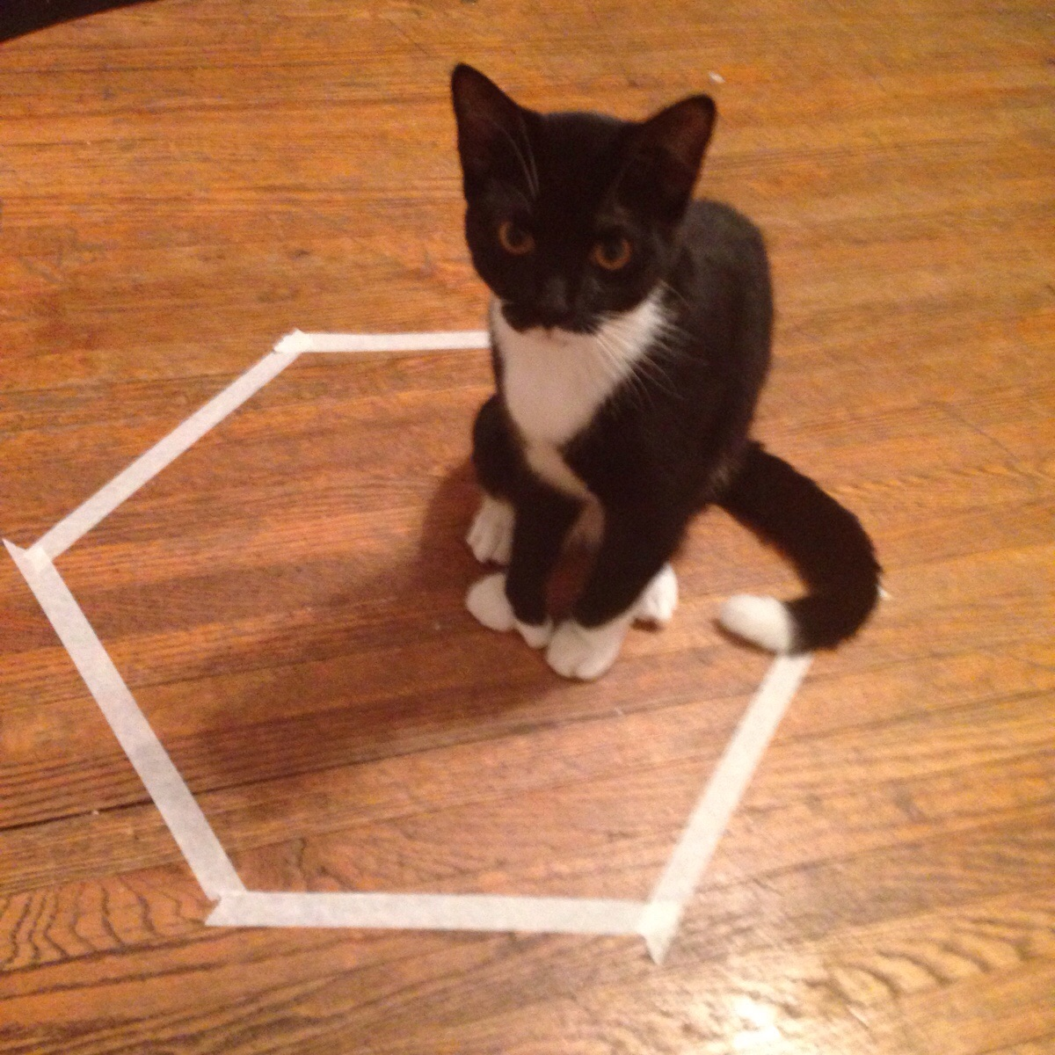
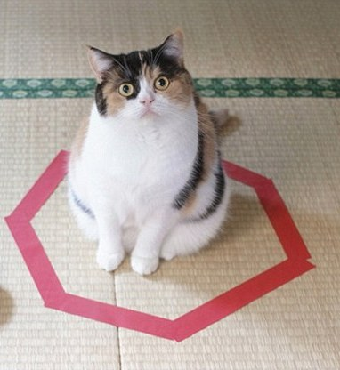
Cats are sur`pi’ zing’ly good at cycloaddition

