Slide 1

Doc’s “magic brownie” version of E2
Step 2
Step 1a
Step 1b
Step 2
What’s wrong here ?

Slide 2
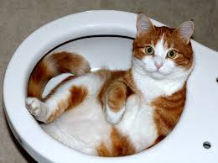
Find anything wrong here ???
(If yes, how to fix ???)
Dry ether
Also missing
H⁺/H₂O step
H₂SO₄
reflux
HCl/reflux
In ether

Slide 3

Fill me in, please !
O₃
Zn/H⁺
H₂SO₄
reflux
H⁺/H₂O
Mg/dry ether
PCl₃ neat/bubbling
CuI/THF

Slide 4

Given that:
And, given CH₂I₂ + Zn(Cu), suggest a route to the odd looking organic critter below starting with just 2-propanol

Slide 5
