Slide 1

More of this ugly NMR Sh$t? NOOOOOOO ! Please stop !!!

Slide 2

Not all NMR spectra are as `easy’ as those in the first NMR lab assignment

Slide 3
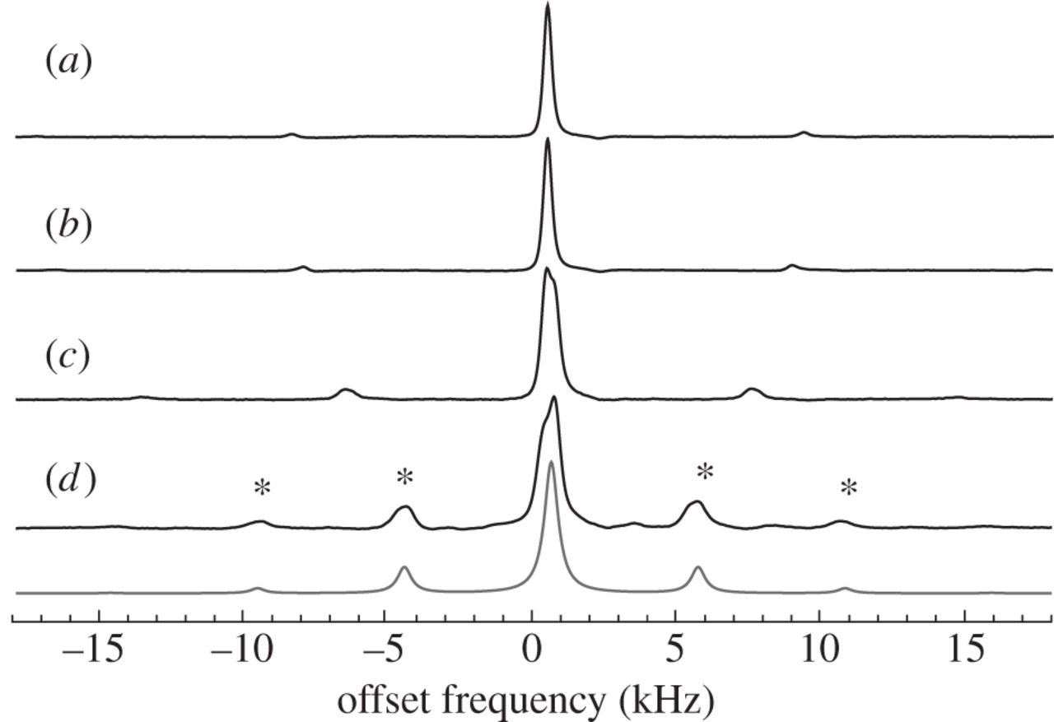
Spinning side bands (created by the need to rotate sample tube)

Slide 4
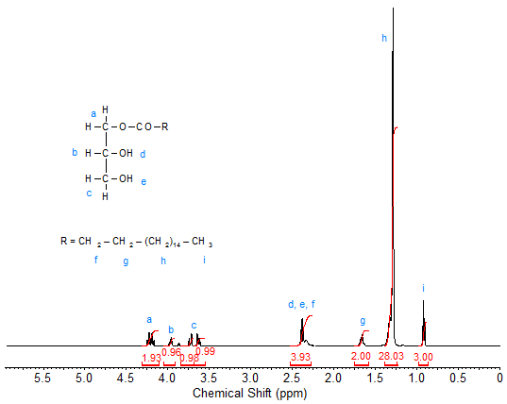
Sometimes you can’t figure out the splittings:
The N+1 rules fails
Glycerol

Slide 5
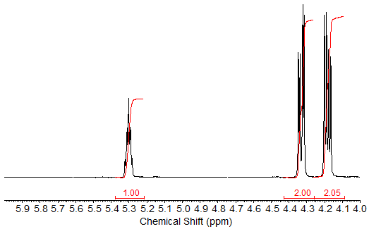
…even when you go to very high resolution

Slide 6
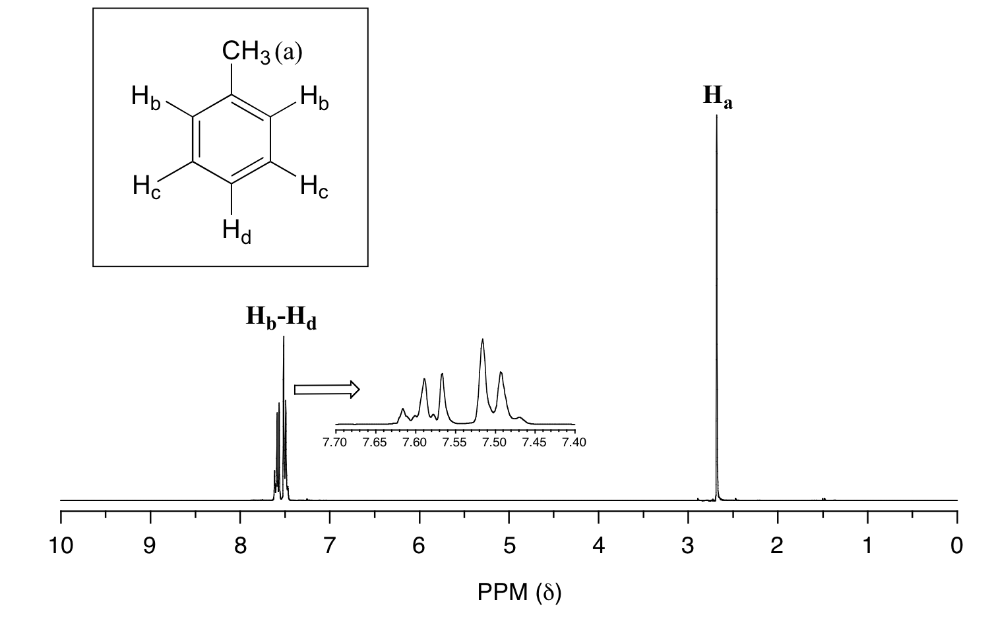
…and sometimes too much resolution is not a great thing

Slide 7
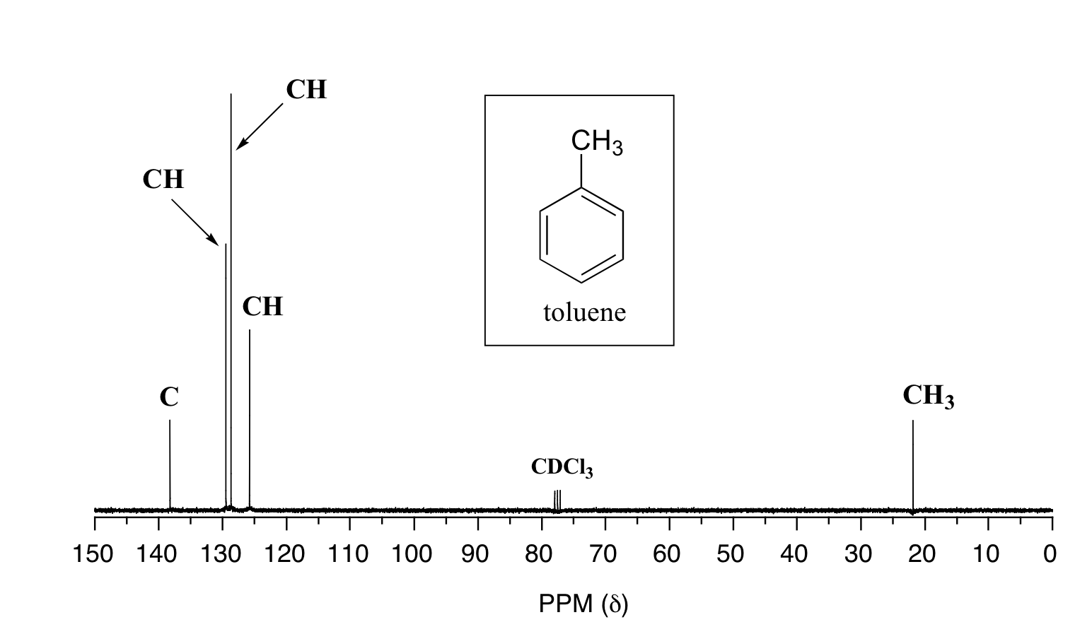
Examples of 13-C NMR…knowing how many different C provides lots of help in structure analysis
reference

Slide 8
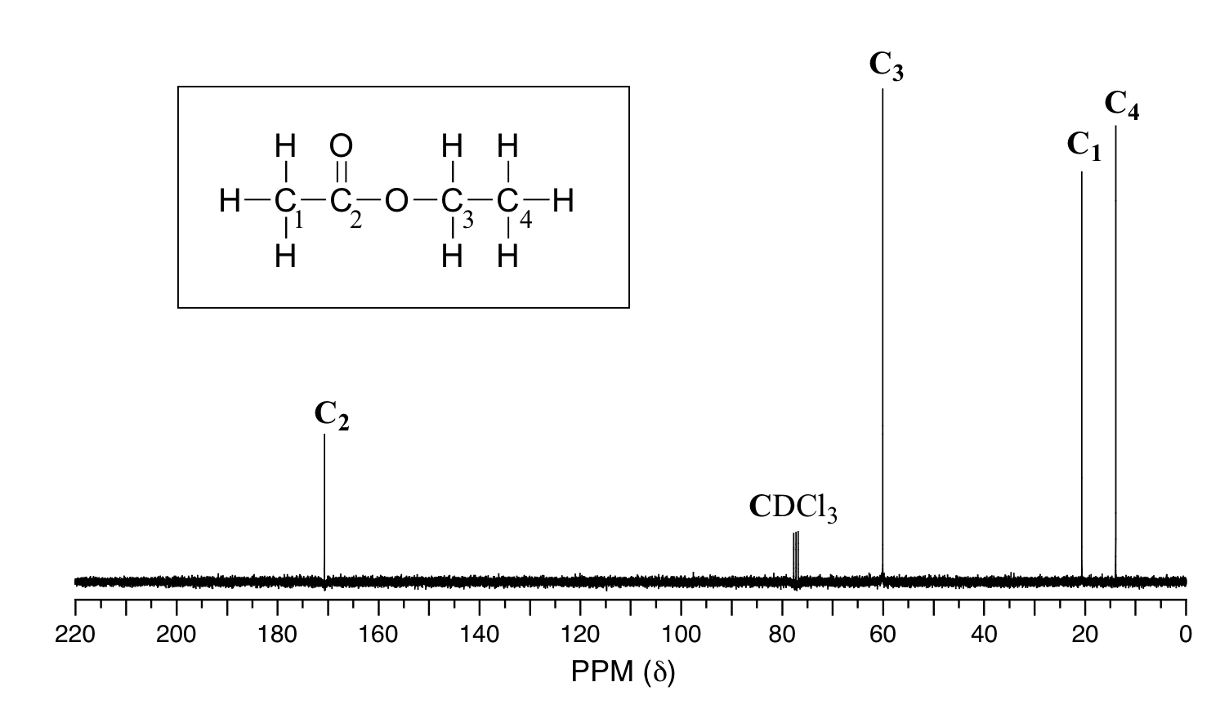

Slide 9
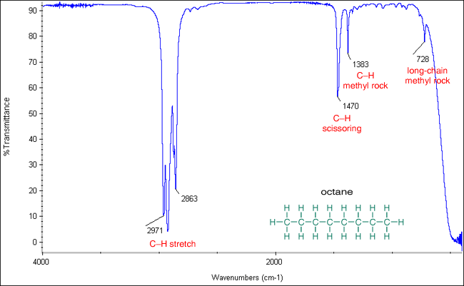
IR of alkane
3000 cm⁻¹

Slide 10
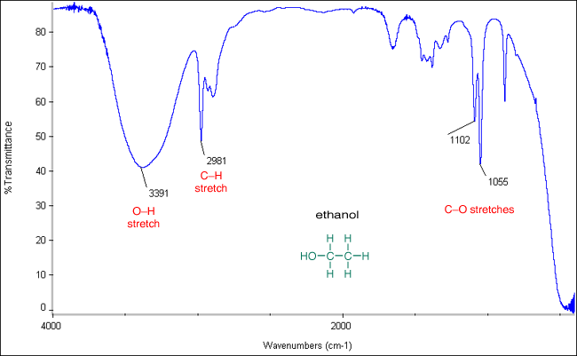
IR of alcohol…
Broad, strong band near 3400 => OH

Slide 11
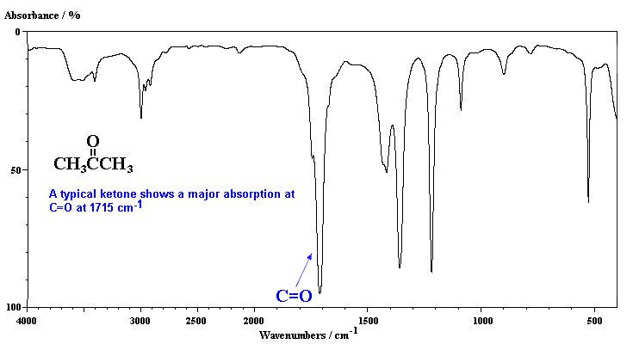
IR of Ketone (Acetone)
1700 cm⁻¹ very strong is C=O
3000 cm⁻¹

Slide 12
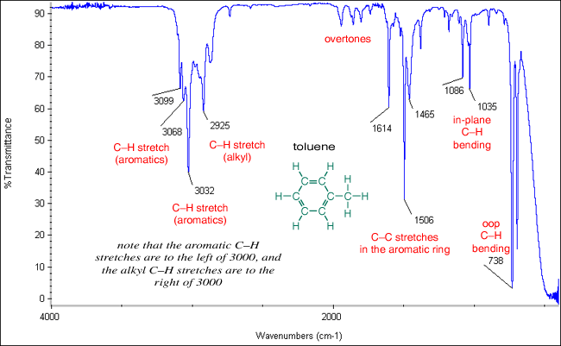
IR of Aromatic (toluene)
C=C ring breathing
overtones
Lines above 3000 cm⁻¹

Slide 13
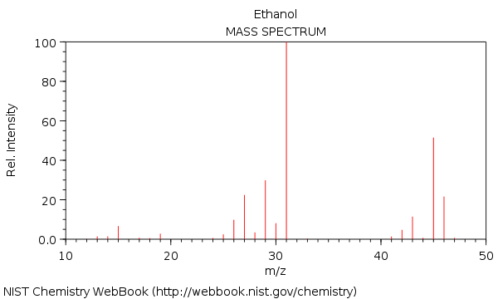
MW=46 g/mol
P-CH₃
31
P-H
45
P-OH=C₂H₅
29
46
CH₃
P=parent
15

Slide 14
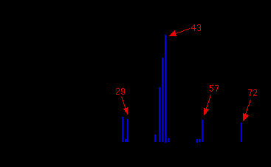
Mass spectrum of n-pentane
MW=72 g/mol
P- CH₂CH₃
Fragment masses
P-CH₃
CH₂CH₃
Parent=P

Slide 15

Please stop. I haz headache now from diz stuff!

