Slide 1
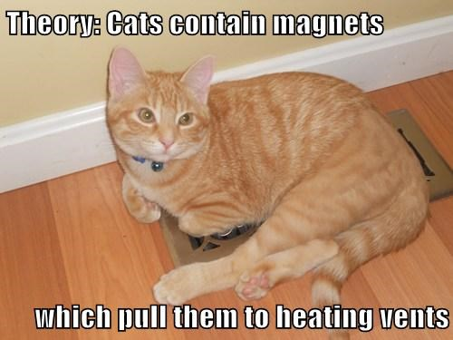
Introduction to Nuclear Magnetic Resonance Spectroscopy (NMR)

Slide 2
NMR effect is the magnetic equivalent of a atom-sized top in precession
Top in gravity field
https://www.youtube.com/watch?v=4QGQU60C4GQ
Equivalent model for protons in magnetic field
https://www.youtube.com/watch?v=p3WnFYBnghU

Slide 3
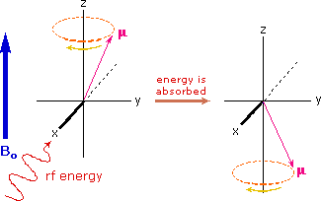
hf

Slide 4
Naked proton piece
Chemical shielding piece
f = 4.265* 10⁷* H_{a}(1-s) Hz
H_{a} = permanent magnet field strength
chemical shift=δ(ppm) = [f(sample) -f(TMS)] *10⁶
f(TMS)

Slide 6
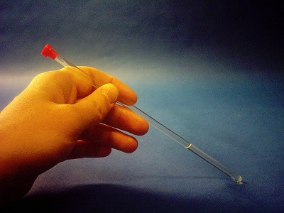
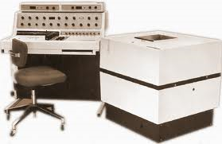
Old school permanent magnet room temperature CW 360L Varian NMR

Slide 7
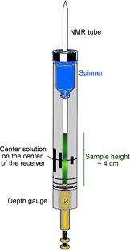
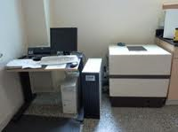
Anasazi `FT’ digital replacement for analog signal and tuning module

Slide 8
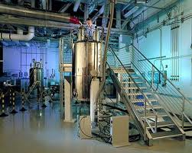

Superconducting research NMR (0.75 M$)
for molecules

Slide 9
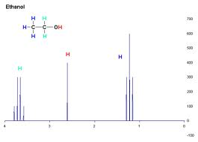
High resolution, hyperfine split ¹H NMR signal of ethanol

Slide 10
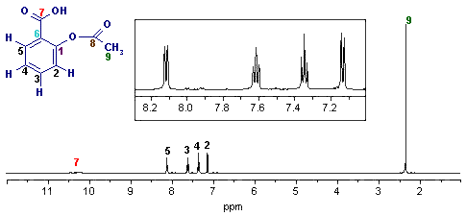
High Resolution NMR of aspirin (o-acetylsalicylic acid)
5 3 4 2

Slide 11
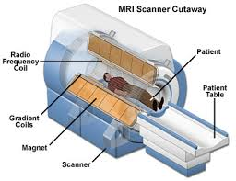
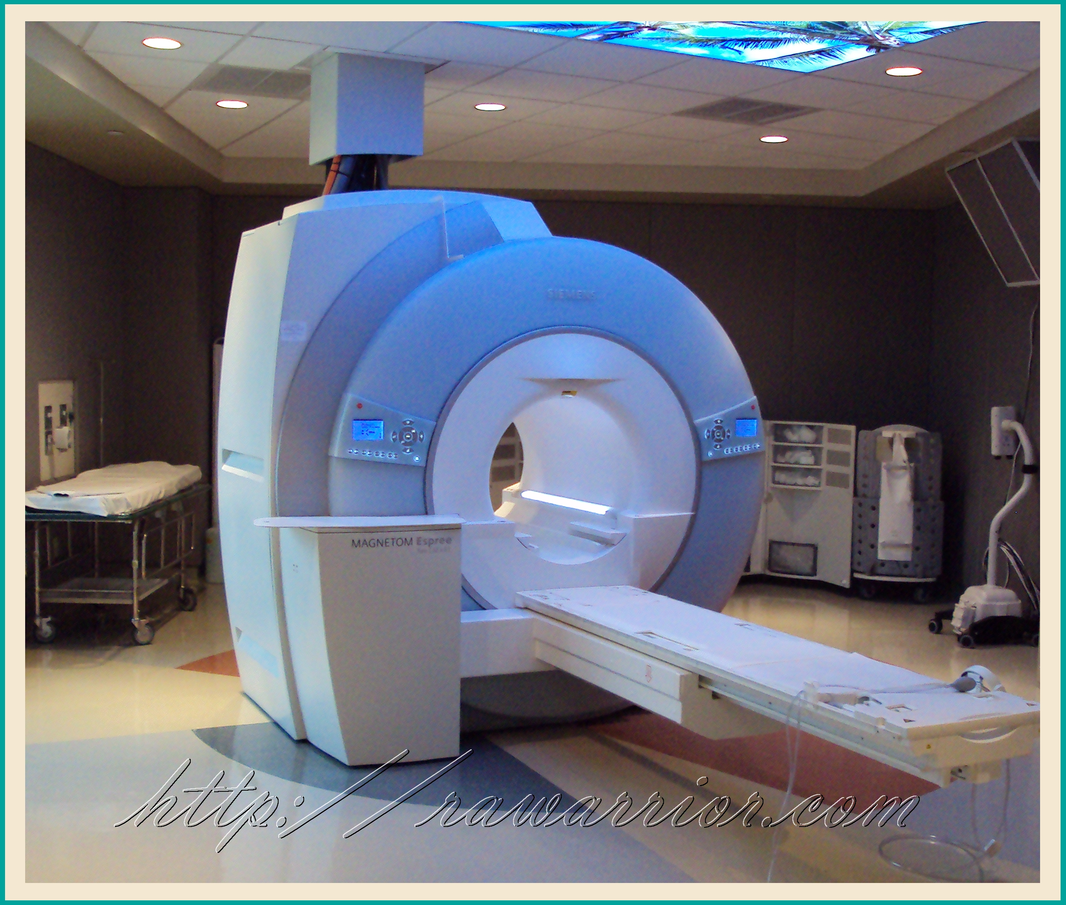
MRI = magnetic resonance imaging=NMR for humans 3M$

Slide 12
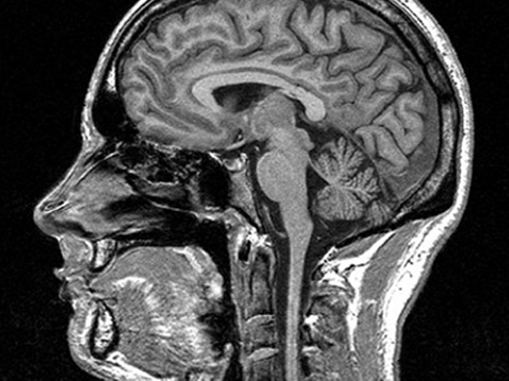
MRI of a patient’s head (in cross-section)

Slide 13
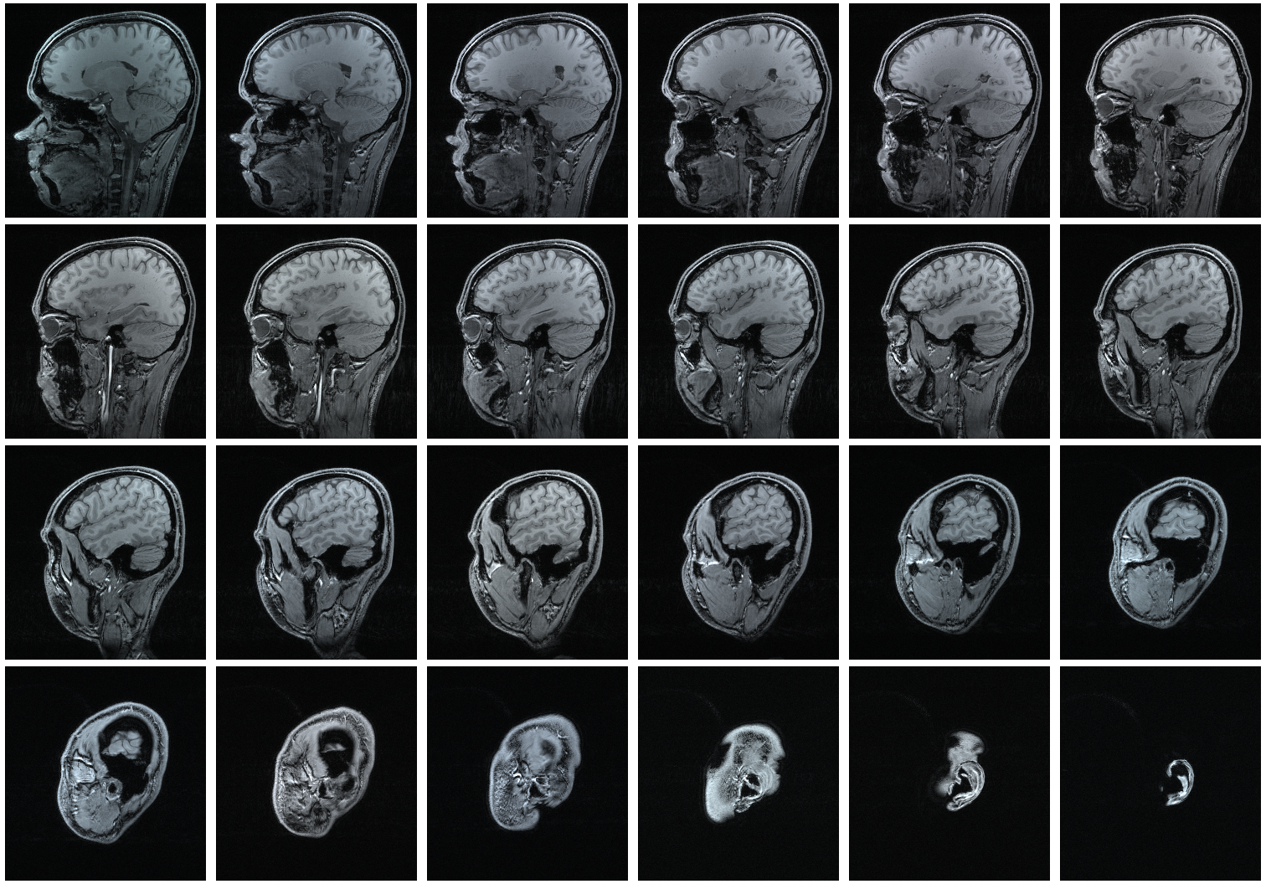
Several MRI cross-sections taken serially

Slide 14


