Slide 1
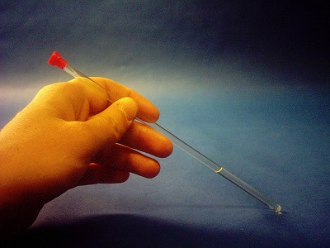
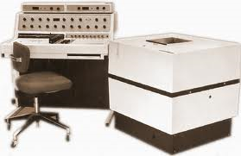
Old school permanent magnet room temperature CW 360L Varian NMR

Slide 2
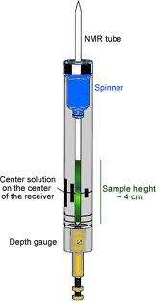
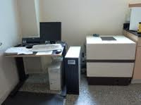
Anasazi `FT’ digital replacement for analog signal and tuning module

Slide 3
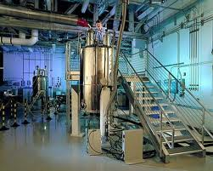

Superconducting research NMR (0.75 M$)
for molecules

Slide 4
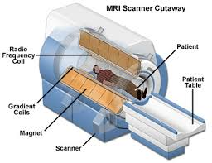
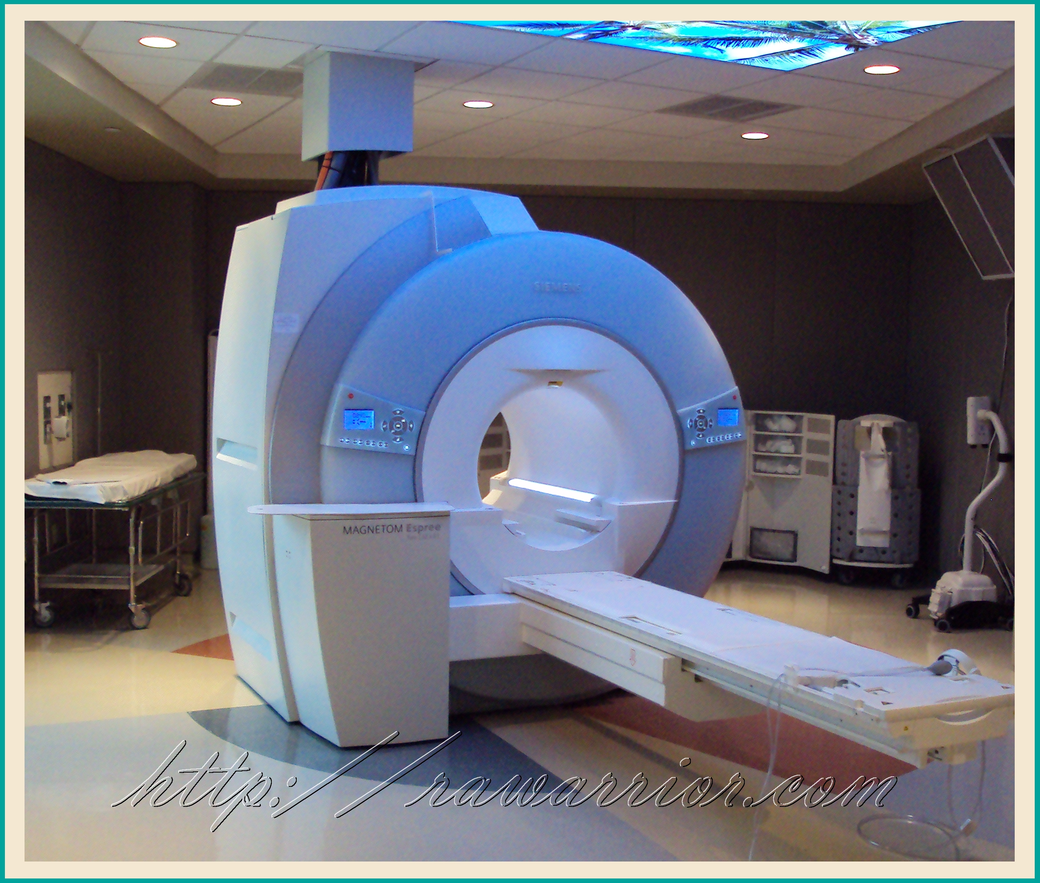
MRI = magnetic resonance imaging=NMR for humans 3M$

Slide 5
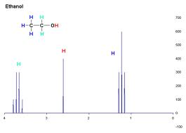
High resolution, hyperfine split ¹H NMR signal of ethanol

