Slide 1
Electrolysis of water with sunlight demo

Slide 2
Example of the interplay of Stoichiometry and the Ideal Gas Law
A 1.0 gram liquid sample of X composed of H and O, is decomposed into O₂ and H₂ gas in an initially evacuated 10 L volume. The total pressure of the two gases after decomposition is 0.1447 atm at 300 K.
Is the liquid sample is H₂O (water), H₂O₂ (hydrogen peroxide) or H₂O₃ (HOOOH= Hyperperoxide)?
1) How many moles of X start in the 10 L vessel ?
IF…
X is H₂O
X is H₂O₂
X is H₂O₃
MW (g/mol)
18 34 50
Initial
moles
1.0/18=0.0555
1.0/34=0.0294
1.0/50=0.020

Slide 3
2) Given assumed ID for X, what does it decompose to ??
H₂O(l) → H₂(g) + ½ O₂(g)
H₂O₂(l) →H₂(g) + O₂(g)
H₂O₃(l)→ H₂(g) + 3/2 O₂(g)
1 mole H₂O in→ 1 ½ moles gas out
1 mole H₂O₂ in→ 2 moles gas out
1 mole H₂O₃ in→ 2½ moles gas out
X is…
Moles X in
Predicted moles gas out=n
Predicted P=nRT/V*
H₂O
1.0/18=0.0555
0.0555* 1 ½
=0.0832
=0.205 atm
H₂O₂
1.0/34=0.0294
0.0294 * 2
=0.0588
=0.1447 atm
H₂O₃
1.0/50=0.020
0.020 * 2.5
=0.050
=0.123 atm
*From original problem statement
“… The total pressure of the two gases in 10 L after decomposition is 0.1447 atm at 300 K. “
*=n*0.082*300/10
=n*2.46
√ X is H₂O₂ (hydrogen peroxide)

Slide 4
Another ‘Old School’ Ideal Gas Problem
A sample of PCl₅ weighing 2.69 grams is placed in a 1.000 liter flask and vaporized completely at 523.15 K . The final pressure observed at this temperature is 1.000 atmospheres. Note that some, but not all of the PCl₅ decomposes according to the equation:
MW= 208.25 137.35 70.90 g/mol
PCl₅ (g) ---------> PCl₃ (g) + Cl₂ (g)
What are the pressures ( in atm) of PCl₅ , PCl₃ and Cl₂ once the reaction is complete and at equilibrium ?

Slide 5
Initially
V=1
T=523.15
Mass PCl₅=2.69 g
Finally
V=1
T=523.15
P=1 atm
(some PCl₅ still present)
n_{final} = PV
RT
Ideal Gas Law=>
n_{final} = 1*1_
0.082*523.15
= 0.0233 mol

Slide 6
Initially
V=1
T=523.15
Mass PCl₅=2.69 g
Finally
V=1
T=523.15
P=1 atm
(some PCl₅ still present)
Mole Chemistry =>
MW= 208.25 137.35 70.90 g/mol
PCl₅ (g) ---------> PCl₃ (g) + Cl₂ (g)
Initial moles
2.69/208.25
= 0.01292
0
0
Final moles
0.01292-x
x
x

Slide 7
Ideal Gas Law=>
Mole count =>
n_{FINAL} = 0.0233
Moles PCl₅= 0.01292-x
Moles PCl₃=x
Moles Cl₂ =x
n_{final} = 0.01292-x + x +x
n_{final} = 0.01292- + x
Combine results:
n_{f} = 0.0233= 0.01292 + x
∴x=0.0233-0.01292=0.01038

Slide 8
Finally
V=1
T=523.15
P=1 atm
(some PCl₅ still present)
x= 0.01038= moles PCl₃ = moles Cl₂
P_{x} = xRT
V
= 0.01038*0.08206*523.15
1
=0.4456 atm
1= P(PCl₅) + P(PCl₃) + P(Cl₂)
1= P(PCl₅) + 0.4456 + 0.4456
P(PCl₅) = 1- 0.4456 -0.4456
=0.109 atm

Slide 9

The not-so-obvious meanings of PV=nRT why do they call it the Ideal Gas law ??
No dependence on gas velocities….speed vs mass appear to cancel each other’s effects out exactly…(???)
1 mole SF₆ vs 1 mole N₂ vs 1 mol He at 273.15 K in 22.41 L
SF₆
Observed pressure
1.0
N₂
1.0
He
1.0

Slide 10
What relationship between mass (m) and velocity (v) must exist for gas particles big and small to have same pressure even if they move at different velocities?
Physics thinking trip:
energy= E = ½ mv²
SPECULATION: If each gas molecule- irrespective of mass- has same energy then each would hit the wall with same energy:
E₁ = E₂
½ m₁ v₁² = ½ m₂v₂²
⇒ v₁² /v₂ ² = (v₁ /v₂)² = m₂/m₁ .
OR v₁/v₂ = (m₂/m₁)^{1/2} Graham’s law

Slide 11

Graham’s law in pictures
2.46 meter Glass tube
1.46 meter
(41% of tube length)
(59% of tube length)
1 meter
NH₃(g)
m₁ =17 g/mol
NH₄Cl(s) powder forms
Where HCl and NH₃ meet
HCl(g)
m₂=36.5 g/mol
Chemical factoid:
NH₃(g) +HCl(g)→NH₄Cl(s)
a white powder
Testing Graham’s Law:
v₁/v₂ = (m₂/m₁)^{1/2}
=1.46
v(NH₃)/v(HCl) = (36.5/17)^{1/2}
∴Predicts that if HCl travels 1 meter, NH₃ will travel 1.46 meters in the same time
See FAVORITES LIST FOR DEMO

Slide 12
The not-so-obvious meanings of PV=nRT (cont.)
There is no account of crowding or gas density
….all the volumes V are equal at constant P,T
n= (P/RT) V = const*V equal volumes- equal moles (Avogodro’s law)
SF₆
N₂
He

Slide 13
The not-so-obvious meanings of PV=nRT
(cont.)
Your common sense says ball will bounce so…
The is no time variable in the equation…
PV=nRT implies ball bounces forever without stopping

Slide 14
The ideal part explained
(kinetic theory of gases: )
If PV=nRT…gases are ~ ideal particles which are…:
point masses (no volume, just masses-else crowding a problem)
Non-interacting (else they would stick and condense eventually)
hit walls elastically (no loss of energy, else they would start to pile up at the bottom of the closed cylinder)
No dependency on gas identity…all gas particles big and small seem to have same pressure even if they move at different speeds
=>Grahams Law seems to apply: (v₁/v₂)² = m₂/m₁

Slide 15
Assuming all gas molecules have same energy recapitulates Graham’s law for gases, so what dictates energy value ?
Big idea: E(gas) ~ nRT
R tells us something fundamental about how gases move and how that movement is connected to T

Slide 16
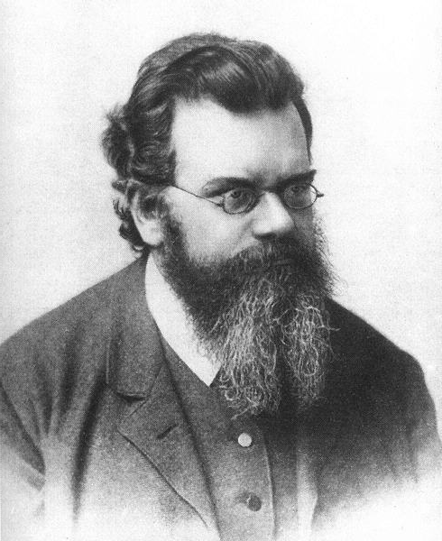
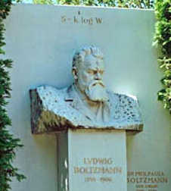
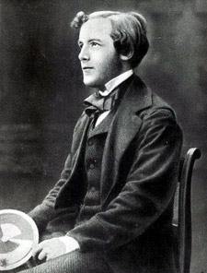

Main Inventors of this improbable kinetic model of ideal gases
Ludwig von Boltzmann (considered a total loon)
publishes his big idea (connected to T~RT)…on his grave
James Clerk Maxwell
(..considered too young to be taken seriously even with 2 doctorates in Physics and Math)

Slide 17
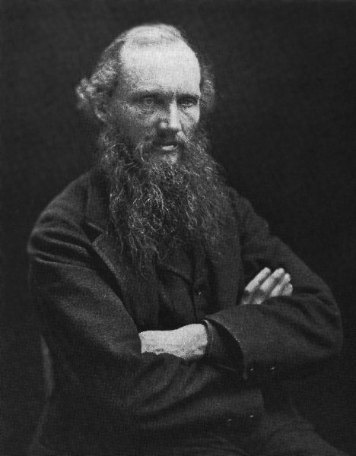
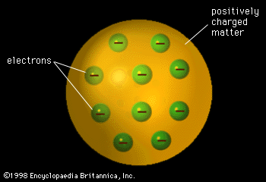
Also partly responsible for the improbable model of ideal gases…another `wacko’…
“X-rays will prove to be a hoax."
“There is nothing new to be discovered in physics now. All that remains is more and more precise measurement." (1896)
"I can state flatly that heavier than air flying machines are impossible."
Lord Kelvin: knighted wacko
“I give you the likely shape of atoms…”

Slide 18
moral
Sometimes crazy and naïve works just fine…
PV = nRT !!
Ludwig von Boltzmann
James Clerk Maxwell
Lord Kelvin

