Slide 1
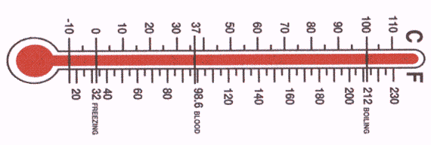
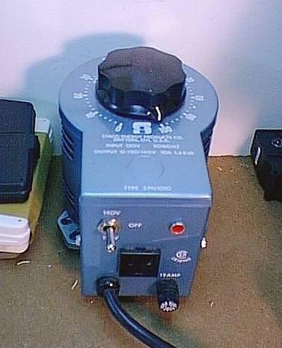
Ideal Gas Law Derived
P (piston head)
Hypothetical Gas Property testing apparatus
piston walls
insulation
T
n
V (varies
GAS
GAS VALVE
Heating/cooling coils

Slide 2
Ideal Gas derived:
Why gas identity not important
Vary gas and fix three out of four gas variables…
Variables fixed at constant values (`STP’)
..see what happens
Gas varied
T(^{O}C) P(atm) n(moles)
V(obs)
H₂(2)
He(4)
N₂(28)
CO₂(44)
SF₆ (146)
0º 1 1 22.414
0º 1 1 22.414
0º 1 1 22.414
0º 1 1 22.414
0º 1 1 22.414
STP =Standard Temperature & Pressure ( and n=1)
Gas ID (and size) not important

Slide 3
Ideal Gas Law derived (cont.): origin of R
What happens if we hold different sets of three variables constant and watch the fourth for a given gas ?
Anything constant ??
P(atm) V(L) T(K) n(moles)
PV/nT
16.43
2 400 1
0.08206
1
24.65
300 1
0.08206
5 2 300
0.406
0.08206
3
0.08206
5 5
101
PV = 0.08205746 =R (a constant)
nT
Or…
PV =nRT

Slide 4


Exercise #9: Ideal gas law problems…when n is the focus
Exercise 9.1 problem 4
Exercise 9.3 problems 1→3
The relevant equation:
PV=nRT

Slide 5
The Ideal Gas Law is more than just about plugging into PV=nRT to find P,V,n and/or T….. we have a new way to measure moles:
n (moles) = mass
MW
`OLD WAY
NEW WAY
n(moles) = PV
RT

Slide 6
How the Ideal Gas Law set Chemistry free
…or how we came to know that water is H₂O and not H₂O₂, HO₂ , H₃O, H₃₇O₂₂ ….(before we knew the atomic and molecular weights of anything for sure)
PV=nRT
=> V= nRT/P
THE BIG IDEA (AVOGADRO’S REAL CONTRIBUTION)
∴ At constant T and P
equal volumes => equal moles
independent of gas identity

Slide 7
The critical experiment….
2) `carefully zap’ (somehow) with electricity
3) Measure volume of gas products (Hydrogen and Oxygen)
H
1) Start with 1 volume, V of water in vapor phase
O
∴Water = 2 parts H and 1 part O

Slide 8
How it’s really done…electrolysis example of `critical’ experiment: seeing the 2:1 nature of water

Slide 9
Example of the interplay of Stoichiometry and the Ideal Gas Law
A 1.0 gram liquid sample of X composed of H and O, is decomposed into O₂ and H₂ gas in an initially evacuated 10 L volume. The total pressure of the two gases after decomposition is 0.1447 atm at 300 K.
Is the liquid sample is H₂O (water), H₂O₂ (hydrogen peroxide) or H₂O₃ (HOOOH= Hyperperoxide)?
1) How many moles of X start in the 10 L vessel ?
IF…
X is H₂O
X is H₂O₂
X is H₂O₃
MW (g/mol)
18 34 50
Initial
moles
1.0/18=0.0555
1.0/34=0.0294
1.0/50=0.020

Slide 10
2) Given assumed ID for X, what does it decompose to ??
H₂O(l) → H₂(g) + ½ O₂(g)
H₂O₂(l) →H₂(g) + O₂(g)
H₂O₃(l)→ H₂(g) + 3/2 O₂(g)
1 mole H₂O in→ 1 ½ moles gas out
1 mole H₂O₂ in→ 2 moles gas out
1 mole H₂O₃ in→ 2½ moles gas out
X is…
Moles X in
Predicted moles gas out=n
Predicted P=nRT/V*
H₂O
1.0/18=0.0555
0.0555* 1 ½
=0.0832
=0.205 atm
H₂O₂
1.0/34=0.0294
0.0294 * 2
=0.0588
=0.1447 atm
H₂O₃
1.0/50=0.020
0.020 * 2.5
=0.050
=0.123 atm
*From original problem statement
“… The total pressure of the two gases in 10 L after decomposition is 0.1447 atm at 300 K. “
*=n*0.082*300/10
=n*2.46
√ X is H₂O₂ (hydrogen peroxide)

