Slide 1


Exercise #9: Typical Gas Problems where n is constant
P₁V₁ = P₂ V₂
T₁ T₂
The relevant equation
Combined gas law equation (continued): exercise 9 (back page

Slide 2
COMBINED GAS LAW (constant n)
P₁V₁= P₂V₂
T₁ T₂
Combined Law can be derived from PV=nRT
If n constant
Ideal Gas Law
(n,T,V and P can vary)
New thing #2:
No reference to identity of gas…
n applies for any gas
New thing #1:
R= Ideal Gas Constant
PV=nRT

Slide 3


☺ All 4 gas variables are explicit
R= 0.08206 atm L/K mole
Chemists’ prefer this unit
Cats rule, dogs drool
☹ ??
R= 8.314 J/K mole
physicists’ prefer this unit

Slide 4
Deriving the Combined Gas Law from the Ideal Gas Law
Gas in State 1
Gas in State 2
P₁V₁=n₁RT₁
P₂V₂=n₂RT₂
Rearrange Ideal gas equation to solve for n
P₁V₁= n₁
RT₁
P₂V₂= n₂
RT₂
If n₁=n₂, e.g. n is the same constant value for both states, the two equations are equal
P₁V₁ =
RT₁
P₂V₂
RT₂
Combined gas law
(n constant)

Slide 5
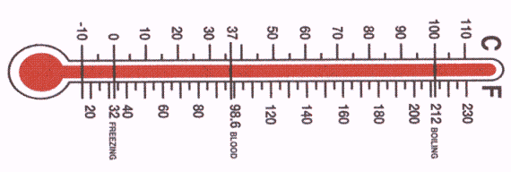
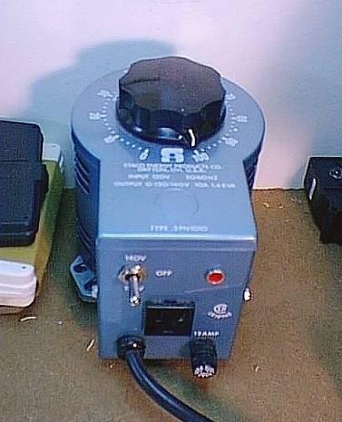
Ideal Gas Law Derived
P (piston head)
Hypothetical Gas Property testing apparatus
piston walls
insulation
T
n
V (varies
GAS
GAS VALVE
Heating/cooling coils

Slide 6
Ideal Gas derived: Avogodro’s law and n
What happens when we turn the gas on and increase n ?? (T,P constant ??) (see also exercise 8.1, problem 4)
… LIKE BLOWING UP A BALLOON
n ∝ V
n₁ = V₁
n₂ V₂
V
n₁ = n₂
V₁ V₂
n
Or… rearranging:
Avogodro’s law

Slide 7
Avogodro’s Law is embedded in Ideal Gas law
n₁ = n₂
V₁ V₂
Avogodro’s law at constant T,P
Ideal Gas law
P₁V₁=n₁RT₁
P₂V₂=n₂RT₂
P₁V₁= R
n₁T₁
P₂V₂=R
n₂T₂
Ideal Gas law rearranged
P₁V₁= R
n₁T₁
= P₂V₂
n₂T₂
Avogodro’s experiment holds P and T constant
V₁ = V₂
n₁ n₂
n₁ = n₂
V₁ V₂
Invert…
√

Slide 8
Ideal Gas derived (cont.):
Why gas identity not important
Vary gas and fix three out of four gas variables…
Variables fixed at constant values (`STP’)
..see what happens
Gas varied
T(^{O}C) P(atm) n(moles)
V(obs)
H₂(2)
He(4)
N₂(28)
CO₂(44)
SF₆ (146)
0º 1 1 22.414
0º 1 1 22.414
0º 1 1 22.414
0º 1 1 22.414
0º 1 1 22.414
STP =Standard Temperature & Pressure ( and n=1)
Gas ID (and size) not important

Slide 9
Ideal Gas Law derived (cont.): origin of R
What happens if we hold different sets of three variables constant and watch the fourth for a given gas ?
Anything constant ??
P(atm) V(L) T(K) n(moles)
PV/nT
16.43
2 400 1
0.08206
1
24.65
300 1
0.08206
5 2 300
0.406
0.08206
3
0.08206
5 5
101
PV = 0.08205746 =R (a constant)
nT
Or…
PV =nRT

Slide 10
Exercise #9: Ideal gas law problems…when n is the focus
Exercise 9.1 problem 4
Exercise 9.3 problems 1→3
The relevant equation:
PV=nRT

