Slide 1
Pressure in `lowbrow’ Chem speak: barometers ( see p 284)
Evacuated space
External atmospheric pressure, P
P in mm Hg
A Torricelli barometer
Hg

Slide 2
Pressure in `lowbrow’ Chem speak:
barometers ( see p 284)
outer space
Pressure =1 atm at sea level
~20 mile tall
column of air in Earth’s atmosphere creates pressure
Earth
Edge of Earth’s atmosphere

Slide 3
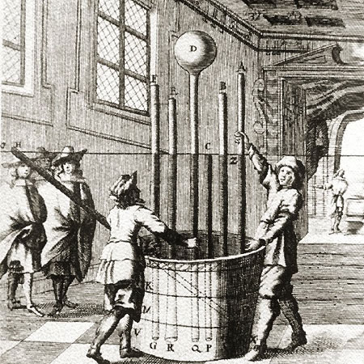
Atmosphere demonstrated the Italian Way (BIG time Torricelli Barometers)
Lesson from 17th century picture
Height of Hg columns is independent of cross-sectional areas of tubes
Vat of mercury (Hg)

Slide 4
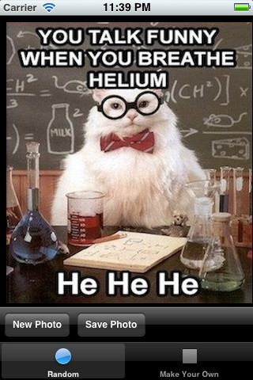
in CHEMISTRY LAND
Pressure units
1 atmosphere =760 mm Hg
= 760 torr
=10336 mm H₂O
=33.9 ft H₂O
= 20 miles of air

Slide 5

Pressure units in PHYSICS COUNTRY
Physics speak
1 atm = 101.3 kPa
Confusing Compromise
1 bar =100 kPa= 0.986 atm

Slide 6

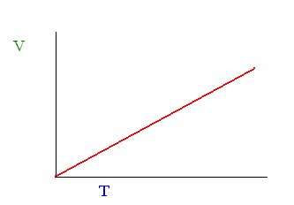
Empiric gas law derivations: the common sense way
P, T, V, n
Piston in ice
V up
n P
T up ⇒ ??
T down⇒ ??
V down
CHARLES’ LAW
T ~ V
V₁ = T₁
V₂ T₂
V₁/T₁= V₂/T₂

Slide 7


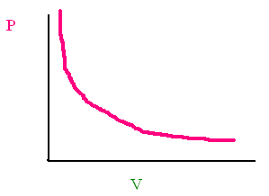
Empiric gas law derivations: the common sense way (cont.)
n T
P up⇒ ??
V down
P down⇒ ??
V up
BOYLE’S LAW
P ~ 1/V
P₁ = 1/V₁
P₂ 1/V₂
P₁V₁=P₂V₂

Slide 8

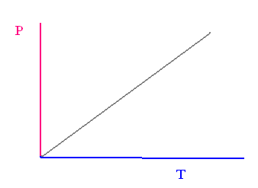
Empiric gas law derivations: the common sense way (cont.)
T up⇒ ??
P up
n V
T down⇒ ??
P down
GAY-LUSSAC’S LAW
T ~ P
T₁ = P₁
T₂ P₂
P₁/T₁= P₂/T₂

Slide 9
How Boyle, Gay-Lussac and Charles Laws are reflected in the Combined Gas Law
Conditions
Gas Law Equation
Name of Gas Law
P₁V₁ = P₂ V₂
T₁ T₂
constant
n
Combined Gas Law
constant n,P
P₁V₁ = P₂ V₂
T₁ T₂
Charles’ Law (P₁=P₂)
P₁V₁ = P₂ V₂
T₁ T₂
constant n, T
Boyle’s Law (T₁=T₂)
P₁V₁ = P₂ V₂
T₁ T₂
Gay-Lussac’s Law
(V₁=V₂)
constant n, V

Slide 10


Exercise #9: Typical Gas Problems where n is constant
P₁V₁ = P₂ V₂
T₁ T₂
The relevant equation
Combined gas law equation

