Slide 1
One other unique and highly useful feature of redox reactions…
The oxidation and reduction can be separated in space and you can still run the reaction
as a `cell’ or ‘battery’

Slide 2
Characteristics of redox reactions
Heat and light common
Reactions are often spectacular (way better than acid base)
Electronic balance altered (of course)
Often accompanied by major decomposition or combination

Slide 3
Example: Cu-Mg cell
The complete redox reaction
Gains 2e⁻
Cu²⁺ + Mgº → Cuº +Mg²⁺
Loses 2e-
Reduction half reaction:
Cu²⁺ +2e⁻ → Cuº
cathode
Oxidation half reaction:
Mgº → Mg²⁺ +2e-
anode
Cu²⁺ + Mgº → Cuº +Mg²⁺

Slide 4
Demos of Cu-Mg cell (battery)
Potato clock

Slide 5
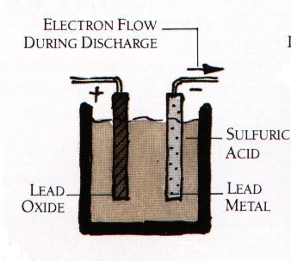
exists as PbSO₄ (white deposit oflead(II) sulfate) on surface of plates after discharge
2e⁻ + Pb⁴⁺→ Pb²⁺
Pbº→ Pb²⁺ +2e⁻
anode
cathode
CAR BATTERY EXAMPLE
Turn on ignition…
Pb⁴⁺ is black PbO₂ coating

Slide 6
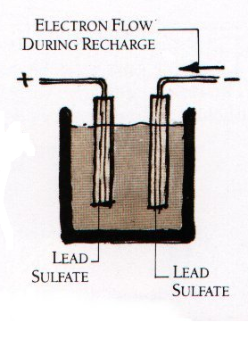
anode
cathode
Pb²+→ Pb ⁴⁺ +2e⁻
Pb²⁺ +2e^{-→} Pbº
Car running on gas…alternator reverses flow

Slide 7
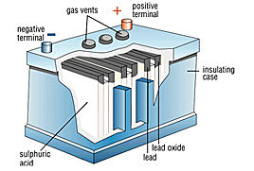
Some practical notes
Over charging makes H₂
6 pairs of plates connected in series and operating at ~2V each=12V
“cranks”
~600-850 amps (A)
12 V_{DC} * 850 A ~12 kW
vs common house main
70 V_{DC eq} *200 A= 14 kW
~2 volts

Slide 8
Exercise 9a and 9b… review of classical reaction ideas and language

Slide 9
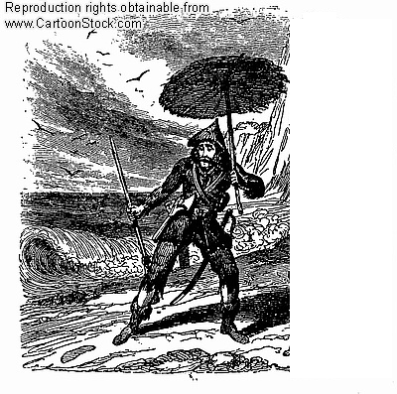

At the “Cultural divide”
Robinson Crusoe all alone
Faceless crowd at college football game
“Allein, allein, allein…”
Road trip so far … individual molecular/atomic properties
Chapter 7: aggregate interactions between molecules/atoms

Slide 10
Pressure (P) concepts & measures in “Physics-speak “(see p 283-4 )
Physics speak
P = Force
Area
P = newtons
m²
Physics units
=kg*m/s²
= kg
m s²
m*m

Slide 11

Pressure (P) concepts & measures in “Physics-speak “(see p 283-4 )
∴
1 kg = 1 Pascal (Pa)
m s²

Slide 12

Some lowbrow chem insights
into Pressure
Getting hammered
Bed of nails

Slide 13

Pressure expresses how much a (constant) impressed force is spread out…
MORE AREA, LOWER PRESSURE
LESS AREA, HIGHER PRESSURE

Slide 14
Pressure in `lowbrow’ Chem speak: barometers ( see p 284)
Evacuated space
External atmospheric pressure, P
P in mm Hg
A Torricelli barometer
Hg

Slide 15
Pressure in `lowbrow’ Chem speak:
barometers ( see p 284)
outer space
Pressure =1 atm at sea level
~20 mile tall
column of air in Earth’s atmosphere creates pressure
Earth
Edge of Earth’s atmosphere

Slide 16
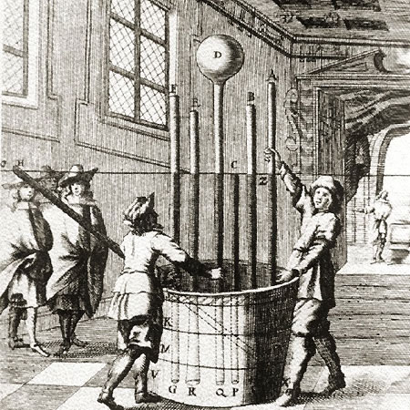
Atmosphere demonstrated the Italian Way (BIG time Torricelli Barometers)
Lesson from 17th century picture
Height of Hg columns is independent of cross-sectional areas of tubes
Vat of mercury (Hg)

Slide 17
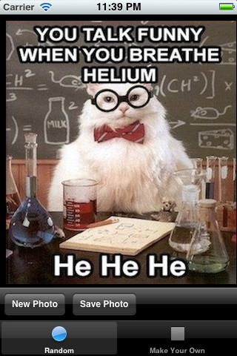
in CHEMISTRY LAND
Pressure units
1 atmosphere =760 mm Hg
= 760 torr
=10336 mm H₂O
=33.9 ft H₂O
= 20 miles of air

Slide 18

Pressure units in PHYSICS COUNTRY
Physics speak
1 atm = 101.3 kPa
Confusing Compromise
1 bar =100 kPa= 0.986 atm

Slide 19


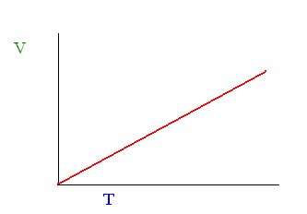

Empiric gas law derivations: the common sense way
P, T, V, n
T up ⇒ ??
V up
n P
T down⇒ ??
V down
CHARLES’ LAW
T ~ V
V₁ = T₁
V₂ T₂
V₁/T₁= V₂/T₂

Slide 20


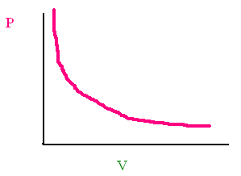
Empiric gas law derivations: the common sense way (cont.)
n T
P up⇒ ??
V down
P down⇒ ??
V up
BOYLE’S LAW
P ~ 1/V
P₁ = 1/V₁
P₂ 1/V₂
P₁V₁=P₂V₂

Slide 21

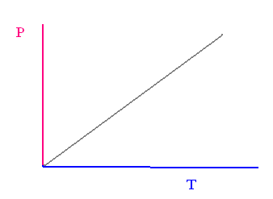
Empiric gas law derivations: the common sense way (cont.)
T up⇒ ??
P up
n V
T down⇒ ??
P down
GAY-LUSSAC’S LAW
T ~ P
T₁ = P₁
T₂ P₂
P₁/T₁= P₂/T₂

Slide 22
How Boyle, Gay-Lussac and Charles Laws are reflected in the Combined Gas Law
Conditions
Gas Law Equation
Name of Gas Law
P₁V₁ = P₂ V₂
T₁ T₂
constant
n
Combined Gas Law
constant n,P
P₁V₁ = P₂ V₂
T₁ T₂
Charles’ Law (P₁=P₂)
P₁V₁ = P₂ V₂
T₁ T₂
constant n, T
Boyle’s Law (T₁=T₂)
P₁V₁ = P₂ V₂
T₁ T₂
Gay-Lussac’s Law
(V₁=V₂)
constant n, V

