Slide 1
SPECTACULAR REDOX REACTION BEHAVIOR
1) Thermite reaction
1)assign oxidation #
0 +3 -2 0 +3 -2
2Alº(s) + Fe₂O₃ (s)→2Fe⁰ (liq)+Al₂O₃(s)
2) Who does what?
Which element oxidized ?
Al
Which element reduced ?
Fe
3)let’s see the reaction in the `flesh’

Slide 2
SPECTACULAR REDOX REACTION BEHAVIOR (continued)
Example 2: Combustion
1) Assign Oxidation #
-4 +1 0 +4 -2 +1 -2
CH₄ +2O₂ → CO₂ +2H₂O
2) Who does what?
Which element oxidized ?
C
Which element reduced ?
O
3) BURN BABY, BURN

Slide 3
SPECTACULARF REDOX REACTION BEHAVIOR (continued)
Example 3: Combination redox
1) Assign Oxidation #
0 0 +1 -1
:
2Na + Cl₂ → NaCl (table salt)
2) Who does what?
Which element oxidized ?
Which element reduced ?
3) Let’s see it

Slide 4


SPECTACULAR REDOX REACTION BEHAVIOR (continued)
4) Decomposition redox: aka The DEATH TO skittles reaction
0 +1 -2 +1 +7 -2 +1 -2 +4 -2 +1 -1
C₁₂H₂₂O₁₁ + 8KClO₃ → 11H₂O + 12CO₂ + 8KCl
Ox
Red
In class demo

Slide 5
One other unique and highly useful feature of redox reactions…
The oxidation and reduction can be separated in space and you can still run the reaction
as a `cell’ or ‘battery’

Slide 6
Characteristics of redox reactions
Heat and light common
Reactions are often spectacular (way better than acid base)
Electronic balance altered (of course)
Often accompanied by major decomposition or combination

Slide 7
Example: Cu-Mg cell
The complete redox reaction
Gains 2e⁻
Cu²⁺ + Mgº → Cuº +Mg²⁺
Loses 2e-
Reduction half reaction:
Cu²⁺ +2e⁻ → Cuº
cathode
Oxidation half reaction:
Mgº → Mg²⁺ +2e-
anode
Cu²⁺ + Mgº → Cuº +Mg²⁺

Slide 8
Demos of Cu-Mg cell (battery)
Potato clock

Slide 9
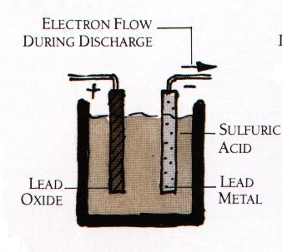
exists as PbSO₄ (white deposit oflead(II) sulfate) on surface of plates after discharge
2e⁻ + Pb⁴⁺→ Pb²⁺
Pbº→ Pb²⁺ +2e⁻
anode
cathode
CAR BATTERY EXAMPLE
Turn on ignition…
Pb⁴⁺ is black PbO₂ coating

Slide 10
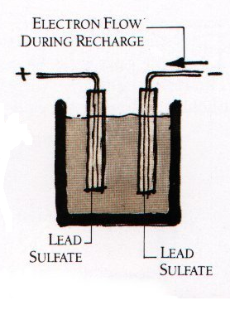
anode
cathode
Pb²+→ Pb ⁴⁺ +2e⁻
Pb²⁺ +2e^{-→} Pbº
Car running on gas…alternator reverses flow

Slide 11
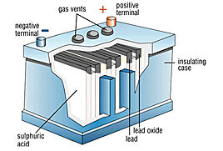
Some practical notes
Over charging makes H₂
6 pairs of plates connected in series and operating at ~2V each=12V
“cranks”
~600-850 amps (A)
12 V_{DC} * 850 A ~12 kW
vs common house main
70 V_{DC eq} *200 A= 14 kW
~2 volts

Slide 12
Exercise 9a and 9b… review of classical reaction ideas and language

