Slide 1

OXIDATION-REDUCTION (REDOX) REACTIONS see pages text 458-466
REDOX REACTIONS ALL INVOLVE CHANGES IN ELECTRON OWNERSHIP
EXAMPLE #1:
Mgº + 2H⁺ → Mg²⁺ + H₂
0
+2
Mg loses 2 e⁻
Losing is oxidation
+1
0
Each H+ gains 1 e-
Gaining is reduction

Slide 2
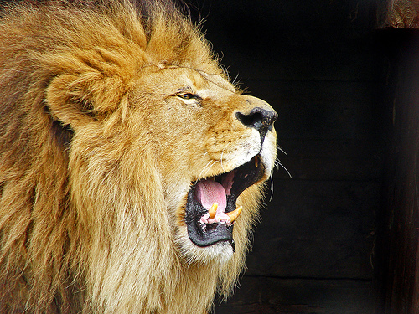
Oxidation-Reduction:
Remembering which is which…..
Leo-Ger
Lose electrons = oxidation
Gain electrons =reduction

Slide 3
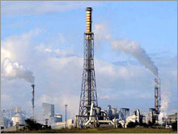
Oxidation-Reduction:
Remembering which is which…..
Oil-Rig
Oxidation is losing
Reduction is gaining

Slide 4
How to know if a reaction is a `redox’ reaction:
assign OXIDATION NUMBERS
RULES: (SEE PAGE 460 TABLE 10.2)
PURE UNCHARGED ELEMENTS HAVE 0 OXIDATION #
OXIDATION # OF A CHARGED ATOM IS THE CHARGE ITSELF
F (AND USUALLY THE OTHER HALOGENS) IS -1
O IS -2 EXCEPT IN PEROXIDES (X-OO-Y) WHERE IT IS -1
H IS +1 FOR COVALENT COMPOUNDS (AND MOST IONIC ONES TOO)

Slide 5
PRACTICE ASSIGNING OXIDATION #
N₂
O₂
H₂O
Fe₂O₃
H₂SO₄
N=0
O=0
H=+1 O= -2
Fe=+3 O= -2
H= +1 O= -2 S=+6

Slide 6
PRACTICE ASSIGNING OXIDATION #(cont.)
0 +1 -1 +2 -1 0
Mg(s) + 2HCl(aq) → MgCl₂(aq) + H₂(g)
Which element oxidized ?
Mg
Which element reduced ?
H
0 +2 +6 -2 +3 +6 -2 0
2Al(s) + 3CuSO₄(aq)→ Al₂(SO₄)₃(aq) + 3 Cu(s)
Which element oxidized ?
Al
Which element reduced ?
Cu

Slide 7
SPECTACULAR REDOX REACTION BEHAVIOR
1) Thermite reaction
1)assign oxidation #
0 +3 -2 0 +3 -2
2Alº(s) + Fe₂O₃ (s)→2Fe⁰ (liq)+Al₂O₃(s)
2) Who does what?
Which element oxidized ?
Al
Which element reduced ?
Fe
3)let’s see the reaction in the `flesh’

Slide 8
SPECTACULAR REDOX REACTION BEHAVIOR (continued)
Example 2: Combustion
1) Assign Oxidation #
-4 +1 0 +4 -2 +1 -2
CH₄ +2O₂ → CO₂ +2H₂O
2) Who does what?
Which element oxidized ?
C
Which element reduced ?
O
3) BURN BABY, BURN

Slide 9
SPECTACULARF REDOX REACTION BEHAVIOR (continued)
Example 3: Combination redox
1) Assign Oxidation #
0 0 +1 -1
:
2Na + Cl₂ → NaCl (table salt)
2) Who does what?
Which element oxidized ?
Which element reduced ?
3) Let’s see it

Slide 10

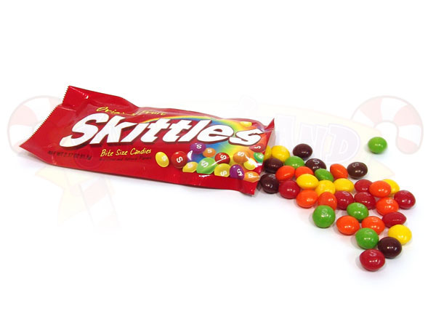
SPECTACULAR REDOX REACTION BEHAVIOR (continued)
4) Decomposition redox: aka The DEATH TO skittles reaction
0 +1 -2 +1 +7 -2 +1 -2 +4 -2 +1 -1
C₁₂H₂₂O₁₁ + 8KClO₃ → 11H₂O + 12CO₂ + 8KCl
Ox
Red
In class demo

Slide 11
One other unique and highly useful feature of redox reactions…
The oxidation and reduction can be separated in space and you can still run the reaction
as a `cell’ or ‘battery’

Slide 12
Characteristics of redox reactions
Heat and light common
Reactions are often spectacular (way better than acid base)
Electronic balance altered (of course)
Often accompanied by major decomposition or combination

Slide 13
Example: Cu-Mg cell
The complete redox reaction
Gains 2e⁻
Cu²⁺ + Mgº → Cuº +Mg²⁺
Loses 2e-
Reduction half reaction:
Cu²⁺ +2e⁻ → Cuº
cathode
Oxidation half reaction:
Mgº → Mg²⁺ +2e-
anode
Cu²⁺ + Mgº → Cuº +Mg²⁺

Slide 14
Demos of Cu-Mg cell (battery)
Potato clock

Slide 15
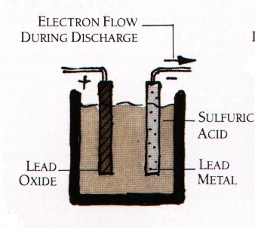
exists as PbSO₄ (white deposit oflead(II) sulfate) on surface of plates after discharge
2e⁻ + Pb⁴⁺→ Pb²⁺
Pbº→ Pb²⁺ +2e⁻
anode
cathode
CAR BATTERY EXAMPLE
Turn on ignition…
Pb⁴⁺ is black PbO₂ coating

Slide 16
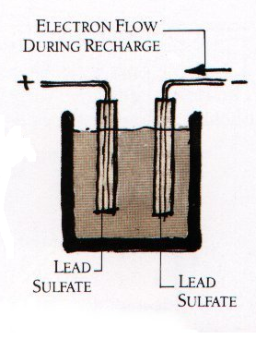
anode
cathode
Pb²+→ Pb ⁴⁺ +2e⁻
Pb²⁺ +2e^{-→} Pbº
Car running on gas…alternator reverses flow

Slide 17
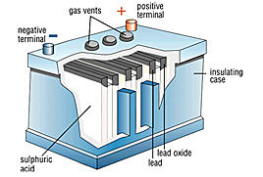
Some practical notes
Over charging makes H₂
6 pairs of plates connected in series and operating at ~2V each=12V
“cranks”
~600-850 amps (A)
12 V_{DC} * 850 A ~12 kW
vs common house main
70 V_{DC eq} *200 A= 14 kW
~2 volts

Slide 18
Short video showing basics of how car battery works

