Slide 1

And now (after many weeks of &^%!! Moles and Lewis)….
…..
….for something completely different….
4) CLASSICAL REACTIONs- chapter 10 ( + tiny bit of 14)
(where the fun begins)
Metatheses 443-452
Acid-base 452-458;623-625
Oxidation-reduction 458-466

Slide 2
Classical Reactions Classified
    1) Metathesis (double replacement)
Complete Molecular reaction
Pb(NO₃)₂ (aq) + 2KI(aq)
→ PbI₂(s) + 2KNO₃(aq)
Complete Ionic Reaction
Pb²⁺ +2NO₃⁻ +2K⁺ +2I⁻ → PbI₂(s) + 2K⁺ +2NO₃⁻
Net Ionic Reaction
Pb²⁺ + 2I^{- →} PbI₂(s)
Practice a few on board…

Slide 3
Thinking Like a Chemist (TLC)
What if anything can we learn from metathesis reactions (beyond how to balance and write the *%&^$ things…)

Slide 4
Thinking like a chemist...organizing metathesis reactions
SOLUBILITY PATTERNS
OH⁻ (VI) | Cl⁻ (VII) | CO₃²⁻ (IV) | NO₃² (V) | PO₄²⁻ (V) | SO₄³⁻ (VI)
solid
Li⁺
Na⁺
K⁺
Mg²⁺
Ca²⁺
Ba²⁺
Fe²⁺
Cu²⁺
Ag⁺
Pb²⁺
I
II
TM
PM
aqueous
heavier

Slide 5
Smaller anions
Larger anions
SOLUBILITY PATTERNS
OH⁻ (VI) | Cl⁻ (VII) | CO₃²⁻ (IV) | NO₃² (V) | PO₄²⁻ (V) | SO₄³⁻ (VI)
Li⁺
Na⁺
K⁺
Mg²⁺
Ca²⁺
Ba²⁺
Fe²⁺
Cu²⁺
Ag⁺
Pb²⁺
TLC anion solubility tends to decrease with size of anion and as central atom moves left towards cations on Periodic table for a given row
I
II
TM
PM
heavier
TLC –cation solubility (except to alkaline earths, tends to decrease as electronic cloud becomes more diffuse, bigger and `puffy’ (also called `softness’)

Slide 6
Effect of diffuseness of electrons on solubility:
What isoelectronic cations teach us…*
OH⁻ (VI) | Cl⁻ (VII) | CO₃²⁻ (IV) | NO₃² (V) | PO₄²⁻ (V) | SO₄³⁻ (VI)
Fe²⁺ 24 e
Fe²⁺
Cu⁺
Cu⁺ 24 e
∴Softer, pillow-like clouds of electrons tend to form more insoluble (~covalent) bonds
**Isolectronic=
SAME ELECTRON COUNT

Slide 7
    Metathesis (double replacement)
    –continued
Pb²⁺ + 2I^{- →} PbI₂(s)
Net ionic
General characteristics
Ionic, aqueous salts are reactants
Product is formed from cation swap is a solid
Low energy…no heat

Slide 8
Overview of classical reactions(cont.)
2) Acid-base
Complete Molecular reaction
HCl(aq) + NaOH(aq)
NaCl(aq) + HOH + heat
salt
water
acid
base
Complete Ionic reaction
H⁺ + Cl⁻ + Na⁺ +OH⁻ → Na⁺ + Cl⁻ +H₂O
Net ionic reaction
H⁺ + OH^{- →} H₂O
`neutralization

Slide 9
Overview of classical reactions(cont.)
2) Acid-base…- continued
Net ionic reaction
H⁺ + OH^{- →} H₂O
General characteristics
Reactants are specially defined `acid’ and `base’ ionic solutions
Products are soluble salt and water
Significant heat is generated
Indicators signal endpts

Slide 10
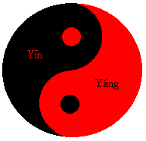
Acid-Base Theories (pp 136-44, 625-8)
0) Pre-science: acids and bases are eternal opposites
ACID + BASE = `BALANCE’
Positive + negative = null
Hot + cold = just right
Taoist version

Slide 11
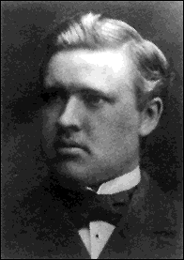
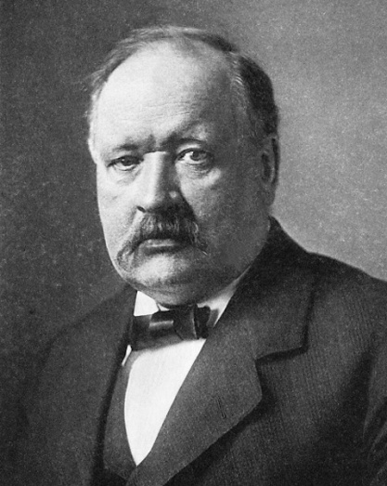
Acid-Base Theories (pp 623-625)
Modern Theory: Try #1
Svante Arrhenius: Father of the first modern acid/base theory
Thesis on Acids & Bases derided by his research committee…
Graduates with Ph.D ordinare
(no distinction)
Young Arrhenius
(dimwitted “loser”)
Old Arrhenius
(wins Nobel prize for acid base theory)

Slide 12

Becomes distinguished scholar and chair of his old alma mater school…
Moral #1
Revenge is a dish best served cold

Slide 13
Moral #2:
Trust your own dreams and ideas

Slide 14
A measure of this Ph.D `ordinaire’’s brilliance…
In 1896 Arrhenius predicted that green house gas (CO₂) from profligate burning of the the newly popular fuel source …petroleum oil…
would cause (gasp !) measurable and catastrophic global warming…
…starting in 1990-2000 AD
…the entire scientific establishment (and Standard Oil) laughed at him (again)

Slide 15
1) Arrhenius Model
BASE
=OH- donor
ACID
=H+ donor
HF
HCl
HBr
HNO₃ HClO₄
H₂SO₄ H₂CO₃
H₃PO₄
NaOH KOH NH₄OH Ca(OH)₂ Mg(OH)₂
Al(OH)₃ Fe(OH)₃

Slide 16
Acid-Base reactions ala’ Arrhenius: A+B= neutral
HCl(aq) + NaOH(aq) → NaCl(aq) + H₂O
H₂SO₄ + Mg(OH)₂→ MgSO₄(aq) + 2H₂O
General rule for Arrhenius acid-base
ACID + BASE = SALT + WATER

Slide 17
The `Inconvenient Truth’ about the Arrhenius model: basic salts
EXAMPLE: Na₂CO₃ (sodium carbonate)
No H⁺ or OH⁻….=> salt only

Slide 18
The `Inconvenient Truth’ about the Arrhenius model: basic salts (continued)
EXAMPLE: Na₂CO₃ (sodium carbonate)
experimental results of adding to water:
Turns pink in presence of phenolphthalein
gas-forming reaction with HCl, pink disappears
=> A base !!!!?????
Where’s OH ???

Slide 19
The `Inconvenient Truth’ about the Arrhenius model: basic salts (continued)
Other examples of `basic’ salts
Na₃PO₄ K₂SiO₃ NaC₂H₃O₂
A phenomenon not rationalized by Arrhenius

Slide 20


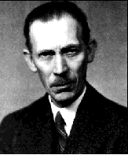
Bronsted to the rescue…
Winner of the Bronsted look alike contest….
Young Bronsted…Swedish chemist circa 1910…
A Scandinavian ‘emo’ kind of guy
Young James Dean…American actor circa 1955…(“Rebel Without a Cause,”“East of Eden”, )
America’s first ‘emo’ kind of guy
Bronsted a few years after marriage and kids

