Slide 1
further insights provided by Lewis model:(see also: p 178-182)
Formal charge rule (p 180)
“Atoms in molecules try to achieve formal charges as close to zero as possible.” **
**….and if we need to break octet rule to minimize formal charge….do it !!!! (see also pp 172-175)

Slide 2

Formal charge rule (p 180)

Slide 3
Board examples practicing formal charge determination and using them to determine the `best’ Lewis structure
In-Class Board Examples to work….
CO
CO₂ (two possible Lewis structures)
NO₂⁺
NO₃⁻
COCl₂ (two possible Lewis structures
SO₂ (Lewis and non-Lewis)
SO₄²⁻ (Lewis and non-Lewis)

Slide 4
Some other Lewis rule factoids restated: (see also-page 175-178)
Second row elements always obey octet rule
(except B(6e⁻ ok) and Be (2e⁻ ok )
Third row and higher elements can break octet rule to satisfy formal charge minimization requirement. (H₂SO₄ , PF₅ examples)
If symmetric resonance exists, it means partial bonds are actually present. (NO₂⁻,NO₃⁻)
Symmetric resonance is stabilizing ! (benzene, carbonate)

Slide 5
Some other Lewis rule factoids restated: (see also-page 175-178) ….continued
Odd-numbered electron systems produce highly reactive and unstable radicals (NO, NO₂)

Slide 6
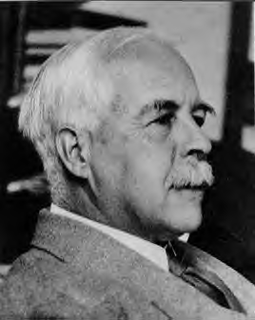
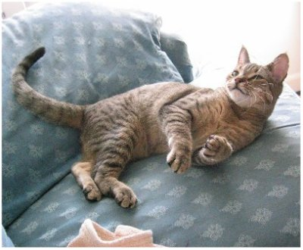
Why chemists still love the Lewis model even though it is later found to `miss’ some really big effects
It often correctly predicts and rationalizes chemical behavior with simple pictures
EXAMPLES:
Why….
N₂ doesn’t burn
CO kills
CO₂ doesn’t (kill)
water is bent
Why SO₂ is bent and uncharged
Miaow, wow !!
Lewis still
`da Man’

Slide 7

Retrospective of our chemistry road trip…
1)Atomic structure
Rutherford atom
Bohr atom
spdf model
Quantum theory
Periodic table
spectroscopy
3)Compounds & Reaction Math
(the `foundation’ of chemistry)
Dalton’s law of multiple proportions
Compound formulas & Periodic Table
Naming
Mole concept
% composition
Reaction balancing
Stoichiometry, limiting yield, % yield
2)Molecular structure
Ionic compounds
Lewis rule of 8
Lewis octet rule and beyond
VSEPR (lab)

Slide 8
And now (after 3 weeks of &^%!! moles)
…..
….for something completely different….
4) CLASSICAL REACTIONs- chapter 10 ( + tiny bit of 14)
(where the fun begins)
Metatheses 443-452
Acid-base 452-458;623-625
Oxidation-reduction 458-466

Slide 9
Classical Reactions Classified
    1) Metathesis (double replacement)
Complete Molecular reaction
Pb(NO₃)₂ (aq) + 2KI(aq)
→ PbI₂(s) + 2KNO₃(aq)
Complete Ionic Reaction
Pb²⁺ +2NO₃⁻ +2K⁺ +2I⁻ → PbI₂(s) + 2K⁺ +2NO₃⁻
Net Ionic Reaction
Pb²⁺ + 2I^{- →} PbI₂(s)

Slide 10
    Metathesis (double replacement)
    –continued
Pb²⁺ + 2I^{- →} PbI₂(s)
Net ionic
General characteristics
Ionic, aqueous salts are reactants
Product is formed from cation swap is a solid
Low energy…no heat

Slide 11
Overview of classical reactions(cont.)
2) Acid-base
Complete Molecular reaction
HCl(aq) + NaOH(aq)
NaCl(aq) + HOH + heat
salt
water
acid
base
Complete Ionic reaction
H⁺ + Cl⁻ + Na⁺ +OH⁻ → Na⁺ + Cl⁻ +H₂O
Net ionic reaction
H⁺ + OH^{- →} H₂O
`neutralization

Slide 12
Overview of classical reactions(cont.)
2) Acid-base…- continued
Net ionic reaction
H⁺ + OH^{- →} H₂O
General characteristics
Reactants are specially defined `acid’ and `base’ ionic solutions
Products are soluble salt and water
Significant heat is generated
Indicators signal endpts

Slide 13
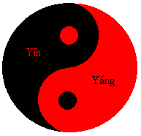
Acid-Base Theories (pp 136-44, 625-8)
0) Pre-science: acids and bases are eternal opposites
ACID + BASE = `BALANCE’
Positive + negative = null
Hot + cold = just right
Taoist version

Slide 14
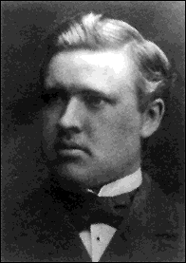
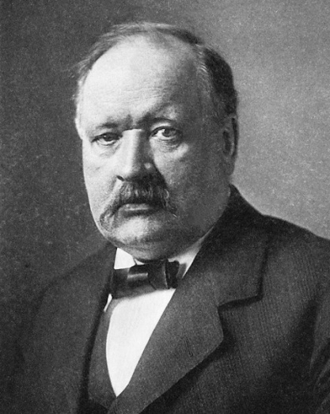
Acid-Base Theories (pp 623-625)
Modern Theory: Try #1
Svante Arrhenius: Father of the first modern acid/base theory
Thesis on Acids & Bases derided by his research committee…
Graduates with Ph.D ordinare
(no distinction)
Young Arrhenius
(dimwitted “loser”)
Old Arrhenius
(wins Nobel prize for acid base theory)

Slide 15

Becomes distinguished scholar and chair of his old alma mater school…
Moral #1
Revenge is a dish best served cold

Slide 16
Moral #2:
Trust your own dreams and ideas

Slide 17
A measure of this Ph.D `ordinaire’’s brilliance…
In 1896 Arrhenius predicted that green house gas (CO₂) from profligate burning of the the newly popular fuel source …petroleum oil…
would cause (gasp !) measurable and catastrophic global warming…
…starting in 1990-2000 AD
…the entire scientific establishment (and Standard Oil) laughed at him (again)

Slide 18
1) Arrhenius Model
BASE
=OH- donor
ACID
=H+ donor
HF
HCl
HBr
HNO₃ HClO₄
H₂SO₄ H₂CO₃
H₃PO₄
NaOH KOH NH₄OH Ca(OH)₂ Mg(OH)₂
Al(OH)₃ Fe(OH)₃

Slide 19
Acid-Base reactions ala’ Arrhenius: A+B= neutral
HCl(aq) + NaOH(aq) → NaCl(aq) + H₂O
H₂SO₄ + Mg(OH)₂→ MgSO₄(aq) + 2H₂O
General rule for Arrhenius acid-base
ACID + BASE = SALT + WATER

Slide 20
The `Inconvenient Truth’ about the Arrhenius model: basic salts
EXAMPLE: Na₂CO₃ (sodium carbonate)
No H⁺ or OH⁻….=> salt only

Slide 21
The `Inconvenient Truth’ about the Arrhenius model: basic salts (continued)
EXAMPLE: Na₂CO₃ (sodium carbonate)
experimental results of adding to water:
Turns pink in presence of phenolphthalein
gas-forming reaction with HCl, pink disappears
=> A base !!!!?????
Where’s OH ???

Slide 22
The `Inconvenient Truth’ about the Arrhenius model: basic salts (continued)
Other examples of `basic’ salts
Na₃PO₄ K₂SiO₃ NaC₂H₃O₂
A phenomenon not rationalized by Arrhenius

Slide 23


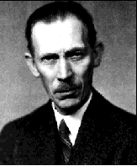
Bronsted to the rescue…
Winner of the Bronsted look alike contest….
Young Bronsted…Swedish chemist circa 1910…
A Scandinavian ‘emo’ kind of guy
Young James Dean…American actor circa 1955…(“Rebel Without a Cause,”“East of Eden”, )
America’s first ‘emo’ kind of guy
Bronsted a few years after marriage and kids

