Slide 1

Octet rule extended to covalent compounds: the Lewis electron bond pair/lone pair `trick’
See page 170-172; 175 review

Slide 2
Classic Octet Rule examples (continued)
IN-CLASS BOARD PRACTICE WITH::
Diatomics O₂√ N₂√ CO√ Cl₂√
Diatomics CO₂ H₂O SOCl₂
oxyanions NO₃⁻ CO₃⁻ SO₄²⁻
More ????

Slide 3
further insights provided by Lewis model:(see also: p 178-182)
Formal charge rule (p 180)
“Atoms in molecules try to achieve formal charges as close to zero as possible.” **
**….and if we need to break octet rule to minimize formal charge….do it !!!! (see also pp 172-175)

Slide 4
Formal charge rule (p 180)

Slide 5
Board examples practicing formal charge determination and using them to determine the `best’ Lewis structure
In-Class Board Examples to work….
CO
CO₂ (two possible Lewis structures)
NO₂⁺
NO₃⁻
COCl₂ (two possible Lewis structures
SO₂ (Lewis and non-Lewis)
SO₄²⁻ (Lewis and non-Lewis)

Slide 6
Some other Lewis rule factoids restated: (see also-page 175-178)
Second row elements always obey octet rule
(except B(6e⁻ ok) and Be (2e⁻ ok )
Third row and higher elements can break octet rule to satisfy formal charge minimization requirement. (H₂SO₄ , PF₅ examples)
If symmetric resonance exists, it means partial bonds are actually present. (NO₂⁻,NO₃⁻)
Symmetric resonance is stabilizing ! (benzene, carbonate)

Slide 7
Some other Lewis rule factoids restated: (see also-page 175-178) ….continued
Odd-numbered electron systems produce highly reactive and unstable radicals (NO, NO₂)

Slide 8
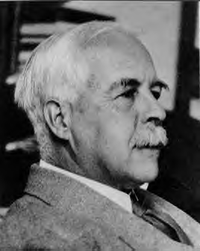
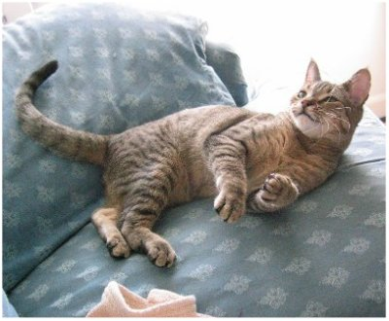
Why chemists still love the Lewis model even though it is later found to `miss’ some really big effects
It often correctly predicts and rationalizes chemical behavior with simple pictures
EXAMPLES:
Why….
N₂ doesn’t burn
CO kills
CO₂ doesn’t (kill)
water is bent
Why SO₂ is bent and uncharged
Miaow, wow !!
Lewis still
`da Man’

