Slide 1
What’s so curious ??
8
The “Noble” Elements are utterly stable
Noble gas chemistry
0
None
Nada
…And what’s with this number 8 ??
Noble…because they have nothing to do with any of the lower class elements=>……

Slide 2
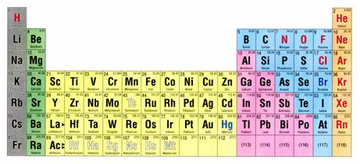

Explaining the trend…
∴every element wants to be Noble
O, P, K, Al as examples + exercise 8.1
Stable O is O²⁻
Stable K is K¹⁺
O + 2e⁻ → O²⁻
K→ K¹⁺ + e⁻
Stable P is P³⁻
P +3e- → P³⁻
Stable Al is Al³⁺
Al→Al³⁺ 3e⁻

Slide 3
How does knowing the stable charge desired by the elements help us build the right (binary =A_{n}B_{m}) compound formulas ????
Crossing rule in-class exercise 8.2

Slide 4
2+ 3-
3+ 2-
Ca + As
Ca₃As₂
Al + S
Al₂S₃
3
2
2
3
+3 *(+2) - 3*2=0
2*(+3) -2*(3) =0
4+ 2-
C + O
C₂O₄ → CO₂
2
4

Slide 5
All atoms wish to have an`inert’gas appearance which means a group of 8 outside electrons is desired
The Lewis octet picture
..with an octet of valence electrons
Everyone wants to be like me !!
Ne
Pix of electrons as dots on `outside’ of atom (“valence electrons”)
1 2 3 4 5 6 7 8

Slide 6
Lewis dot pix for atoms
Complete octet
Dot pix of ion formation
2+
-2
Ca
O
Ca
O
O
Ne
1 2 3 4 5 6 7 8
Ca→ Ca²⁺ = [Ar]

Slide 7

Lewis dot structures and pix of compound formation:
A chemical love story about Na and Cl
Na + Cl → ??
Elemental Na
Elemental Cl
-
Na
+
Cl
BOARD WORK WITH EXAMPLES
1 electron on outside that wants to get off and leave an inert (octet) gas core (Ar).
7 electrons on outside aching to add one more to make an octet
Come to me my hot, darling electron !

Slide 8
The `crossing’ trick works great for ionic compounds A_{n}B_{m} built from opposite ends of Periodic table
B
A
+

Slide 9
But how to explain combinations of elements near each other on Table ???
C + O= CO??
N + N = N₂ ?????

Slide 10
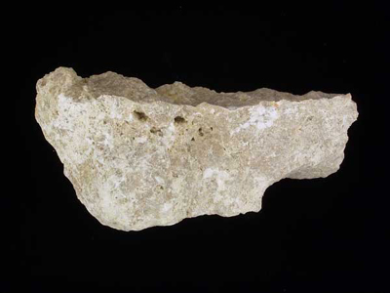
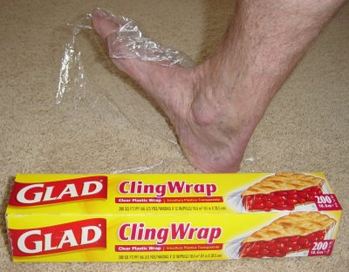
COVALENT BONDING involves
elements near each other on
Periodic Table
IONIC BONDING (+…-) involves elements from opposite sides of Periodic Table
Ex.1 Nitrogen gas (N₂)
`azote’
Ex.1 NaCl
(table salt)
Ex. 2 Limestone
mostly Ca and O
Ex 2: plastic `cling’ wrap
C and H

Slide 11

Octet rule extended to covalent compounds: the Lewis electron bond pair/lone pair `trick’
See page 170-172; 175 review

Slide 12
IN-CLASS BOARD PRACTICE WITH::
Diatomics O₂ N₂ CO
Diatomics CO₂ H₂O SOCl₂
oxyanions NO₃⁻ CO₃⁻ SO₄²⁻
More ????

