Slide 1
Examples of chemical % yield
5O₂ + C₃H₈ → 3CO₂ + 4H₂O
Given mol excess 0.25 0.7 (obs)
% yield =obs/theory
0.7 x 100 = 70%
1
4 x 0.25 =1 1 theory
Theory mol
Another chemical example
MW 32 44 44 18
Given excess 1.1 g 0.5 g
% yield =
0.0114 x 100=15.2%
0.075
Mol 1.1/44=0.025
0.5/44=0.0114
Theory moles
3 x 0.025 =0.075
1

Slide 2
Exercise 6b: #3
% yield: beer chemistry
ethanol formic acid
C₂H₆O +2O₂ → 2CH₂O₂ + H₂O
w(g) 17 g 25.5 g
MW (g/mol) 46 g/mol 46 g/mol
Moles (obs)
17/46= 0.37 C₂H₆O 25.5/46= 0.55 CH₂O₂ observed
Moles (theory)
x 2/1
0.37 C₂H₆O
2*0.37=0.74 CH₂O₂ theory
Moles (obs) x 100
Moles (theory)
0.55 x 100 =74.3 %
0.74
=

Slide 3
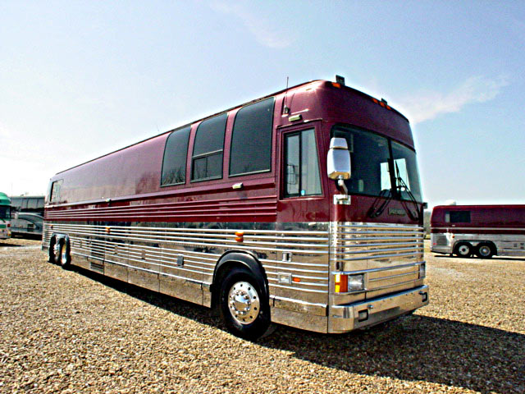
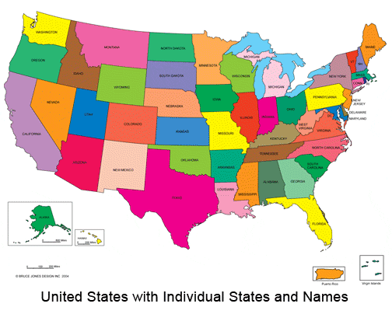


Where we’ve been so far on the chemistry bus trip…

Slide 4


Where we’ve been….
Rutherford & Bohr 1910
1) Atomic structure & dimensions
2) p+.nº , e⁻ bookkeeping
3) Crazy quantum models

Slide 5

Where we’ve been ……
Mendeleev 1865 AD
1)Organizing element behavior to predict chemistry
2)Periodicity and the Periodic Table

Slide 6


In the land of the spectroscopists:
Where we’ve been….
1s² 2s² 2p⁶ 3s² 3p⁴ ……
Describing atoms by electronic configurations implied by observation and predicted by Periodic table
spectroscopy
`fugetabout theory….let the line spectra rule…wise guys

Slide 7
Where we’ve been…
Dalton 1805AD
1)Law of constant proportions
2)Law of multiple proportions
Moles till we drop…..

Slide 8

The Americans land…
Lewis 1925 AD: using the Periodic table to predict compound formulas without breaking a sweat…Father of an American-style Chemistry that looks at the big picture and uses simple, intuitive models .
(sans calculations …)*
* We know how to use the fancy math…but not as a crutch

Slide 9

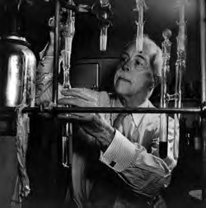

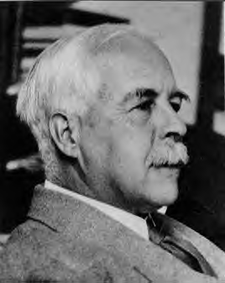
Thinking like the American chemist:
Gilbert Newton Lewis
In early 1970s…Young Doc Fong sits in here staring every day at a 4’x 6’ photo of…
The House that Lewis Built: Lewis Hall of Chemistry
UC Berkeley
Gilbert Newton Lewis American Chemist UC Berkeley “at work” ~1930

Slide 10
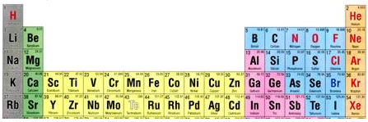
Compound building with Dmitri’s little chart: the rule of 8 for some Na* compounds (NOT IN TEXT)
*Works with H, Li,K and Rb too
Na + N→ Na₃N
Na + P → Na₃P
Na+ As→ Na₃As
Na + Sb→ Na₃Sb
Na + O→ Na₂O
Na + S → Na₂S
Na+ Se→ Na₂Se
Na + Te→ Na₂Te
Na + F → NaF
Na + Cl→ NaCl
Na+ Br→ NaBr
Na + I → NaI
How ?
1 + 5
3*1 +5= 8
1 + 6
2*1 +6= 8
1 7
1+7=8
Uncle Gil sez”
If you can add to 8 you can rationalize these reactions, kids….
1 2 3 4 5 6 7 8

Slide 11

The rule of 8 ( early version of the `octet rule’)
rule of 8: sum of column numbers in elements combined in many simple binary compounds¹ add to 8
Ca + O → ?
CaO
Li + Se →??
Li₂Se
col 2 6
2+ 6=8
2*1+6=8
col 1 6
H + N →?
H₃N or NH₃
Is it safe to assume this works all the time ????
col 1 5
3*1+5=8
¹simple ionic compounds ~formed
of column 1- 2 elements (cations)
with columns 5-7 (anions)

Slide 12
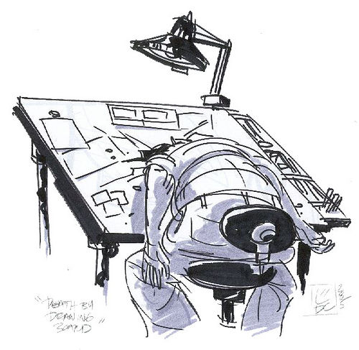
BUT…what about…
Mg + N ???
2 5
Rule of 16 ??? 3*2 +2*5=16 =2x8
(ICKY…too much math for us Americans) ☹
Actual formula Mg₃N₂

Slide 13
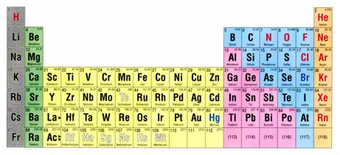
Thinking about the curious case of column 8
1 2 3 4 5 6 7 8

Slide 14
What’s so curious ??
8
The “Noble” Elements are utterly stable
Noble gas chemistry
0
None
Nada
…And what’s with this number 8 ??
Noble…because they have nothing to do with any of the lower class elements=>……

Slide 15

Data about stable versions of elements: what’s the likely charge on an element?
X → X^{m}
Element stable elemental ion (m is + or - )
m
+1
+2
1
???
-3
-2
-1
0
Col 3
+3,-5
Col # 1 2 3 4 5 6 7 8
rare
+2 +2 +2 +2 +2
+3 +4 +4 +3 +3
+6 +6 +4
(+3?) +5
+ 6
Col 4
+4,-4
Stable ions here are often negative (-)
← stable ions here are positive(+) →

Slide 16
Explaining the trend…
∴every element wants to be Noble
O, P, K, Al as examples + exercise 8.1
Stable O is O²⁻
Stable K is K¹⁺
O + 2e⁻ → O²⁻
K→ K¹⁺ + e⁻
Stable P is P³⁻
P +3e- → P³⁻
Stable Al is Al³⁺
Al→Al³⁺ 3e⁻

