Slide 1
Bohr model failures re-summarized
Model can only accurately predict behavior of H. It fails (miserably) to explain either qualitative or quantitative features of an other element.
Model even misses effect of magnetic field on H atom (`Zeeman’ Effect).
One good thing for Bohr …they can’t take back the Nobel prize $ once awarded…..

Slide 2

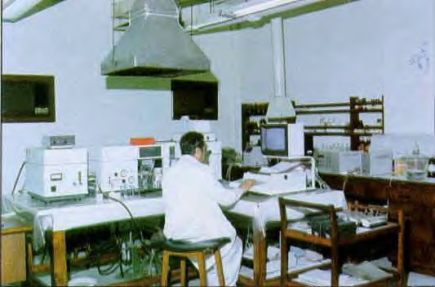

Why sing the spdf electron address song ??…
the spectroscopist’s experimental description of the atom is the spdf song
The atom we can `see’ is spectral
1s²2s²2p⁶3s²3p⁴….

Slide 3
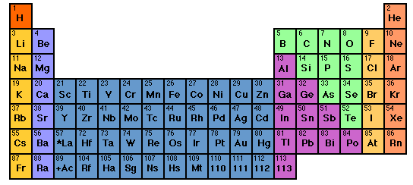

Singing the song…what is the complete electronic configuration of….
Will stay in first 5 rows so f orbitals can be dropped
s
p
1
2
3
4
5
6
7
1s² 2s¹
d
3d
4d
5d
6d
f
H =
1s¹
He =
1s²
Li=
1s²
2s¹
Be=
1s²
2s²

Slide 4
spdf song –continued: YOU complete electronic configuration of:
s d p
H
He
Li
Be
B
C
N
1
2
3
4
5
1s¹
1s²
1s² 2s¹
1s² 2s²
1s² 2s² 2p¹
O
F
Ne
1s² 2s² 2p⁴
1s² 2s² 2p²
1s² 2s² 2p⁵
1s² 2s² 2p³
1s² 2s² 2p⁶

Slide 5
s d p
He is s not p
3d
4d
5d
6d
EXERCISE 2:
COMPLETE ELECTRONIC CONFIGURATIONS

Slide 6
EXERCISE #2 CHEM 1114
2.1 Write the complete electron configuration for the elements below
Cl
K
c) Mn
d) Se
1s² 2s² 2p⁶ 3s² 3p⁵
1s² 2s² 2p⁶ 3s² 3p⁶ 4s¹
1s² 2s² 2p⁶ 3s² 3p⁶ 4s² 3d⁵
1s² 2s² 2p⁶ 3s² 3p⁶ 4s² 3d¹⁰4p⁴

Slide 7
s d p
He is s not p
3d
4d
5d
6d
INERT GAS CORE
EXERCISE 2:
ABBREVIATED ELECTRONIC CONFIGURATIONS

Slide 8
2.2 Write the abbreviated electron configurations for
the elements below, assuming they are in the
gas phase or solids
a) Ca
b) Al
c) As
[Ar] 4s²
[Ne] 3s² 3p¹
[Ar] 4s² 3d¹⁰ 4p³

Slide 9
d electron variations
s d electron configuration switching
Example: behavior of Mn
From spectra of atomized elements
As it behaves chemically
Mn
[Ar] 4s² 3d⁵
[Ar] 3d⁵ 4s²
Mn ²⁺
[Ar] 3d⁵
Evidenced by fact that all transition metals have a stable 2+ state… => outer 4s² are removed first

Slide 10
s d p
He is s not p
3d
4d
5d
6d
EXERCISE 2.3
d electron switch configurations

Slide 11
2.3. Write the correct, abbreviated d-switched
configurations for the transition metals below
a) Cu
b) Fe ²⁺
c) Zn ²⁺
[Ar] 3d⁹ 4s² (3d and 4s switch order)
[Ar] 3d⁶ (outer 4s electrons lost first)
[Ar] 3d¹⁰ (outer 4s electrons lost first)

