Slide 1
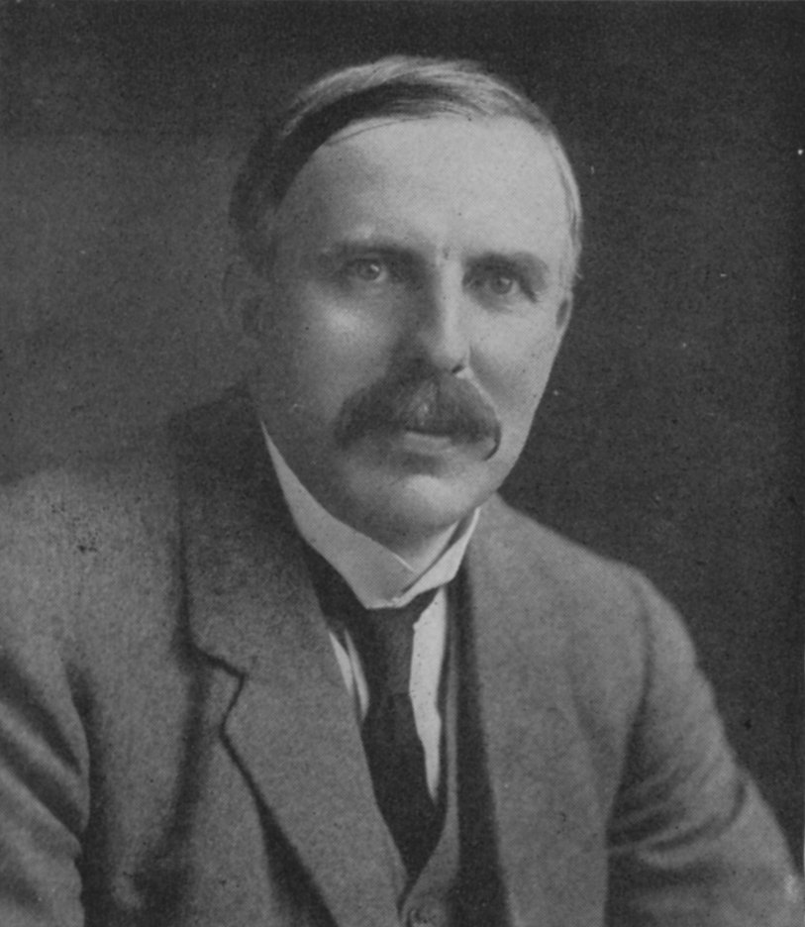
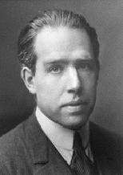
How Bohr’s new way of thinking about matter bails out Rutherford
1)Why don’t the p⁺ and e⁻ attract and come together ??? (or…why isn’t Earth the size of a golf ball?)
Electrons can exist only in precisely defined quantum states . They don’t `travel’ through space, but `tunnel’ to move from state to state (quantum jump)….There is no allowed electron state at the nucleus.
help
???

Slide 2
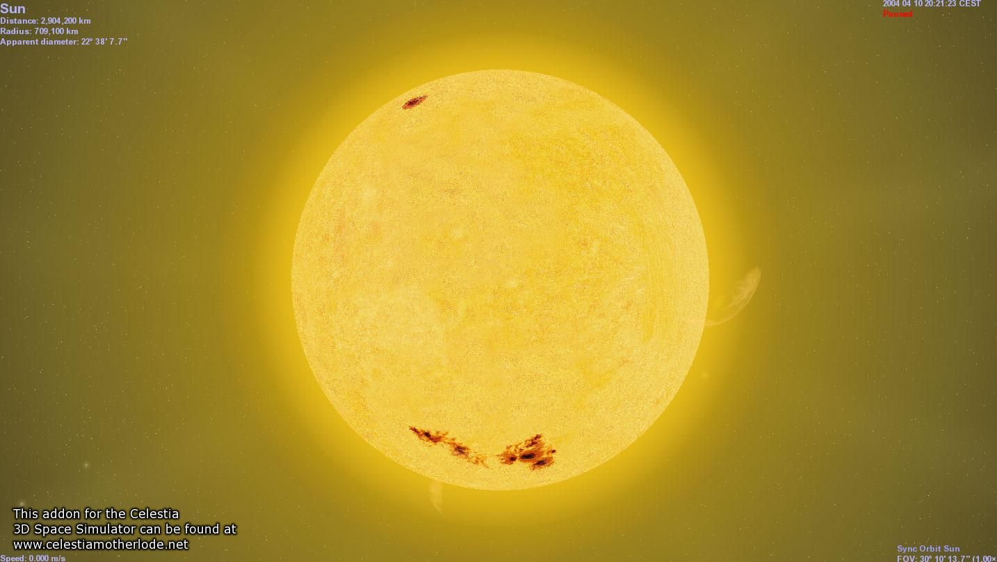

2)Why doesn’t the sun show all colors (e.g. show white light) when telescopes record spectrum?
???
Because electrons exist in just a few defined energies, transitions naturally release energies at just few very well-defined wavelengths (which I predicted perfectly)
help
???

Slide 3



the quantum cat dilemma-one consequence of Bohr’s quantum concept
Kitty state =ψ = f₁ ϕ₁ + f₂ϕ₂
(According to quantum physics)
f₁ ~ 1, but not quite f₂ ~ 0 but not quite
Quantum physics is surreal, baby !

Slide 4


What happened to chemistry ?????
Walter White talking chemistry in “Breaking Bad”

Slide 5

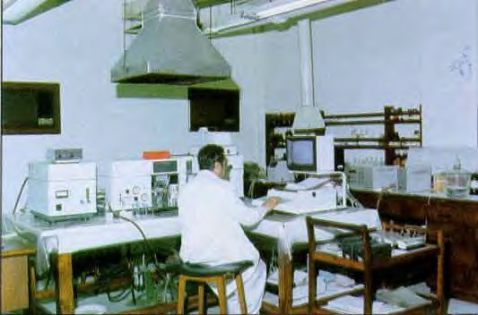

The Bohr Model dies…1930
The Bohr Model dies…1930
1930
Bohr theory
The experimental chemists and spectroscopists say “fugetabout” it.
“typical” experimental spectroscopist/chemist
Experimentalist’s attitude towards theoreticians
“If I want your opinion, I’ll give it to you…”

Slide 6


Bohr’s little Problem…
1930
Bohr theory
Observed
Na-`D’ line
Is yellow
Even worse..
Spectroscopists observe….
Bohr’s prediction: 1 green line
20 lines !!
1≠20
1)Bohr can’t predict anything right except H…the other elements have too many lines, e.g. Na
BOHR
1 line predicted
EXPERIMENT
20 LINES OBSERVED

Slide 7
Bohr model’s failures (continued)
2)…even Bohr’s predictions for H have problems
Can’t predict magnetic `fine’ structure of H, e.g
…magnetize H and even n=1 splits into 2 lines
1 ≠ 2
Turn on magnet near H
☹ Not even the smartest theoretical physicists of the day (Sommerfeld, Planck, Dirac) can make 1=2 or 1=20…. with Bohr’s model

Slide 8
Bohr model failures re-summarized
Model can only accurately predict behavior of H. It fails (miserably) to explain either qualitative or quantitative features of an other element.
Model even misses effect of magnetic field on H atom (`Zeeman’ Effect).
One good thing for Bohr …they can’t take back the Nobel prize $ once awarded…..

Slide 9

The spdf electron address song*…
* mantra taught to all high school students in chemistry…but why ???
Usual start of the song….
Describe the complete electronic configuration of P, Ca, Br………
1s²2s²2p⁶3s²3p⁶….
Write the abbreviated electronic configuration of Cl, Se, Ba… ………
[Ne] 3s²3p⁶….
etc
Etc
etc
Etc…

Slide 10

Why sing the spdf electron address song ??…
the spectroscopist’s experimental description of the atom is the spdf song
The atom we can `see’ is spectral
1s²2s²2p⁶3s²3p⁴….

Slide 11
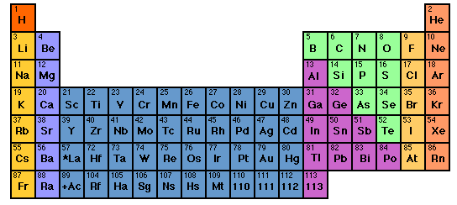

How to sing the spdf song: part 1: electron neighborhoods: s, p, d and f
s
d
p
1
2
3
4
5
6
7
3d
4d
5d
6d
f
4f
5f

Slide 12
Singing the song…what is the complete electronic configuration of….
Will stay in first 5 rows so f orbitals can be dropped
s
p
1
2
3
4
5
6
7
1s² 2s¹
d
3d
4d
5d
6d
f
H =
1s¹
He =
1s²
Li=
1s²
2s¹
Be=
1s²
2s²

