Slide 1
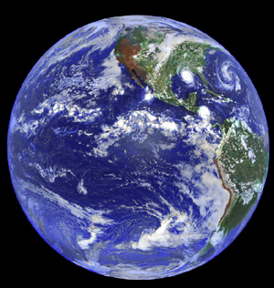
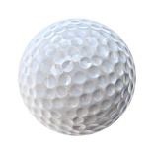
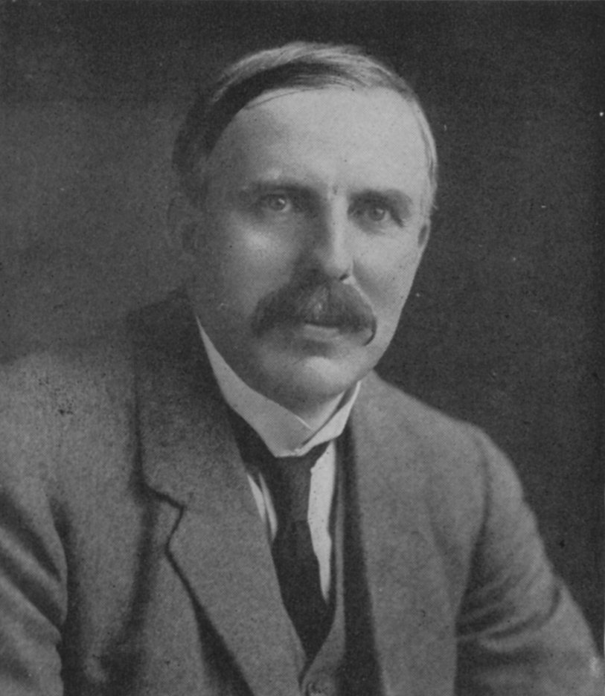
2 BIG Problems
with Rutherford’s model
1)Why don’t the p⁺ and e⁻ attract and come together ??? (or…why isn’t Earth the size of a golf ball?)
???

Slide 2

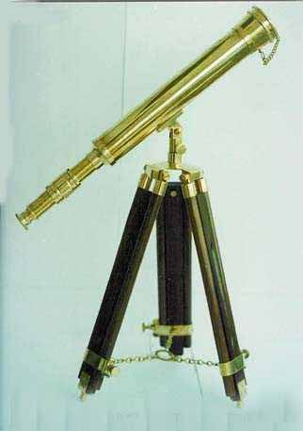
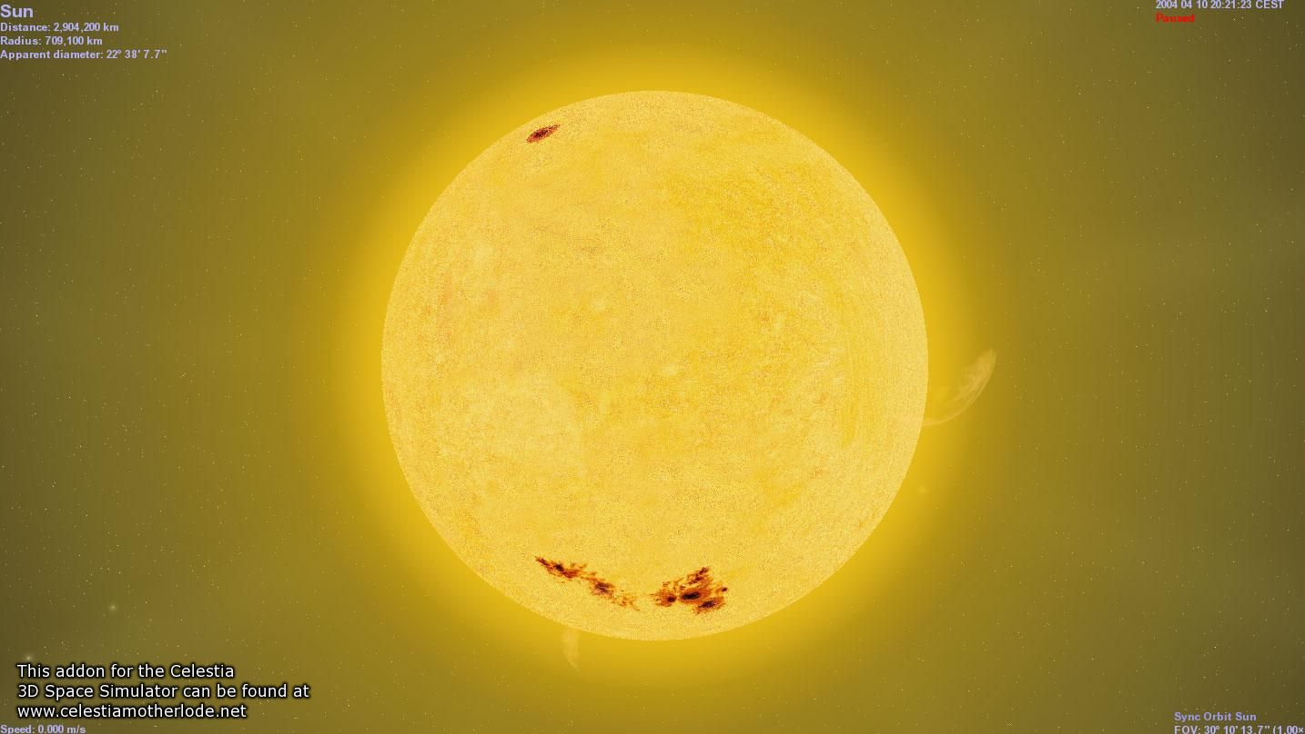
Rutherford atom’s problems (continued)
2)Why doesn’t the sun show all colors (e.g. show white light) when telescopes record spectrum?
Diffraction grating divides up light colors
???
Why only few really strong lines

Slide 3
AN EVEN BIGGER third PROBLEM FOR RUTHERFORD’S LAB
3) The photoelectric effect problem
and the trouble with the theory of light
Help!!!!

Slide 4
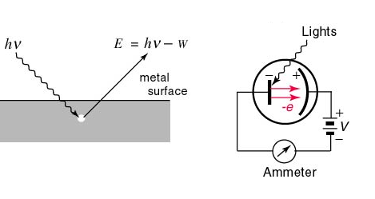
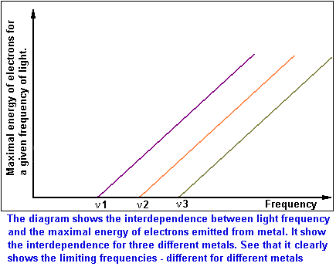
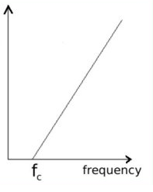
Photoelectric effect: the textbook version
E=Energy of ejected electron from metal
See also p. 62 of text
Threshold frequency for emission varies with metals (f1=ν1 for metal 1, f2=ν2 for metal 2 etc.)

Slide 5
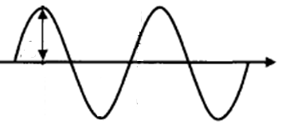
λ
Language of classical light theory (see also: p 58-60)
A
C
A= amplitude
λ= wavelength (meters)
c= speed of light = 3*10⁸ meters/second
“nu”
ν=f = frequency = # full waves passing a point in a second (cycles/second)

Slide 6
λ
Equations of classical light theory (see also:
p 58-60)
A
C
f*λ=c
Wave Energy ~ A²
ν=f = frequency
= # full waves passing a point in a second

Slide 7
Units for wave equation
frequency * wavelength = speed of light
f * λ =c
1
seconds(s)
*
meters(m)
= 3.0*10⁸ m
s
Hertz (Hz)
Cycles/second (cps)

Slide 8
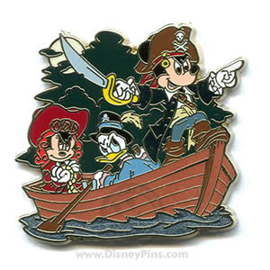
According to `common’ sense, which `wave’ capsizes Mickey and the gang ?
High amplitude (A)
Low frequency (f)
Low amplitude (A)
high frequency (f)
Let Mickey and friends be electrons in metal

Slide 9
What actually happens in the photoelectric effect experiment
High amplitude (A)
Low frequency (f)
Low amplitude (A)
high frequency (f)
Let Mickey and friends be electrons in metal

Slide 10
WHAT PHOTOELECTRIC EFFECT MEANS: (SEE PAGE 60-61)
1) THE ENERGY, E, OF LIGHT IS NOT
CONNECTED TO AMPLITUDE
Planck’s constant
2) E = h*f = 6.63*10⁻³⁴ *f
The Planck equation
3) LIGHT IS NOT A WAVE !!!!

Slide 11
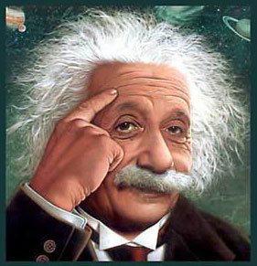
…so what is light if not a wave ??????
Einstein says….
LIGHT IS A “PHOTON”
=A MASSLESS BULLET OF ENERGY
My humble alternative picture….
=A MASSLESS `COILED’ SPRING OF ENERGY (higher frequency=> spring wound tighter)
“Ich weisse !”
=I know !

