Slide 1
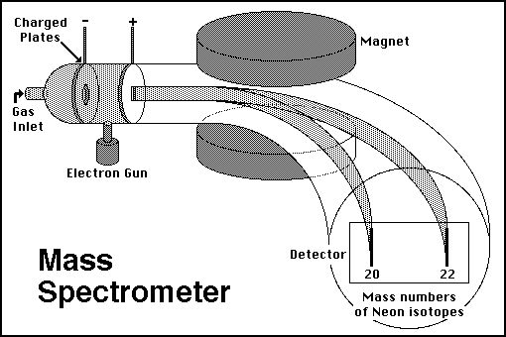
Schematic of magnetic sector mass spectrometer
Magnet `separates’ charged species according to mass alone (no `chemistry’)

Slide 2
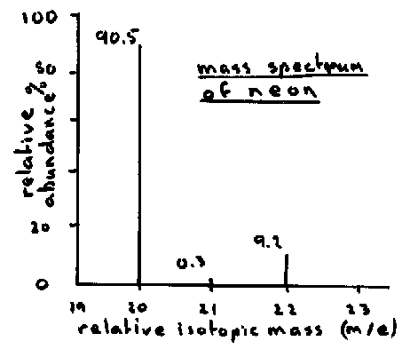
Most common flavor of Neon weighs 20
Less common flavors of Neon weigh 21 & 22
Different flavors of SAME element are called ISOTOPES

Slide 3
Neon Isotopes
Proton count (p⁺) neutron count (nº) p⁺ + nº % abundance
10 10 20 90.5
10 11 21 0.3
10 12 22 9.2
100.0

Slide 4
Atomic symbology
#p = atomic number (Z) defines element
#p + #n = mass number (several choices for given element)
#p = #e in neutral atom
Isotope = element with specific count of n
Examples:
Boron 10 (¹⁰B) = 5 p + 5 n
Boron 11 (¹¹B) = 5 p + 6 n
Hydrogen 1 (¹H) = 1 p + 0 n
Hydrogen 3 (³H) = 1 p + 2 n (tritium)
Copper 63 (⁶³Cu) = 29 p + 34 n
Copper 65 (⁶⁵Cu) =29 p + 36 n

Slide 5
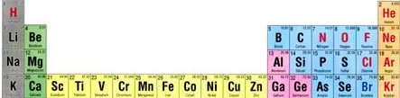
ATOMIC BOOKKEEPING
(first 3 problems from exercise 1)
Atomic # mass# symbol #p⁺ #nº #e⁻ atom charge
. |  |  | 12 | 12 |  | 0
 | 31 |  | 15 |  |  | 0
 | 17 | O |  | 9 | 10
12
24
Mg
12
15
P
16
15
8
8
-2
Pertinent section of Periodic table

Slide 6
ATOMIC BOOKKEEPING (cont.)
(last 4 problems from exercise 1)
Brain toss variant….
Atomic # mass# symbol #p⁺ #nº #e⁻ atom charge
 | 20 |  |  |  | 10 | 0
7 | 14 |  |  |  |  | -1
 |  | Fe |  | 30 |  | 0
17 |  |  |  | 18 | 19
10
Ne
10
10
N
7
7
8
26
56
26
26
35
Cl
17
-2
Let’s go down a column left to right….
1 mole buck/right answer with explanation

Slide 7
The Chemist’s element vs. the Physicist’s element
Chemist’s element
Physicist’s element
Periodic table entry for `average’ atom of C
Nuclear notation for specific isotope of C
Atomic # = p
Mass #= n + p
charge
6
C
12.01
12 _{O}
C
6
Atomic # = p
Average atomic mass (not mass number ??)

Slide 8
Why the chemist’s C lists 12.01 and not 12
Imagine `fishing’ out 100 atoms of Carbon from a sample of graphite (pure carbon). What would you catch ?
# p # n mass # caught out of 100 sampled C atoms
6
6
12
99
6
7
13
1
Both kinds isotopes of C act exactly the same, chemically so chemists just average the masses
99*12 + 1*13
100
Average mass of each C=
= 12.01

Slide 9
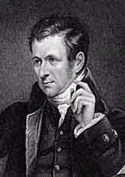
DALTON WAS WRONG (A LITTLE)
“All atoms of a given element weigh the same”
…he didn’t know about isotopes and neutrons
…but he can be forgiven…in 1805 his equipment was little better than kitchen ware….
Dalton’s measured mass
Correct average mass
C
N
O
Na
12
14
16
23
12.01
14.01
15.99
22.99

Slide 10
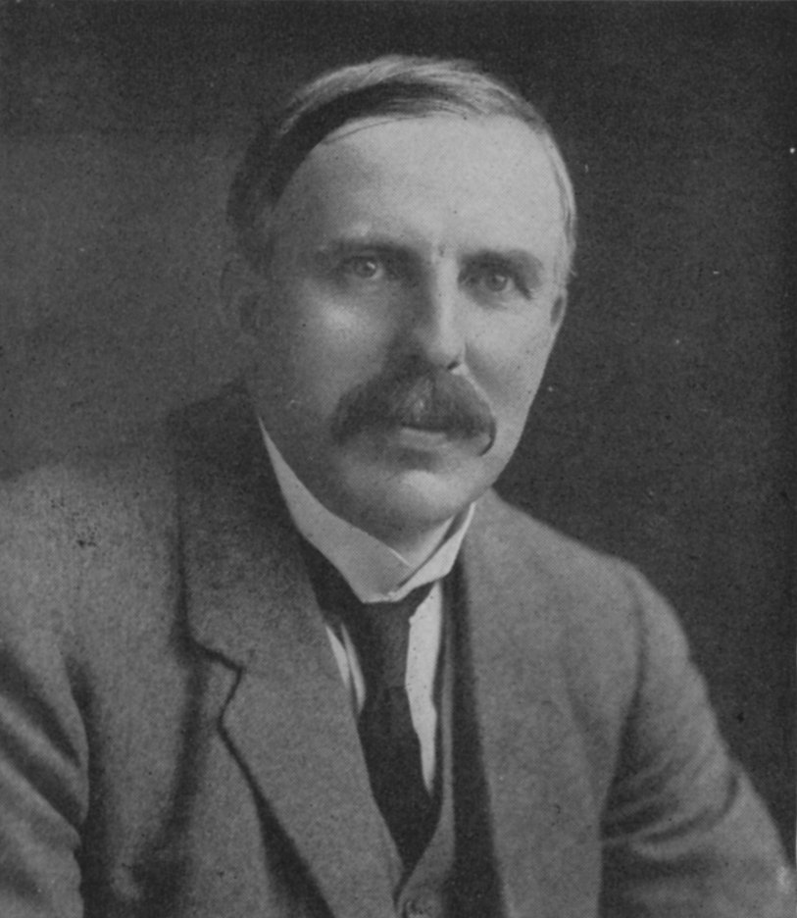
1912 : Ernst Rutherford is the `Man’…and presides over the `Golden Age of Experimental Physics’…THE ATOM APPEARS CONQUERED
vintage Rutherford:
“All science is either Physics or stamp collecting.”
His students find neutrons, build first mass spectrometers, establish source of isotopes, measure atomic charge, mass & dimensions

Slide 11
1912: Rutherford ‘s atomic model
Electrons (-) in here (kinda…)
Sorta … (kinda….)
+
Protons (+) and neutrons here

Slide 12
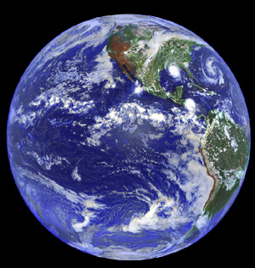
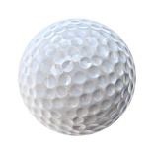
2 BIG Problems
with Rutherford’s model
1)Why don’t the p⁺ and e⁻ attract and come together ??? (or…why isn’t Earth the size of a golf ball?)
???

Slide 13

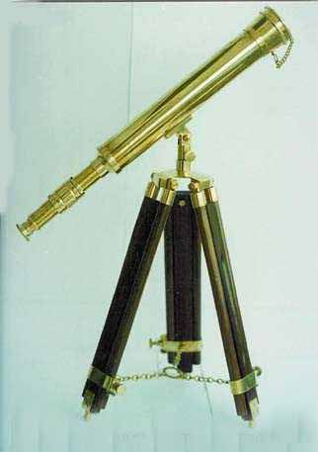
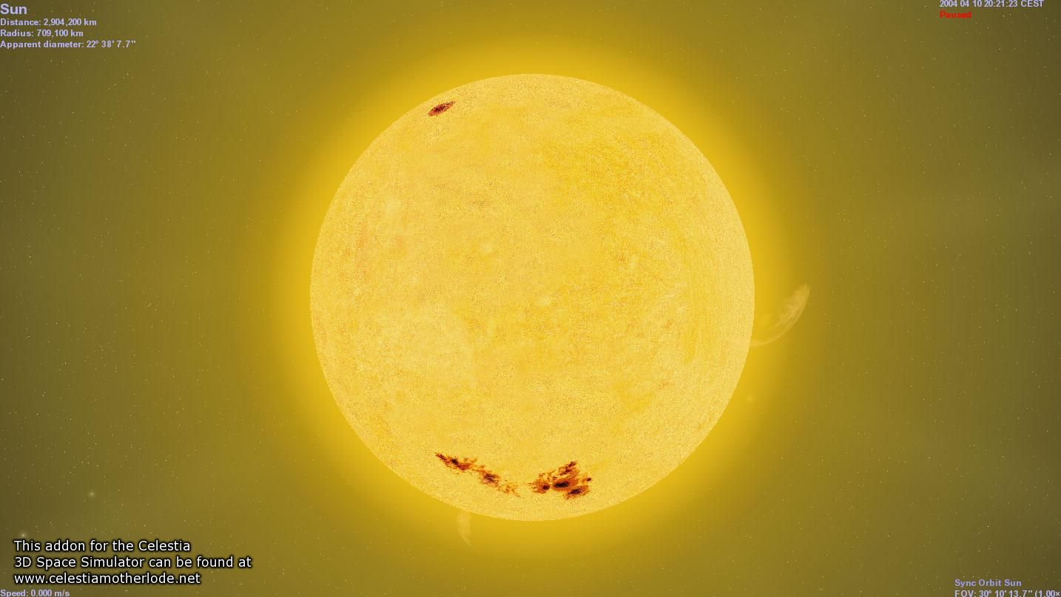
Rutherford atom’s problems (continued)
2)Why doesn’t the sun show all colors (e.g. show white light) when telescopes record spectrum?
Diffraction grating divides up light colors
???
Why only few really strong lines

Slide 14
AN EVEN BIGGER third PROBLEM FOR RUTHERFORD’S LAB
3) The photoelectric effect problem
and the trouble with the theory of light
Help!!!!

