Slide 1
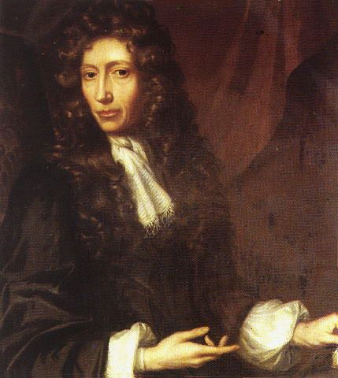
DEFINES ELEMENTS OPERATIONALLY*
An element cannot be broken down into a simpler substance by chemical means.
Alternatively:
an element can never be made to lose weight by any chemical process or procedure….
*(operational=>based on known experimental procedure)

Slide 2
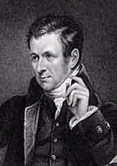
1805: Dalton makes an atomic theory by extending Boyle’s `operational’ definition: TLC gets `physical’
Gist of Dalton’s atomic theory: (see chapter 1)
An element is an `indivisible’ little ball of material called an atom.
All atoms of a given element weigh the same.
Atoms of different elements are distinguished by differences in their weight.
compounds are formed by combining fixed ratios of atoms of different elements and so compounds of a given composition have a constant mass for a constant count of compound.

Slide 3
If all ‘stuff’ is made out of the same atomic bits (protons, electrons, neutrons) what makes the behavior of different materials (chalk, sulfuric acid, sodium metal) so different ????
THE BIG IDEA FROM BOYLE AND DALTON
Compounds interact and exchange atoms (elements) to form new combinations of atoms (compounds) which are comprised of different simple ratios of constituent atoms.

Slide 4
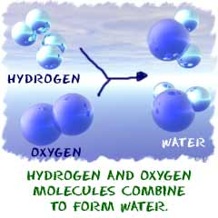

Slide 5
Writing Element symbols: the rules
Element symbols always…one or two letters…*
First letter capitalized; succeeding letter must be lower case
*except for `questionable’ ones (see post lanthanides on Periodic Table… Uun etc. )

Slide 6
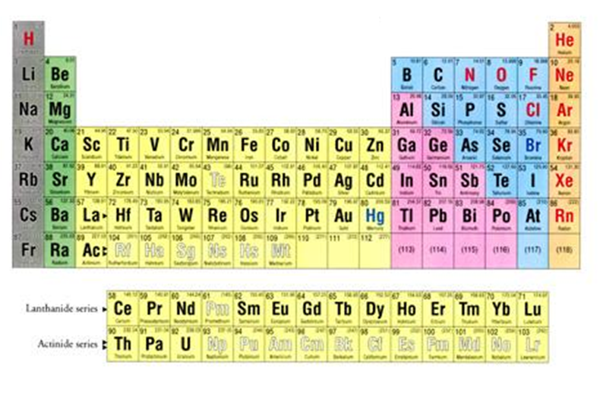
TLC (continued): How chemists organize elements
Modern Periodic Table of the Elements

Slide 7

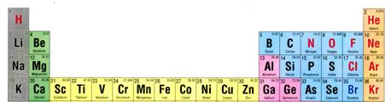
Know thy elements,
Maggots !
By Wednesday…5 September
Symbols and names for…first 4 rows
+ specials:
Ag, Au, Hg, Pb, Pt, Ba, Sr, Sn, I, U

Slide 8
Connection of atomic structure to chemistry
Dalton’s & Boyle’s elements: 1805
…elements defined by mass
All atoms of a given element weigh the same.
Atoms of different elements are distinguished by differences in their weight.
Modern atom…..post 1913
...elements defined by proton count
. All atoms of a given element have the same proton count.
Atoms of different elements have different proton counts.
Why not stick with the weight ????

Slide 9
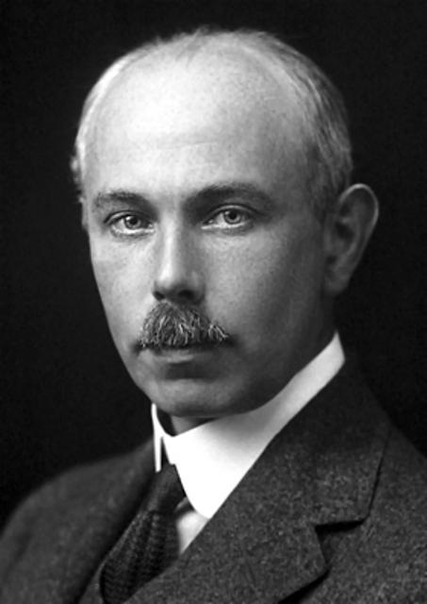
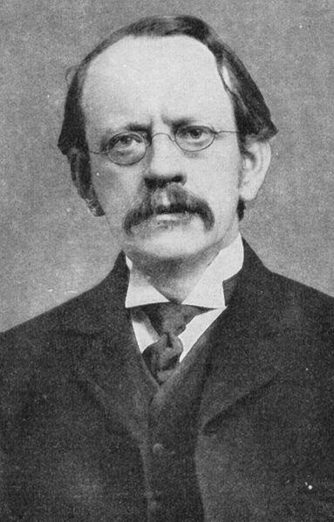
Why not stick with atom weights to define elements?
1913
Francis Aston Joseph Thomson
….discover “isotopes” = different `flavors` of same element

Slide 10
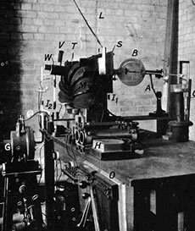
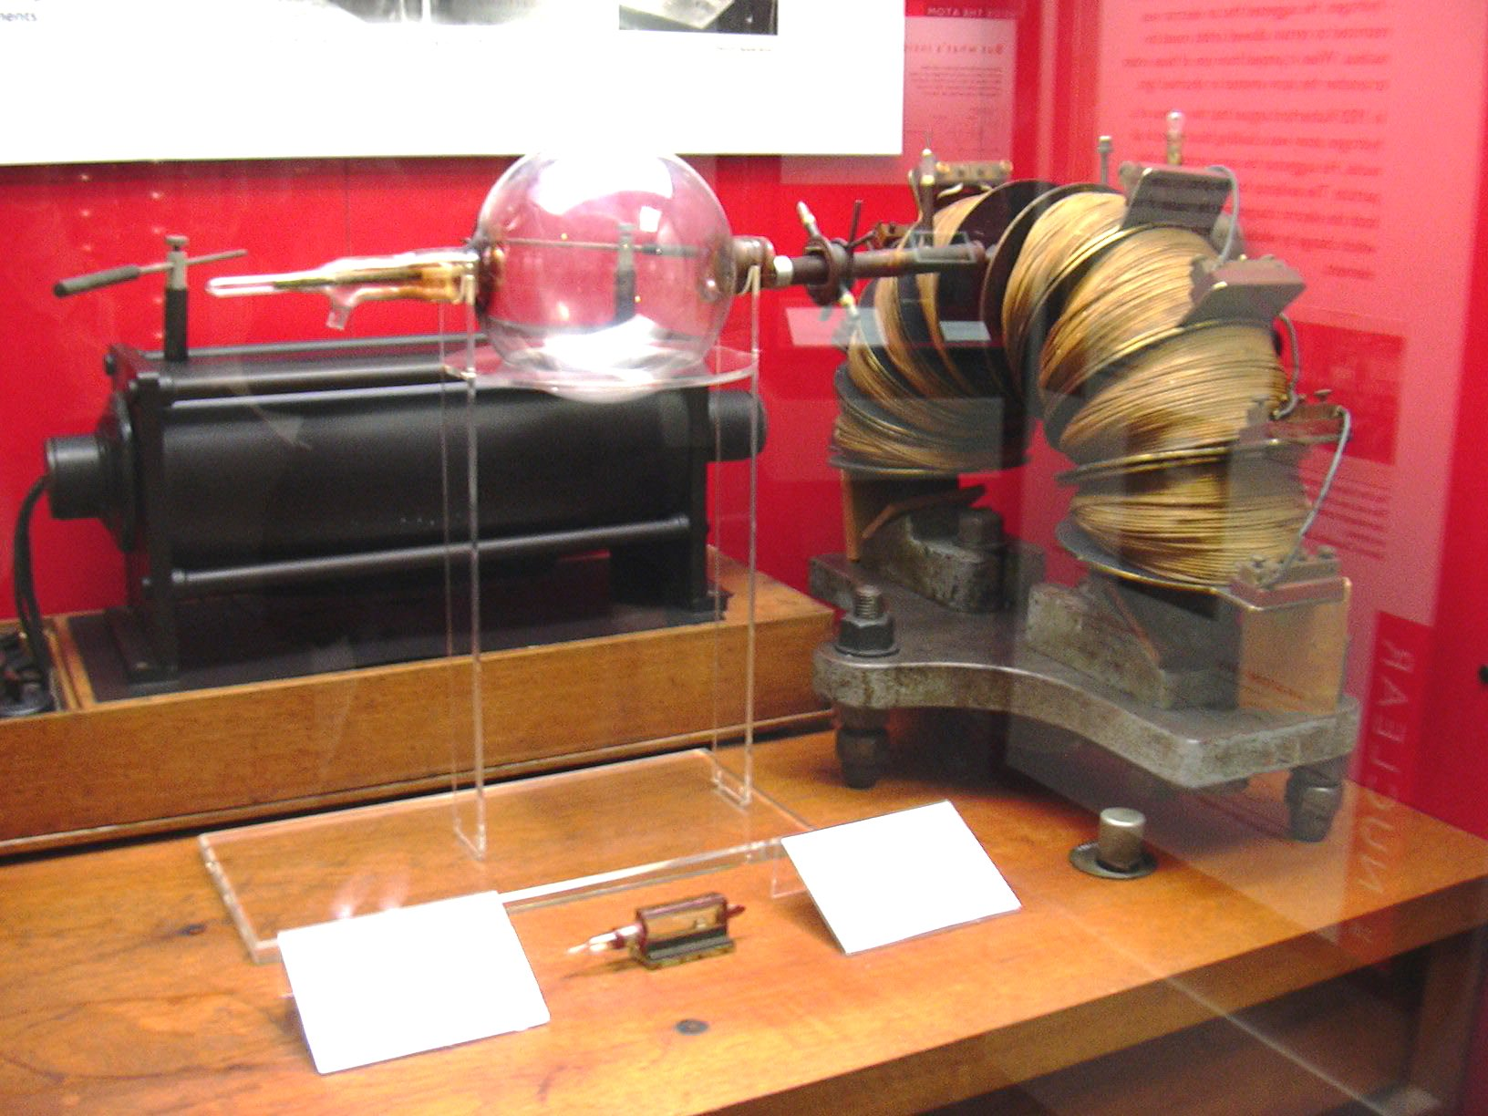
HOW ASTON DISCOVERS THEM:
HE BUILDS THE FIRST MASS SPECTROMETERS
Version 3
Version 1

Slide 11
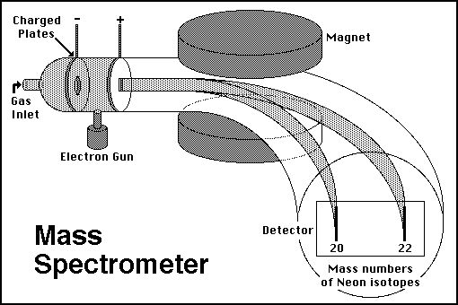
Schematic of magnetic sector mass spectrometer
Magnet `separates’ charged species according to mass alone (no `chemistry’)

Slide 12
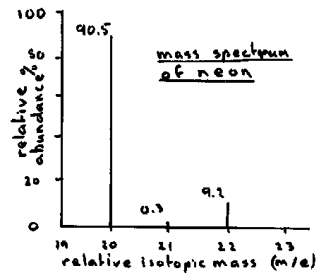
Most common flavor of Neon weighs 20
Less common flavors of Neon weigh 21 & 22
Different flavors of SAME element are called ISOTOPES

Slide 13
Neon Isotopes
Proton count (p⁺) neutron count (nº) p⁺ + nº % abundance
10 10 20 90.5
10 11 21 0.3
10 12 22 9.2
100.0

Slide 14
Atomic symbology
#p = atomic number (Z) defines element
#p + #n = mass number (several choices for given element)
#p = #e in neutral atom
Isotope = element with specific count of n
Examples:
Boron 10 (¹⁰B) = 5 p + 5 n
Boron 11 (¹¹B) = 5 p + 6 n
Hydrogen 1 (¹H) = 1 p + 0 n
Hydrogen 3 (³H) = 1 p + 2 n (tritium)
Copper 63 (⁶³Cu) = 29 p + 34 n
Copper 65 (⁶⁵Cu) =29 p + 36 n

Slide 15
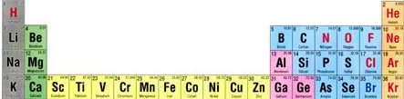
ATOMIC BOOKKEEPING
(first 3 problems from exercise 1)
Atomic # mass# symbol #p⁺ #nº #e⁻ atom charge
. |  |  | 12 | 12 |  | 0
 | 31 |  | 15 |  |  | 0
 | 17 | O |  | 9 | 10
12
24
Mg
12
15
P
16
15
8
8
-2
Pertinent section of Periodic table

Slide 16
ATOMIC BOOKKEEPING (cont.)
(last 4 problems from exercise 1)
Brain toss variant….
Atomic # mass# symbol #p⁺ #nº #e⁻ atom charge
 | 20 |  |  |  | 10 | 0
7 | 14 |  |  |  |  | -1
 |  | Fe |  | 30 |  | 0
17 |  |  |  | 18 | 19
10
Ne
10
10
N
7
7
8
26
56
26
26
35
Cl
17
-2
Let’s go down a column left to right….
1 mole buck/right answer with explanation

Slide 17
The Chemist’s element vs the Physicist’s element
Chemist’s element
Physicist’s element
Periodic table entry for `average’ atom of C
Nuclear notation for specific isotope of C
Atomic # = p
Mass #= n + p
charge
6
C
12.01
12 _{O}
C
6
Atomic # = p
Average atomic mass (not mass number ??)

Slide 18
Why the chemist’s C lists 12.01 and not 12
Imagine `fishing’ out 100 atoms of Carbon from a sample of graphite (pure carbon). What would you catch ?
# p # n mass # caught out of 100 sampled C atoms
6
6
12
99
6
7
13
1
Both kinds isotopes of C act exactly the same, chemically so chemists just average the masses
99*12 + 1*13
100
Average mass of each C=
= 12.01

Slide 19
DALTON WAS WRONG (A LITTLE)
“All atoms of a given element weigh the same”
…he didn’t know about isotopes and neutrons
…but he can be forgiven…in 1805 his equipment was little better than kitchen ware….
Dalton’s measured mass
Correct average mass
C
N
O
Na
12
14
16
23
12.01
14.01
15.99
22.99

Slide 20

2 BIG Problems with Rutherford model
1912: Rutherford ‘s atomic model
Electrons (-) in here kinda…
Sorta … (kinda….)
+
1)Why don’t + and – come together ??? (why isn’t Earth the size of a golf ball?)
Protons (+) and neutrons here
2)Why doesn’t the sun show all colors when telescopes record spectrum?
…Why only few really strong lines ?????
= Sun’s light ??? (the Balmer series)

