Slide 1
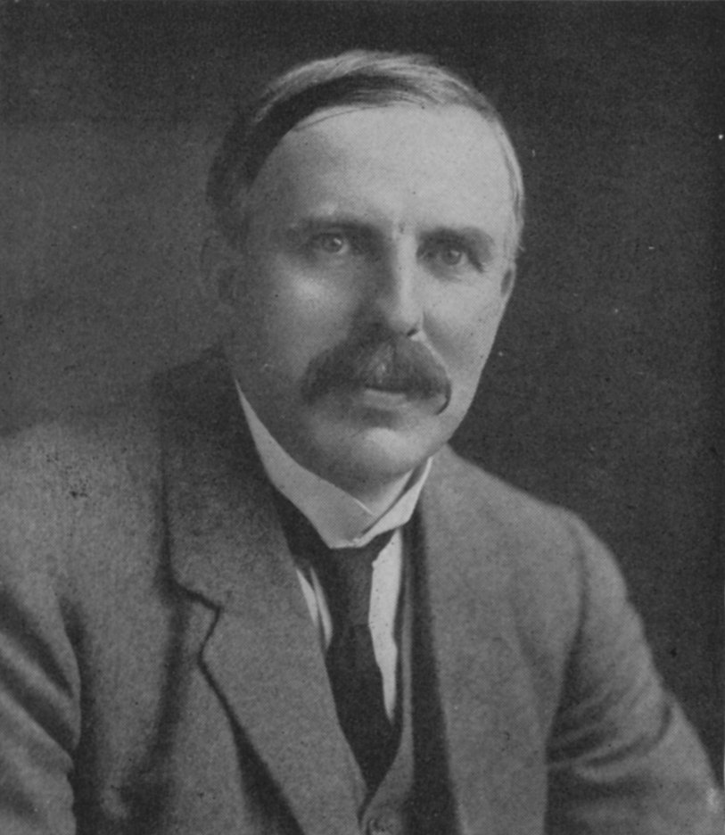
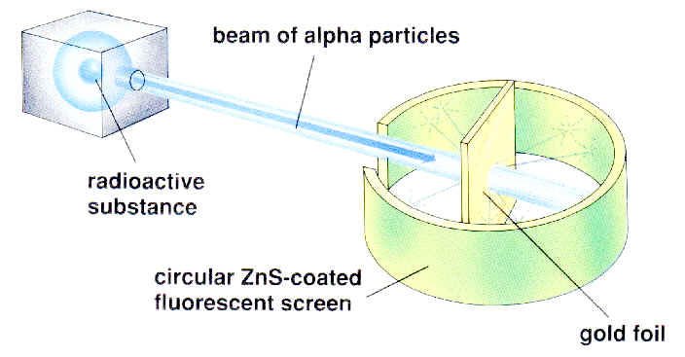
1910: Ernst Rutherford ‘s `gold foil experiment’: How we first got an experimental grip on atomic structure
(=He⁺)
1 mm thick
Ernst Rutherford: Cavendish Lab, Cambridge, UK

Slide 2
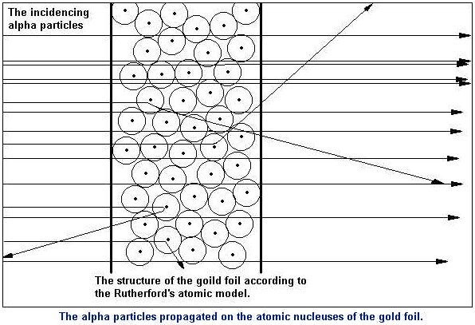
On a Diffuse Reflection of the α-Particles
Proc. Roy. Soc. 1909 A
vol. 82, p. 495-500
By H. GEIGER, Ph.D., John Harling Fellow,
and E. MARSDEN, Hatfield Scholar, University of Manchester.
(Communicated by Prof. E. Rutherford, F.R.S.
Received May 19, -- Read June 17, 1909.)
Pictorial version of what gold foil paper teaches

Slide 3
What the picture teaches (after a bit of math…)
Alpha particles bounced back or deflected
Total count of Alpha particles fired
= 1
8000
The vital imagery is Rutherford’s simili:
“Like firing a howitzer at tissue paper and having the shell bounce back !!”

Slide 4
The Gold foil statistics lead to
Rutherford’s Model of the Atom: 1910
~ 10⁻¹⁰ m
But could be diffuse , ill-defined electron cloud
(not necessarily a circle)*
~10⁻¹⁵ m
(Rutherford assumes diffuse, filled sphere for electrons (simple)
Nucleus at center (magnified here ~10,000X)

Slide 5
Connection of atomic structure to chemistry
Chemistry: Yes or No ?
IN-CLASS DEMOS
Chemistry: Yes or No ?
Chalk in water
Sulfuric acid in water
Sulfuric acid with chalk
Sodium in water
No
Yes
Yes
Yes

Slide 6
Connection of atomic structure to chemistry (continued)
Thinking Like a Chemist = TLC
A `TLC’ kind of question….
If all ‘stuff’ is made out of same atomic bits (protons, electrons, neutrons) what makes the behavior of different materials (chalk, sulfuric acid, sodium metal) so different ????

Slide 7
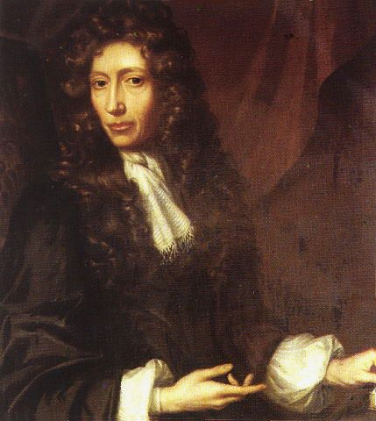
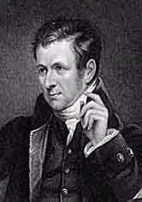
THE BIG IDEA COMES FROM…
ROBERT BOYLE
1627-1691
JOHN DALTON
1766-1844
Describes how to identify ELEMENTS
Describes HOW ELEMENTS FORM COMPOUNDS

Slide 8
DEFINES ELEMENTS OPERATIONALLY*
An element cannot be broken down into a simpler substance by chemical means.
Alternatively:
an element can never be made to lose weight by any chemical process or procedure….
*(operational=>based on known experimental procedure)

Slide 9
1805: Dalton makes an atomic theory by extending Boyle’s `operational’ definition: TLC gets `physical’
Gist of Dalton’s atomic theory: (see chapter 1)
An element is an `indivisible’ little ball of material called an atom.
All atoms of a given element weigh the same.
Atoms of different elements are distinguished by differences in their weight.
compounds are formed by combining fixed ratios of atoms of different elements and so compounds of a given composition have a constant mass for a constant count of compound.

