Slide 1
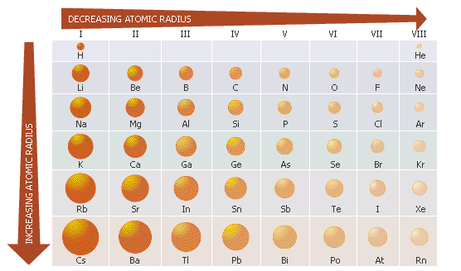

Notable Periodic Trends
Representative element trends (see fig 2.36 pg 96)
Transition metal element (d block) trend

Slide 2
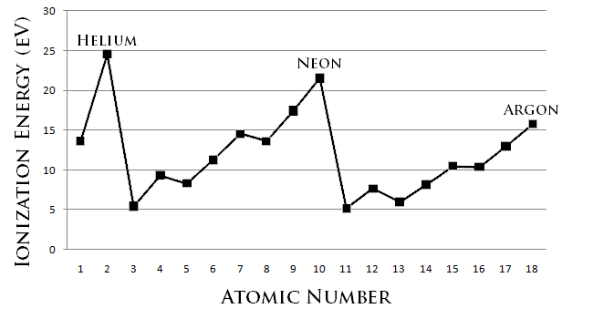
(First) Ionization energy = energy needed to remove outermost electron of an element (see fig 2.32 p 92)
Filled s,p, d states are most stable;
half-filled states `shield’ succeeding electrons from nucleus (makes them less stable)
N= [He]2s²2p³
P= [Ne]3s²3p³
Be=
[He] 2s²
Mg=
[Ne] 3s²

Slide 3
d-ionization potentials (IP) expanded
IP energy
Zn
filled
Mn
more than half-filled
Less than half-filled
1 2 3 4 5 6 7 8 9 10
3 d electron count

Slide 4
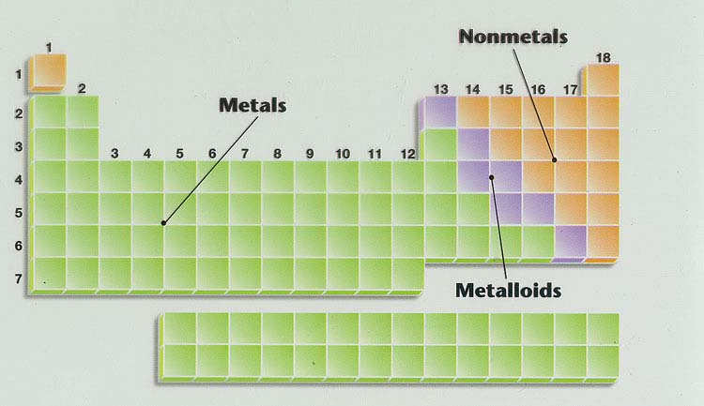
Geography of Periodic Table
see also figures on pp. 89,97
Main group elements
Alkaline earth metals
Noble metals
Ag, Au, Pt (Cu)
Noble gases
halogens
Transition metals
Alkali metals
Lanthanides (good to know too) f electrons here
Actinides (good to know too) more f electrons here
Know where metals, metalloids and non metals are + stuff in yellow boxes

Slide 5
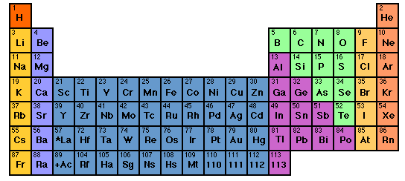
In-Class Drill/Practice

Slide 6
Periodic Table Geography Bee
1) Last column to right; Neon is an example
Noble (Inert) Gases
2) Three main divisions: Metals, Non-Metals and…..
Metalloids
3) Name two (2) of the metalloids
B, Si, Ge, As,Te (Tellurium), Sb (Antimony),
At (Astatine)…B,As,Ge,Si = microelectronic chips

Slide 7
Periodic Table Geography Bee (continued)
4) Chlorine is in this column
Halogens
5) Another name for where d electrons live….
Transition metal block
6) Au, Pt, Ag, Cu…we’re special and called…
NOBLE METALS (very unreactive…but not as unreactive as NOBLE GASES)

Slide 8
Periodic Table Geography Bee (continued)
7) Column 1 type elements are…
Alkali Metals
8) Another name for where f electrons live….
Lanthanide or actinide
9) Au, Pt, Ag, Cu…we’re special and called…
NOBLE METALS (very unreactive…but not as unreactive as NOBLE GASES)

Slide 9
Periodic Table Geography Bee (continued)
10) Calcium’s in this club. So is Barium and Radium. You can often dig us up….
Alkaline Earths
11) Another name for where p electrons live….and chemical act `normal’
Main Group Elements
12) The majority of elements are….
metals

Slide 10
Elements in the `hood’:
1) My atomic number is 17. What are two names for where I live ???
Halogens or Main Group element
2) My average atomic mass is ~73. Who am I and what kind of animal am I ???
Germanium (Ge), a Metalloid
3) [Ar] 3d¹⁰4s¹ (when I’m `right’). Who am I and am I metal, metalloid or non-metal
Copper (Cu) a metal

Slide 11
Elements in the `hood’ (continued):
4) Since we’re here, name two different names for where Cu lives
Transition metal block and noble metal
5) I’m in table salt, colored green as a gas and am sweet 17…I must live where ? (name the column)
Chlorine…in the halogen column
6) I ‘m very rightwing, lazy, and never mix with lower class elements.I weigh ~40. Who am I and what sort of animal am I
Argon an inert=noble gas

Slide 12
Exam 1 Headers and sample questions
(Monday 24 September 2012)
1.0. Introductions
What corporation did Doc Fong work at before becoming an impoverished chemistry professor?
__________________________________
1.1 Atomic dimensions and scaling
What is the ~ratio of an electron orbit diameter to an atomic nucleus diameter?____________________
What is the ratio of proton to electron mass ? ___________
If baseball (~2 inches across) is the nucleus the electrons would be
a) 10 feet away b) 300 miles away c) 3 miles away

Slide 13
1.2 Element Symbols and Names
Circle all the symbolic representations of atomic elements below that are incorrect: (must circle all for credit)
BB Xe tO yyy Cr
Write the correct name or symbol for the elements listed below: (1 pt for each correct answer) SPELLING MATTERS
Silver ____ Hg _________ potassium ___
How many neutrons are present in neutral Boron-11 ? __

Slide 14
1.3 Atomic Body Part Count
Atomic # | mass # | element symbol | #p | #n | #e | atom charge
12 | 25 |  |  |  |  | 0
1.4. Let There be Light
Sort the statements below as belonging to the `old; or `new’ theory of light:
E_{photon} =hf________
light’s energy is in the amplitude _________

Slide 15
1.5 Basic Calculations
Given that λ*f = c=3*10⁸ m/s
Calculate f given λ=10,000 m ____
Given E=hf= hc/λ ; h=6.63*10⁻³⁴ J*s c=3*10⁸ m/s
Calculate E given f=3*10⁷ hz _______________
Calculate E given λ =1*10⁻⁴ m _______________
Convert 0.0000000035 to scientific notation ________
Convert 2.1*10⁵ to decimal notation __________________
1.6. Bohr’s Theory of the atom
Name two new ideas Bohr introduced to describe the H atom:
1) 2)
Name two failures of the Bohr theory of the atom::
1) 2)

Slide 16
1.7. Electronic Configurations of the Atoms (using the Periodic Table provided during exam)
Write the complete electronic configurations for the elements below Mg _________________________________
Write the correct abbreviated electronic configurations for the elements below, making sure to pay attention to all the rules associated with d electrons if they are present.
P_______ Fe__________
Write the correct pigeonhole (orbital) diagrams for the elements below, making sure to pay attention to all the rules associated with d electrons if they are present, and including the correct inert gas core.
Cr_________________ Cu__________________________

Slide 17
1.8 Periodic Table Predictions and Vocabulary
See mini-quiz 10
Chlorine is in this group column __________________
Example of an alkali metal__________________
1.9 This, that and the other things
What experiment destroyed the old theory of light ? _____________________________
True or False
Bohr’s theory of the atom is good for all the elements. T F

