Slide 1
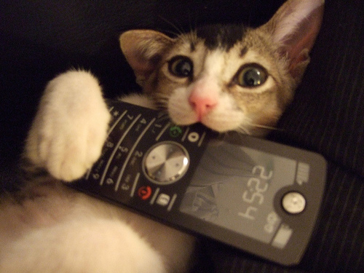
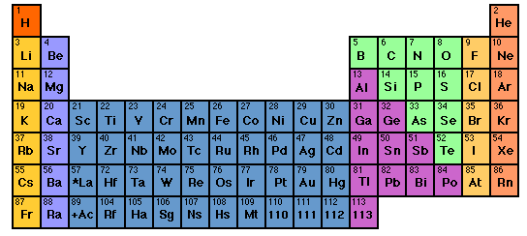
Hold the phone kids…
where did the Periodic Table come from in the first place ????
Whose your Daddy ?
READ pages
82-98

Slide 2
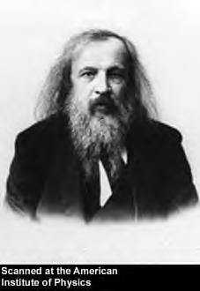
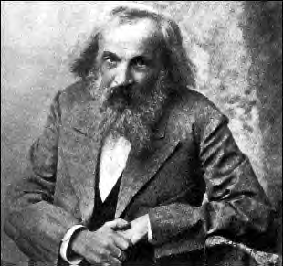

THINKING LIKE A CHEMIST: Russian style
Dimitri Mendeleev ~1865
Winner of Mendeleev look alike contest
Dr. Steve Jakobi,Alfred State Biology professor kicking a cold brewski back. Da ! Da !
Out of school… cardplayer, known party animal , political troublemaker & confirmed `tippler’
At …St Petersburg U Chemistry …the dedicated chemistry teacher;

Slide 3
The mess he deals with…
~ 60 elements by 1865
# element some properties
1 H completely reactive; not found except as H₂ gas at room temperature. Found in numerous organic and inorganic compounds
He completely unreactive. Gas at room temperature.
No known compounds of He.
3 Li very reactive. Solid metal at room temperature.
Found many inorganic compounds
No apparent rhyme or reason as element count goes up….

Slide 4
`How Do We Organize the Element Problem’ Analogies
1) Is there a coherent `pattern’ to the 26 symbols ?
ABCDEFGHIJKLMNOPQRSTUVWXYZ
THE QUICK BROWN FOX JUMPS OVER THE LAZY DOG

Slide 5
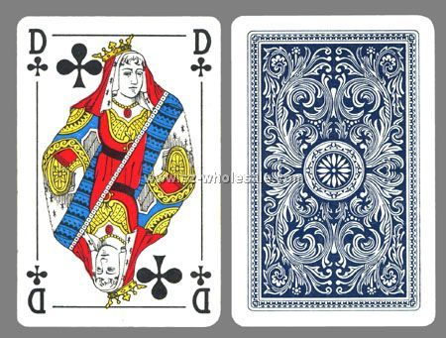

2) Card player insights
Analogies (continued)
⁶C
12.01
GRAPHITE
MP 1710 ^{O}C
d=2.11 g/cm³
BLACK
CO, CO₂
2 other crystal forms
Playing card
Element card

Slide 6
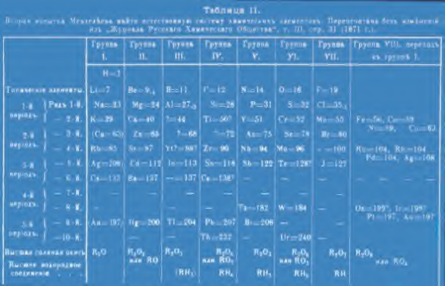

Slide 7
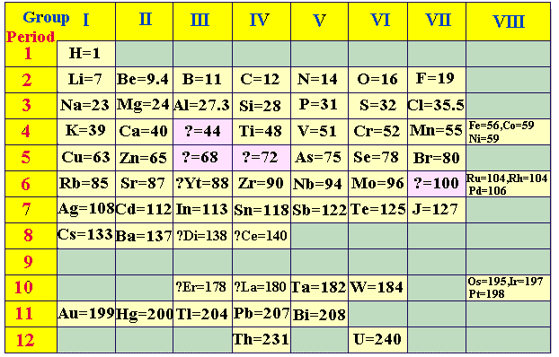
THINKING LIKE A CHEMIST: Mendeleev (cont.)
Organizing the mess that are the ~60 known elements circa 1870:
Negative of Mendeleev’s
Perioyodik tablo
“Colorized” version with English translation

Slide 8
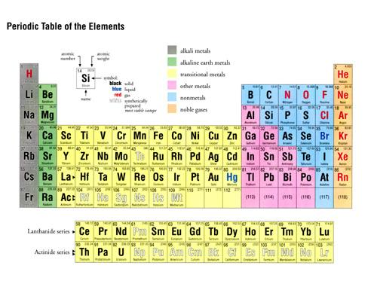
Modern version of Mendeleev’s Periodic table of the elements

Slide 9

Why the Periodic Table Rocks….
Thinking Like a Chemist Russian style
property
Atomic mass
Melting point (º C)
Density (g/cm³)
common oxide
Density of oxide(g/cm³)
common chloride
chloride boiling point (º C)
??
Ge
Silicon (Si)
predicted¹
Found¹
Tin (Sn)
28
1410
2.33
SiO₂
2.66
SiCl₄
57.6
72
821
5.5
XO₂
4.7
XCl₄
100
72.6
947
5.4
GeO₂
4.23
GeCl₄
84
118
232
7.28
SnO₂
6.95
SnCl₄
114
Average of Si and Sn data
²1886 Germanium (Ge) discovered

Slide 10
Another example…
property
Atomic mass
Melting point º C
Boiling point ºC
Density (g/cm³)
common oxide
Predicted for
`eka-Aluminum
Gallium ¹
68 amu
Low
HIGH
5.9
X₂0₃
69.7
30.1 ^{O} C
1983 ºC
5.91
Ga₂O₃
¹ discovered in 1874 by Paul-Emile Lecoq de Boisbaudran

Slide 11
You Try Thinking Like a Russian Chemist…
symbol | Atomic # | Mass # | #n/#p | Melting pt ºC | Boiling point ºC | Density g/cm³ | name
Fi | 150 | 315 | 1.10 | 1400 | 2400 | 7.0 | Fee
 |  | Done on board
Fo | 170 | 357 | 1.10 | 1800 | 3000 | 9.0 | Foe
 |  | Done on board
Fy
160
160
1.10
1600
2700
8.0
Fye
Fu
180
1.10
2000
3300
10.0
Fum
Finding Mass # for Fy:
#n/#p= 1.10 =#n/160
=> 1.10*160=#n= 176
∴mass #=#n+#p= 176+160=336

Slide 12

Periodic Commonalities: halogens
MP and BP very different
X
p mass
MP (^{O}C) BP ( ^{O} C)
So what’s common ???
3 7
11 23
19 40
37 85
55 133
-220
-101
-7
114
302
-188
-35
59
184
337
Halogen chemistry !!!
2Na + X₂ → 2NaX (high melting white salts)
X₂(colored) + ethene→ colorless dihalides
Breathing X₂ kills you

Slide 13
Another example of periodic commonality inert (noble) gases
p mass
MP(º C) BP (⁰ C )
4
20
40
84
131
86 222
-272 - 269
-249 -246
-189 -186
-157 -152
-112 -107
-71 -62
So what’s common ???
Noble gas chemistry
NONE

Slide 14

A final example of `period commonality’:
reactivities of alkali metals
Alkali metals
SO WHAT’S COMMON ??
It’s all about ….
[inert gas] ns¹
chemistry
SIZE (n) MATTERS !

