Slide 1

Ways of singing the spdf song so far….
1)COMPLETE CONFIGURATION:
1s²2s² 2p⁶ 3s²…
Exercise 2.1
2)ABBREVIATED CONFIGURATION:
[Ne]3s²…
Exercise 2.2
3) d-SWITCHED CONFIGURATIONS FOR ELMENTS WITH `d’
[Ar] 4s²3d⁵
→[Ar]3d⁵4s²
Exercise 2.3
Periodic Table
Chemistry correction

Slide 2
another d block example:
One more song…
Cr⁺¹
[Ar] 4s¹ 3d⁵
Cr
Remove 1 e⁻
[Ar] 4s¹ 3d⁴
[Ar] 3d⁴ 4s¹
[Ar] 3d⁵ 4s⁰
Cr⁺¹
Correct for chemistry by d-switching
RIGHT based on aqueous chemistry and spectroscopy
Periodic Table predicts
STILL WRONG !! ☹

Slide 3
Pigeonhole representation of electrons¹
As implied by Table
+ d switch
After fill, half-filled, empty correction
Cr⁺
=
[Ar] 3d⁴ 4s¹
[Ar]3d⁵ 4s⁰
Pigeonhole representation
3d
4s
[Ar]
d rule: s and d electrons in valence shell move around to produce filled, half-filled and/or empty orbitals in order to attain a more stable atom
Corrected for filled,half-filled, empty rule
¹Called orbital diagrams in text

Slide 4



Exercise: 2.4 Write the correct, pigeonhole diagrams for the
transition metal species below
a) Cr
Ni
Ag⁺
remember…rule is applied ONLY with the s & d electron combos (e.g. transition elements only)

Slide 5
Why the spdf song is sung…..
1) Electrons do all the chemistry
2) Just the outermost (valence)
electrons determines an element’s
specific chemical behavior (!!)

Slide 6
detailed chemistry?
≈
[Ne] 3s¹
Na
= [Ne] 3s¹
Na chemistry
is all about the
3s¹ electron
Valence electron
Abbreviated configuration ?
detailed chemistry ?
≈
[He] 2s²2p²
C
=[He] 2s²2p²
Abbreviated configuration ?
Chemistry of C is all about 2s²2p² electrons

Slide 7

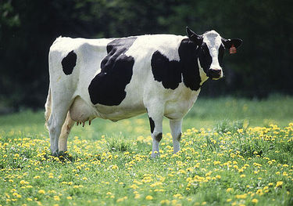

Animal analogies
Dogs drool, cats rule
s is for silly cow
p is for pretty kitty
d is for damned
dumb dog

Slide 8
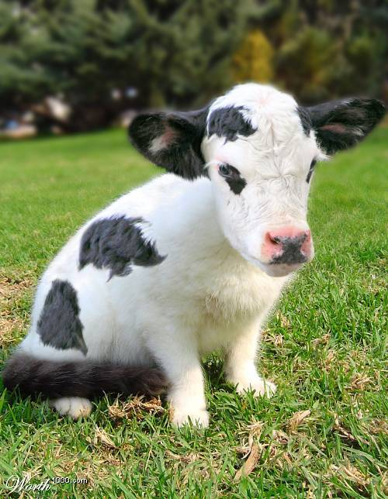
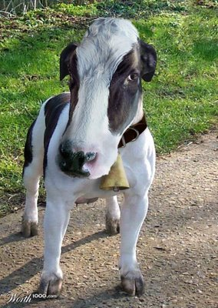
The specific combo of s,p,d
“animal” character defines the unique chemistry of an element
Be= [He]2s²
Cl=[Ne]3s² 3p⁴
Ti = [Ar] 3d²4s²
100% cow
33% cow+66% kitty
50% cow +50% dog

Slide 9
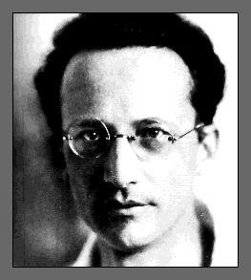

A little addendum…
Erwin Schrodinger (whiz kid) finally solves H atom to everyone’s satisfaction (in mid 1930s) with equation below* but only after the spectroscopists gave him the benchmarks to measure his predictions against….
*
“-h(∇²ϕ)/2m +μϕ/r =Eϕ obviously…(duh)”
Schrodinger’s eigenvalue equation for single electron in 1/r electrostatic potential field (H atom)
“….spectroscopists rule, you drool.”
No closed math form for general atoms

Slide 10

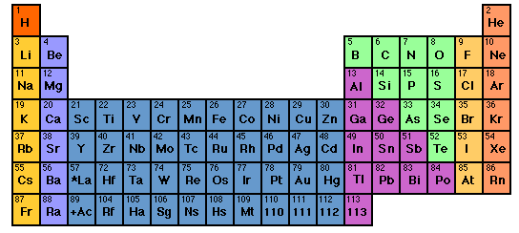
Hold the phone kids…
where did the Periodic Table come from in the first place ????
Whose your Daddy ?
READ pages
82-98

