Slide 1
Exercise 7B problems #1 and 2 examples …on white board

Slide 2

% Yield: a Familiar, non-chemical analogy
Billy comes home with his math test. He got 40 out of 75 questions right. Did he `pass’ the test ?
Test Score = Test Yield =
100* 40 =53.3%
75

Slide 3


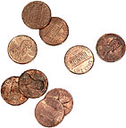
…and % Yield
Lottery Math
What you get back as winnings
(1 billion /year)
+
What New Yorkers put in
(~ $30 billion /year)
% yield = what get back __x 100
what we put in
29 billion “for the children”’
% yield = 1 billion x 100= 3.3
30 billion

Slide 4
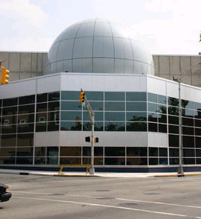
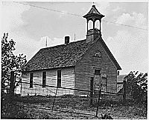

Another non-chemical % yield calculation
Dollars left over from lottery
=
$29 billion
Annual K-12 budget in New York
=
15 billion
% yield =
15 billion x 100
29 billion
51.7 %
=
29 billion-15 billion=14 billion for…
NYS Assemblyman doing what he does best

Slide 5
Examples of chemical % yield
5O₂ + C₃H₈ → 3CO₂ + 4H₂O
Given mol excess 0.25 0.7 (obs)
Theory product mol
Exp. Product mol
4 x 0.25 =1 (theory) 1
% yield =exp. Mol x 100
theory mol.
= 0.7 x 100 1
= 70%

Slide 6
Examples of chemical % yield (continued)
5O₂ + C₃H₈ → 3CO₂ + 4H₂O
MW 32 44 44 18
Given excess 1.1 g 0.5 g
Mol C₃H₈ = 1.1=0.025
44
Exp. Mol CO₂
= 0.5 = 0.01136
44
Theory product
CO₂ moles
3 x 0.025 =0.075
1
% yield =0.01136 x 100% =15.1%
0.75

Slide 7
Exercise 7B problem 3 example …on white board

Slide 8
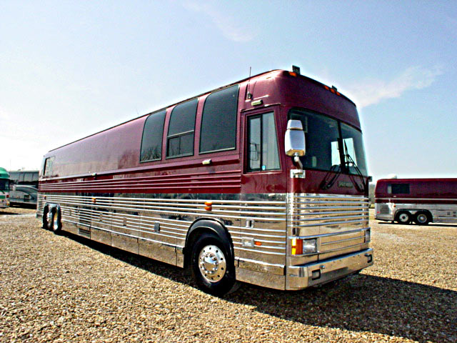
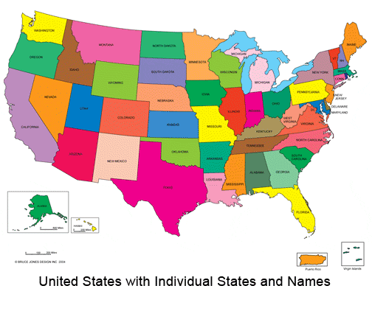


Where we’ve been so far on the chemistry bus trip…

Slide 9


Where we’ve been….
Rutherford & Bohr 1910
1) Atomic structure & dimensions
2) p+.nº , e⁻ bookkeeping
3) Crazy quantum models

Slide 10

Where we’ve been ……
Mendeleev 1865 AD
1)Organizing element behavior to predict chemistry
2)Periodicity and the Periodic Table

Slide 11


In the land of the spectroscopists:
Where we’ve been….
1s² 2s² 2p⁶ 3s² 3p⁴ ……
Describing atoms by electronic configurations implied by observation and predicted by Periodic table
spectroscopy
`fugetabout theory….let the line spectra rule…wise guys

Slide 12
Where we’ve been…
Dalton 1805AD
1)Law of constant proportions
2)Law of multiple proportions
Moles till we drop…..

Slide 13

The Americans land… Gilbert Newton Lewis 1925 AD
: using the Periodic table to predict compound formulas without breaking a sweat
READ 169-182

Slide 14

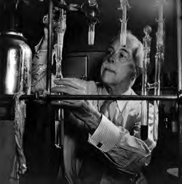

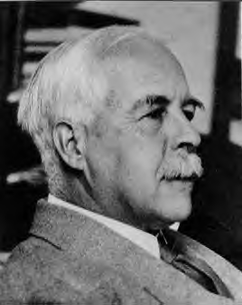
Thinking like the American chemist:
Gilbert Newton Lewis
In early 1970s…Young Doc Fong sits in here staring every day at a 4’x 6’ photo of…
The House that Lewis Built: Lewis Hall of Chemistry
UC Berkeley
Gilbert Newton Lewis American Chemist UC Berkeley “at work” ~1930

