Slide 1


Finish Exercise 7 :
Sample Reaction 2
Chemical Stoichiometry Problems
Sample reaction 2
6HCl + 2Al -----→ 2AlCl₃ + 3H₂
36 27 123 2 g/mol
BOARD WORK

Slide 2
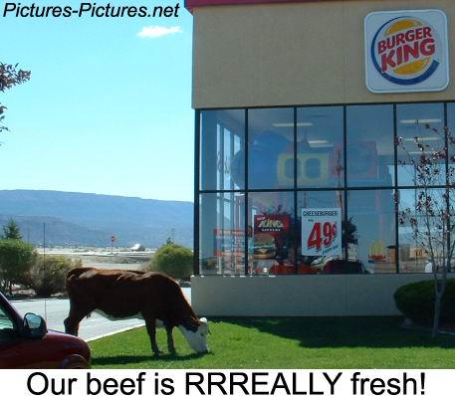



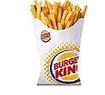
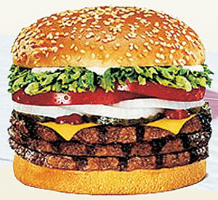
Limiting Reagent (factor) problems see exercise 7b
The bus- tour- stops- at- Burger-King-for- lunch Analogy
30 hungry passengers
$120
2
+

Slide 3

Limiting factor done the `cut and try’ way
Balanced `reaction’
1 `meal’
$5 +
2
1
+
1 bus passenger
BK Super
size fries
Triple
WHOPPER
$120 30
???
Case 1: $120 →
??? fries
fries
* 2 fries
$ 5
$ 120
*
??
= 48 fries

Slide 4
Limiting factor done the `cut and try’ way
Balanced `reaction’
1 meal
$5 +
2
1
+
1 bus passenger
BK Super size fries
Triple WHOPPER
$120 30
???
fries
??? fries
Case 2: 30 passengers →
2 fries
passenger
??
=60 fries
30 passengers *
vs 48 fries using $ limit

Slide 5
The `cut & try’ approach to limiting yield calculations
Chemical reaction example #1 :
5O₂ + C₃H₈ → 3CO₂ + 4H₂O
mol 0.33 0.1 ?? mol
Compute theoretical CO₂ using both reagents
0.33
3*0.33 =0.2 mol
5
…pick smallest… it’s the winner
(small is beautiful)
0.10
3*0.1 = 0.3 mol
1
Given 0.33 mol O₂ and 0.10 mol C₃H₈, compute the theoretical yield of CO₂ moles (what do we run out of first, O₂ or C₃H₈ ?)
Helpful observation: in limiting yield calculations at least two reactant masses or moles are given

Slide 6
The `cut & try’ approach to limiting yield calculations (cont.)
Chemical reaction example #2:
5O₂ + C₃H₈ → 3CO₂ + 4H₂O
0.18 g
g 4.0 2.2 ? g
Compute H₂O wt
MW 32 44 44 18
0.1 x18
Mol 4.0/32
=0.125
2.2/44
=0.05
4 x 0.125 = 0.1 mol
5
4x 0.05 = 0.2 mol
1
Find moles H₂O using both O₂ and C₃H₈
Compute moles O₂ and C₃H₈ using given masses
pick smallest..its the winner
Given 4.0 grams O₂ and 2.2 grams C₃H₈, compute the theoretical yield of H₂O for the combustion shown above

Slide 7
Examples of chemical % yield
5O₂ + C₃H₈ → 3CO₂ + 4H₂O
Given mol excess 0.25 0.7 (obs)
Theory product mol
Exp. Product mol
4 x 0.25 =1 (theory) 1
% yield =exp. Mol x 100
theory mol.
= 0.7 x 100 1
= 70%

Slide 8
Examples of chemical % yield (continued)
5O₂ + C₃H₈ → 3CO₂ + 4H₂O
MW 32 44 44 18
Given excess 1.1 g 0.5 g
Mol C₃H₈ = 1.1=0.025
44
Exp. Mol CO₂
= 0.5 = 0.01136
44
Theory product
CO₂ moles
3 x 0.025 =0.075
1
% yield =0.01136 x 100% =15.1%
0.75

