Slide 1


Finish Exercise 6 :
Sample Reaction 2
Chemical Stoichiometry Problems
Sample reaction 2
6HCl + 2Al -----→ 2AlCl₃ + 3H₂
36 27 123 2 g/mol
BOARD WORK

Slide 2
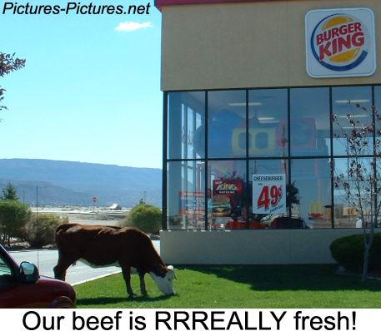
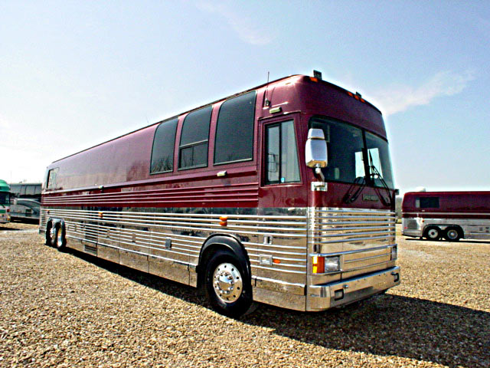


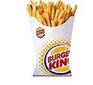
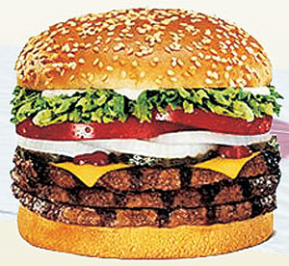
Limiting Reagent (factor) problems see exercise 7b
The bus- tour- stops- at- Burger-King-for- lunch Analogy
30 hungry passengers
$120
2
+

Slide 3

Limiting factor done the `cut and try’ way
Balanced `reaction’
1 `meal’
$5 +
2
1
+
1 bus passenger
BK Super
size fries
Triple
WHOPPER
$120 30
???
Case 1: $120 →
??? fries
fries
* 2 fries
$ 5
$ 120
*
??
= 48 fries

Slide 4
Limiting factor done the `cut and try’ way
Balanced `reaction’
1 meal
$5 +
2
1
+
1 bus passenger
BK Super size fries
Triple WHOPPER
$120 30
???
fries
??? fries
Case 2: 30 passengers →
2 fries
passenger
??
=60 fries
30 passengers *
vs 48 fries using $ limit

Slide 5
The `cut & try’ approach to limiting yield calculations
Chemical reaction example #1 :
5O₂ + C₃H₈ → 3CO₂ + 4H₂O
mol 0.33 0.1 ?? mol
Compute theoretical CO₂ using both reagents
0.33
3*0.33 =0.2 mol
5
…pick smallest… it’s the winner
(small is beautiful)
0.10
3*0.1 = 0.3 mol
1
Given 0.33 mol O₂ and 0.10 mol C₃H₈, compute the theoretical yield of CO₂ moles (what do we run out of first, O₂ or C₃H₈ ?)
Helpful observation: in limiting yield calculations at least two reactant masses or moles are given

Slide 6
The `cut & try’ approach to limiting yield calculations (cont.)
Chemical reaction example #2:
5O₂ + C₃H₈ → 3CO₂ + 4H₂O
0.18 g
g 4.0 2.2 ? g
Compute H₂O wt
MW 32 44 44 18
0.1 x18
Mol 4.0/32
=0.125
2.2/44
=0.05
4 x 0.125 = 0.1 mol
5
4x 0.05 = 0.2 mol
1
Find moles H₂O using both O₂ and C₃H₈
Compute moles O₂ and C₃H₈ using given masses
pick smallest..its the winner
Given 4.0 grams O₂ and 2.2 grams C₃H₈, compute the theoretical yield of H₂O for the combustion shown above

Slide 7
Exercise 6B example …on white board

Slide 8
Exam 2: Monday 29 October 2012
All material after 24 September
mini-quizzes 11-19
Exercises #3-#6 + `More mole-Mol’ handout
Reading pp 2-8; 112-114, 384-395; (396-406)
  English-metric conversions (2 pts each/6 pts total)
Conversion factors 1 meter = 1.094 yards= 3.281 feet 1 inch=2.54 cm=25.4 mm
1 kilometer= 0.622 miles 1 liter=1000 mL = 0.275 gallons
1 mile=5280 feet =1760 yards 1 lb =454 g = 0.454 kg =16 oz
12 in = 1 foot
Ex. How many oz in 567.5 g ? _______oz in 567.5 g
2.2. Metric-metric symbols and conversions (16 pts)
Prefix name | Symbol(letter) | Magnitude (10^{x})
pico
Ex.

Slide 9
2.3. unknown metal density determination (4 pts)
See density lab and review metal density determination
2.4 egg arithmetic (2 pt each/8 pts total))
A dozen monstrously large eggs from Aldi’s weighs 2000 g. Assuming 1 dozen =12 count:
Ex.
If you have 50,000 grams of eggs, how many eggs do you have ? __________ egg count
2.5. Simple mole-weight-count conversions (3 pts each/18 pts total) SHOW WORK !!!
Assuming that a mole count= 6*10²³ and the gram atomic masses:
C=12 g/mol O=16 g/mol H= 1 g/mol
Ex.
Glucose has the molecular formula C₆H₁₂O₆ . What is its’ molecular weight ? ______g/mol
Ex.
How many molecules of glucose are in 9 grams of glucose ? ______ molecules glucose in 9 grams
2.6. Stoichiometry Problems (`Body Parts’): Show work ! (5 pts each/25 pts total)
The molecular mass of dynamite=TNT (C₇H₅N₃O₆) is 227 g/mol.
Given the atomic masses for C=12 g/mol, H = 1 g/mol, N = 14 g/mol O=16 g/mol
Ex.
How many grams of N are in a sample of TNT containing 0.714 mol H ? _______ g N

Slide 10
2.7. % Composition problems ( 4 pts each/8 pts total)
Element | Weight % | Atomic mass
C | 33.3 | 12
H | 8.3 | 1
O | 44.4 | 16
Ex.
Empiric formula=: ____________________
2.8 Reaction Balancing (2 pt each/ 6 pts total)
Balance these reactions:
___ C₂ H₆ + ___O₂ → ___CO₂ + __H₂O
Ex.
2.8 Naming ( 1 pt/name; 4 pts total) Review Stock naming method presented in lab
Given: acetate = C₂H₃O₂⁻¹ phosphite = PO₃⁻³ carbonate = CO₃⁻² nitrate = NO₃⁻¹
Use the Periodic Table provided to name or determine the formula of the four compounds below:
Ex.
CuCO₃ name=_____________________
2.9 Simple Reaction Stoichiometry Problem (3 pts)
Given the balanced reaction:
2C₈H₁₈ + 25O₂ → 16CO₂ + 18H₂O
MW 114 32 44 18 g/mol
How many grams of water form when 0.061728 mol C₈H₁₈ are burned ? (show work or no credit)
Ex.

