Slide 1
Exam 2: Monday 29 October 2012
All material after 24 September
mini-quizzes 11-19
Exercises #3-#6 + `More mole-Mol’ handout
Reading pp 2-8; 112-114, 384-395; (396-406)
  English-metric conversions (2 pts each/6 pts total)
Conversion factors 1 meter = 1.094 yards= 3.281 feet 1 inch=2.54 cm=25.4 mm
1 kilometer= 0.622 miles 1 liter=1000 mL = 0.275 gallons
1 mile=5280 feet =1760 yards 1 lb =454 g = 0.454 kg =16 oz
12 in = 1 foot
Ex. How many oz in 567.5 g ? _______oz in 567.5 g
2.2. Metric-metric symbols and conversions (16 pts)
Prefix name | Symbol(letter) | Magnitude (10^{x})
pico
Ex.

Slide 2
2.3. unknown metal density determination (4 pts)
See density lab and review metal density determination
2.4 egg arithmetic (2 pt each/8 pts total))
A dozen monstrously large eggs from Aldi’s weighs 2000 g. Assuming 1 dozen =12 count:
Ex.
If you have 50,000 grams of eggs, how many eggs do you have ? __________ egg count
2.5. Simple mole-weight-count conversions (3 pts each/18 pts total) SHOW WORK !!!
Assuming that a mole count= 6*10²³ and the gram atomic masses:
C=12 g/mol O=16 g/mol H= 1 g/mol
Ex.
Glucose has the molecular formula C₆H₁₂O₆ . What is its’ molecular weight ? ______g/mol
Ex.
How many molecules of glucose are in 9 grams of glucose ? ______ molecules glucose in 9 grams
2.6. Stoichiometry Problems (`Body Parts’): Show work ! (5 pts each/25 pts total)
The molecular mass of dynamite=TNT (C₇H₅N₃O₆) is 227 g/mol.
Given the atomic masses for C=12 g/mol, H = 1 g/mol, N = 14 g/mol O=16 g/mol
Ex.
How many grams of N are in a sample of TNT containing 0.714 mol H ? _______ g N

Slide 3
2.7. % Composition problems ( 4 pts each/8 pts total)
Element | Weight % | Atomic mass
C | 33.3 | 12
H | 8.3 | 1
O | 44.4 | 16
Ex.
Empiric formula=: ____________________
2.8 Reaction Balancing (2 pt each/ 6 pts total)
Balance these reactions:
___ C₂ H₆ + ___O₂ → ___CO₂ + __H₂O
Ex.
2.8 Naming ( 1 pt/name; 4 pts total) Review Stock naming method presented in lab
Given: acetate = C₂H₃O₂⁻¹ phosphite = PO₃⁻³ carbonate = CO₃⁻² nitrate = NO₃⁻¹
Use the Periodic Table provided to name or determine the formula of the four compounds below:
Ex.
CuCO₃ name=_____________________
2.9 Simple Reaction Stoichiometry Problem (3 pts)
Given the balanced reaction:
2C₈H₁₈ + 25O₂ → 16CO₂ + 18H₂O
MW 114 32 44 18 g/mol
How many grams of water form when 0.061728 mol C₈H₁₈ are burned ? (show work or no credit)
Ex.

Slide 4
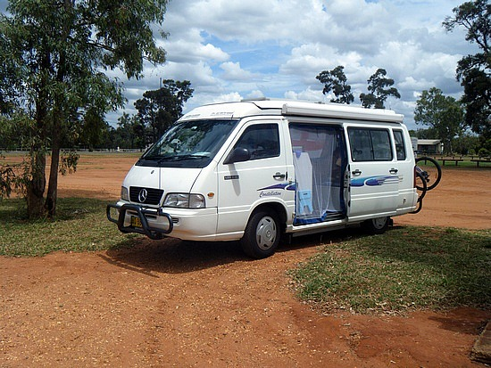

The road trip through mole land so far…
Basic mole-mass-count conversions (Bermuda triangle: exercise 5a)
Mole ratio/ stoichiometry conversion (`body parts related: exercise 5b + exceeding quantities of board practice)
% composition problems and combustion analysis: exercise 6.1
Reaction balancing exercise 6.2

Slide 5
Mole calculations level 3
Reaction Stoichiometry problems: how chemists cook
Sample of Typical Reaction stoichiometry problems
C₃H₈+ 5O₂ → 3CO₂+ 4H₂O
BALANCED√
Example 1: (reactant → product)
Given 16 grams of O₂ predict the maximum molecules of CO₂ that can form.
Example 2: (products → reactants)
How many grams of C₃H₈ are needed to produce 100 grams of H2O ?
Moles or molecules
Moles or molecules
Example 3: (limiting reactant→ product)
Given 1 gram of O₂ and 1 gram of C₃H₈, what is the maximum weight of H₂O we can make ?

Slide 6

“What does reaction stoichiometry have to do with anything really important and practical ?”

Slide 7


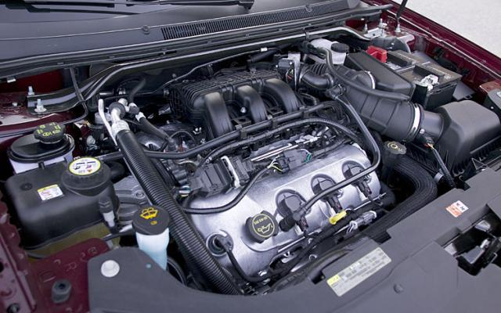
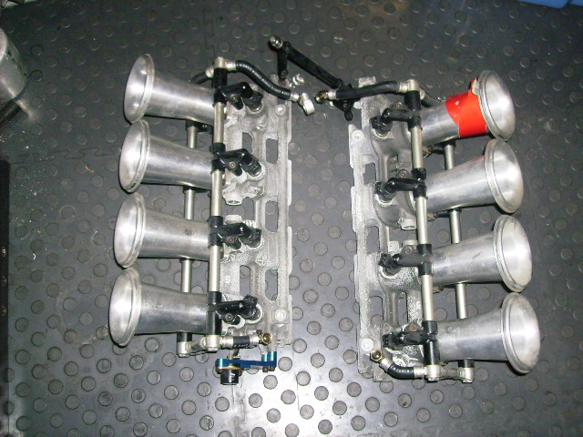
Individual fuel injectors
Stoichiometric control in the real world
Gas/O₂ ratio and flow rate to each fuel injector changes constantly
The GAME CHANGER: Microchips controlling injector flows
V-8 fuel injection module
Goes under here*

Slide 8
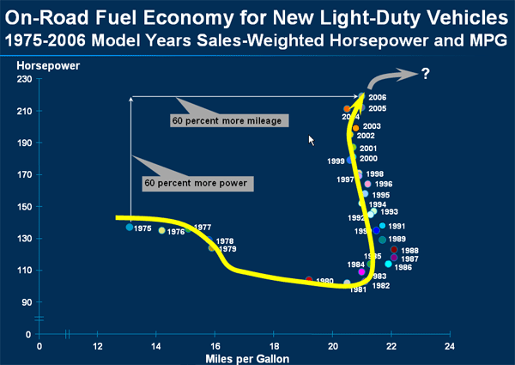
Variation of mpg and hp vs time for light-duty trucks
1975 US Congressional mandate for 23.5 mpg fleet average enacted
8 bit PROM chips become reasonably cheap

Slide 9
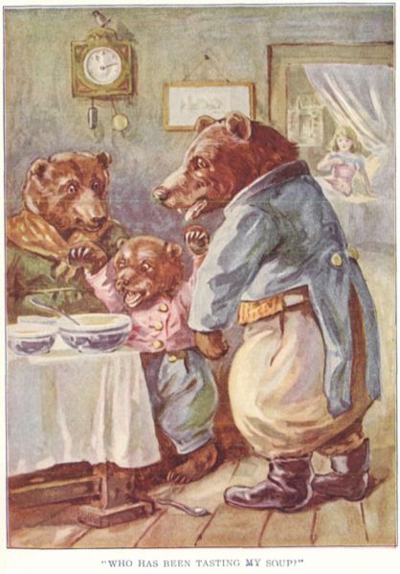

Think about: Goldilocks and the 3 Bears…
The outraged victims….
Mama Bear
O₂/C₃H₈>>5
Papa Bear O₂/C₃H₈<<5
Goldilocks: wantonly commits breaking and entering felony
Baby Bear
O₂/C₃H₈ ≡5

Slide 10
Simple mol-mol stoichiometry conversions
C₃H₈ + 5O₂--------→ 3CO₂ + 4H₂O
How many moles of O₂ will burn to form 1.2 moles of CO₂ ?
Method 1: factor label
1) given
2) want
1.2 mol CO₂
* 5 mol O₂
3 mol CO₂
= ? mol O₂
2
3) Use reaction stoichiometry coefficients in right ratio to cancel and connect…which ratio ???

Slide 11
Mol-mol stoichiometry conversions (continued)
Method 2: `mole ratios’
C₃H₈ + 5O₂--------→ 3CO₂ + 4H₂O
?? m
1.2 mol
Problem stated visually
How many moles of O₂ will burn to form 1.2 moles of CO₂ ?
1) ratio `wanted’ moles in numerator to given in denominator
m
1.2
5
3
2) Set equal to matching coefficients for compounds given in reaction…which ???
=
1.2* m= 1.2 *5
1.2 3
= 2
3)Solve for m

Slide 12
More complex stoichiometry problem done 2 ways
MW 44 32 44 18 g/mol
C₃H₈+ 5O₂ → 3CO₂+ 4H₂O
22 grams of C₃H₈ burned with O₂ makes how many grams of H₂O ?
Method 1: factor label
22 g C₃H₈
x
1 mole C₃H₈
44 g C₃H₈
x
4 mol H₂O
1 mole C₃H₈
x
18 g H₂O
1 mol H₂O
1) Given
= ?? g H₂O
36
2) Want
3)Find ratios that lead to desired units from reaction and MW …which ???...do on board

Slide 13
Method 2: mole ratio way (Board first)
22 grams of C₃H₈ burned with O₂ makes how many grams of H₂O ?
Given:
44 32 44 18 g/mol
Problem
stated
visually
C₃H₈+ 5O₂ → 3CO₂+ 4H₂O
?? g
22 g
0) convert all given and molecule counts to moles
1) ratio `wanted’ moles in numerator to given in denominator
2) Set equal to matching coefficients for compounds given in reaction…which ???
3) Solve for wanted moles
4) Convert wanted moles to wanted final units (grams)

Slide 14
Method 2: mole ratio way
22 grams of C₃H₈ burned with O₂ makes how many grams of H₂O ?
Given:
44 32 44 18 g/mol
Problem
stated
visually
C₃H₈+ 5O₂ → 3CO₂+ 4H₂O
?? g
22 g
0) convert all given and molecule counts to moles
22 g C₃H₈ * 1 mol C₃H₈
44 g C₃H₈
= 0.5 mol C₃H₈
1) ratio `wanted’ moles in numerator to given in denominator
m = mol H₂O
0.5 mol C₃H₈
= 4
1
2) Set equal to matching coefficients for compounds given in reaction…which ???

Slide 15
Method 2: mole ratio way
22 grams of C₃H₈ burned with O₂ makes how many grams of H₂O ?
Given:
44 32 44 18 g/mol
C₃H₈+ 5O₂ → 3CO₂+ 4H₂O
?? g
22 g
3) Solve for wanted moles
m
0.5
= 4
1
0.5 *
*0.5
= 2 mol H₂O
4) Convert wanted moles to wanted final units (grams)
2 mol H₂O * 18 g H₂O
1 mole H₂O
= 36 g H₂O

Slide 16


Exercise 7 : Chemical Stoichiometry Problems

