Slide 1


Chance to earn
Mole $$$ !!
Finish In-class Exercise 6.2 more…
WHITE BOARD WORK

Slide 2
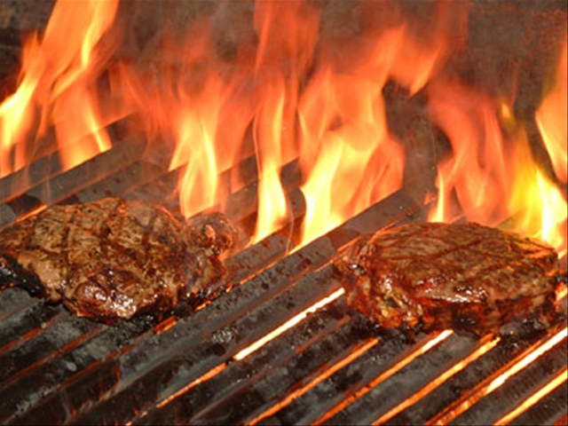
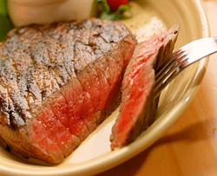
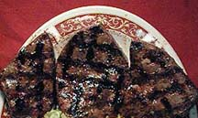
Sometimes several answers possible
Barbecuing steaks…
C₃H₈ + 5O₂ → 4H₂O +3CO₂
Complete combustion
C₃H₈ + 4O₂ → 4H₂O +2CO₂ + C
Incomplete combustion
C₃H₈ + 3O₂ → 4H₂O + CO₂ + 2C
C₃H₈ + 2O₂ → 4H₂O + 3C
Low O₂
→Low CO₂
₋→ High C
(charred)
Hi O₂
→Hi CO₂
→Low C
(no `char’)

Slide 3
From text page 143 Challenge Problem 143…some group discussion on… `cumulative skills’ problem
When M₂S₃ is heated in air it converts entirely to MO₂. A 4.000 gram sample of M₂S₃ loses 0.277 grams when heated. What is the average atomic mass in g/mol of M ?

Slide 4
More group discussion on…
Challenge 3b:
If we burn 1.0 g AsX₅ in O₂ the arsenic (As) releases all the X and forms a pure arsenic oxide, As₂O₃ by consuming 0.09516 g O and expelling 0.7028 g X as X₂. Given that X is a halogen, use the data provided to identify it. (Show work !)

Slide 5

The road trip through mole land so far…
Basic mole-mass-count conversions (Bermuda triangle: exercise 5a)
Mole ratio/ stoichiometry conversion (`body parts related: exercise 5b + exceeding quantities of board practice)
% composition problems and combustion analysis
Reaction balancing

Slide 6
Mole calculations level 3
Reaction Stoichiometry problems: how chemists cook
Some Typical Reaction stoichiometry problems
C₃H₈+ 5O₂ → 3CO₂+ 4H₂O
BALANCED√
Example 1: (reactant → product)
Given 16 grams of O₂ predict the maximum molecules of CO₂ that can form.
Example 2: (products → reactants)
How many grams of C₃H₈ are needed to produce 100 grams of H2O ?
Moles or molecules
Moles or molecules
Example 3: (limiting reactant→ product)
Given 1 gram of O₂ and 1 gram of C₃H₈, what is the maximum weight of H₂O we can make ?

Slide 7

“What does reaction stoichiometry have to do with anything really important and practical ?”

Slide 8

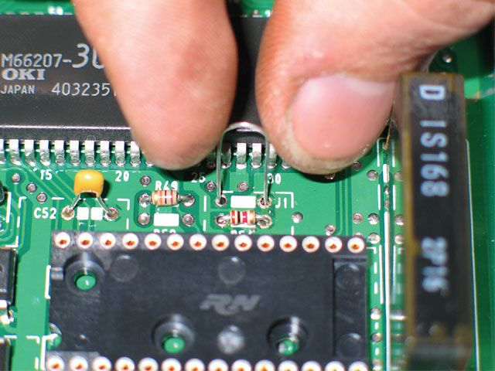
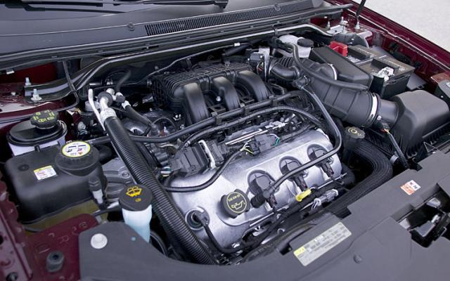
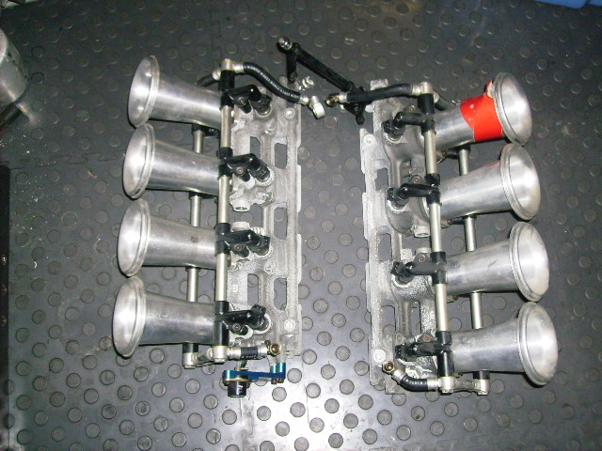
Individual fuel injectors
Stoichiometric control in the real world
Gas/O₂ ratio and flow rate to each fuel injector controlled by engine block microchip
Microchip controlling engine operation
V-8 fuel injection module
Goes under here*
Ok, ok motor heads… I know the engine shown is a V-6

Slide 9
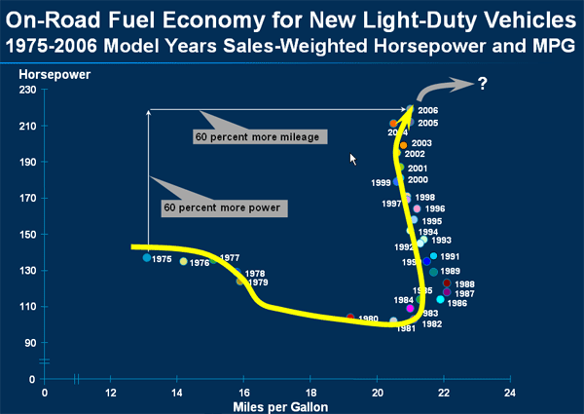
Variation of mpg and hp vs time for light-duty trucks
1975 US Congressional mandate for 23.5 mpg fleet average enacted
8 bit PROM chips become reasonably cheap

Slide 10
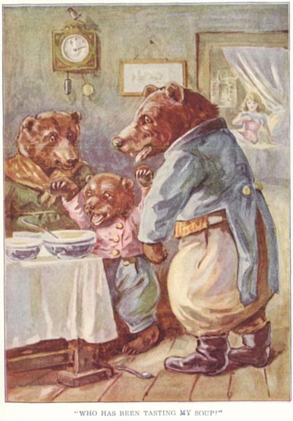

Think about …Goldilocks and the 3 Bears…….
The outraged victims….
Mama Bear
Papa Bear
Goldilocks: wantonly commits breaking and entering felony
Baby Bear

Slide 11
Simple mol-mol stoichiometry conversions
C₃H₈ + 5O₂--------→ 3CO₂ + 4H₂O
How many moles of O₂ will burn to form 1.2 moles of CO₂ ?
Method 1: factor label
1) given
2) want
1.2 mol CO₂
* 5 mol O₂
3 mol CO₂
= ? mol O₂
2
3) Use reaction stoichiometry coefficients in right ratio to cancel and connect…which ratio ???

Slide 12
Mol-mol stoichiometry conversions (continued)
Method 2: `mole ratios’
C₃H₈ + 5O₂--------→ 3CO₂ + 4H₂O
?? m
1.2 mol
Problem stated visually
How many moles of O₂ will burn to form 1.2 moles of CO₂ ?
1) ratio `wanted’ moles in numerator to given in denominator
m
1.2
5
3
2) Set equal to matching coefficients for compounds given in reaction…which ???
=
1.2* m= 1.2 *5
1.2 3
= 2
3)Solve for m

Slide 13
More complex stoichiometry problem done 2 ways
MW 44 32 44 18 g/mol
C₃H₈+ 5O₂ → 3CO₂+ 4H₂O
22 grams of C₃H₈ burned with O₂ makes how many grams of H₂O ?
Method 1: factor label
22 g C₃H₈
x
1 mole C₃H₈
44 g C₃H₈
x
4 mol H₂O
1 mole C₃H₈
x
18 g H₂O
1 mol H₂O
1) Given
= ?? g H₂O
36
2) Want
3)Find ratios that lead to desired units from reaction and MW …which ???...do on board

Slide 14
Method 2: mole ratio way (Board first)
22 grams of C₃H₈ burned with O₂ makes how many grams of H₂O ?
Given:
44 32 44 18 g/mol
Problem
stated
visually
C₃H₈+ 5O₂ → 3CO₂+ 4H₂O
?? g
22 g
0) convert all given and molecule counts to moles
1) ratio `wanted’ moles in numerator to given in denominator
2) Set equal to matching coefficients for compounds given in reaction…which ???
3) Solve for wanted moles
4) Convert wanted moles to wanted final units (grams)

Slide 15
Method 2: mole ratio way
22 grams of C₃H₈ burned with O₂ makes how many grams of H₂O ?
Given:
44 32 44 18 g/mol
Problem
stated
visually
C₃H₈+ 5O₂ → 3CO₂+ 4H₂O
?? g
22 g
0) convert all given and molecule counts to moles
22 g C₃H₈ * 1 mol C₃H₈
44 g C₃H₈
= 0.5 mol C₃H₈
1) ratio `wanted’ moles in numerator to given in denominator
m = mol H₂O
0.5 mol C₃H₈
= 4
1
2) Set equal to matching coefficients for compounds given in reaction…which ???

Slide 16
Method 2: mole ratio way
22 grams of C₃H₈ burned with O₂ makes how many grams of H₂O ?
Given:
44 32 44 18 g/mol
C₃H₈+ 5O₂ → 3CO₂+ 4H₂O
?? g
22 g
3) Solve for wanted moles
m
0.5
= 4
1
0.5 *
*0.5
= 2 mol H₂O
4) Convert wanted moles to wanted final units (grams)
2 mol H₂O * 18 g H₂O
1 mole H₂O
= 36 g H₂O

Slide 17

Exercise 7 : Chemical Stoichiometry Problems

