Slide 1
Chemical Compositions from Reaction Data
1) A 0.30 gram sample of carbon black is burned in a covered crucible. The collected gas weighs 0.70 grams. What is the empiric formula of the gas ? (C =12, O =16)
C ---------------------------------------→ CO_{x}
0.3 g 0.7 g
Mass O=0.7-0.3 g=0.4 g
Mol C= 0.3/12
=0.025
Mol O= 0.4/16
=0.025
Mole C/Mol O = 0.025/0.025=1=>CO

Slide 2
Chemical Compositions from Reaction Data (continued)
2) A hydrocarbon sample (C_{x} H_{y}) is burned in oxygen producing 1.0 gram of CO₂ and 0.4086 g H₂O. What is the empiric formula for the hydrocarbon ? (C=12, O=16, H=1)
Blackboard work !

Slide 3
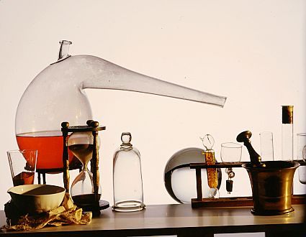
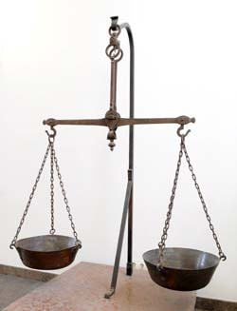
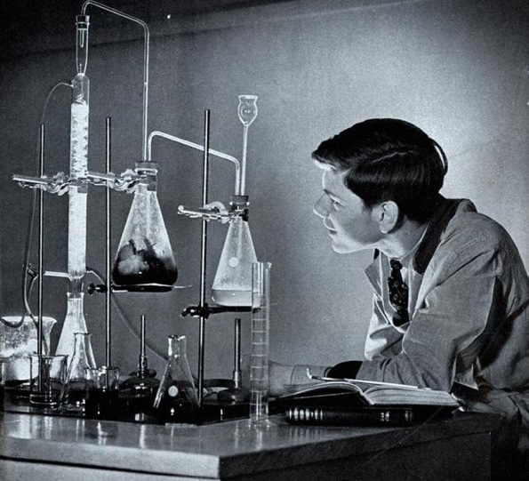
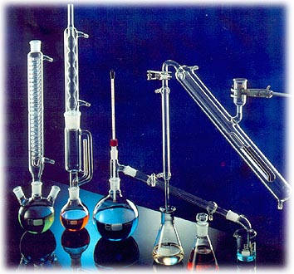
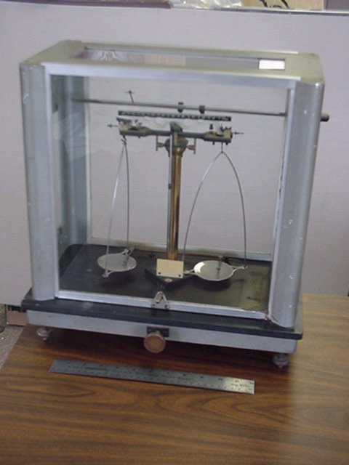

Brief historical aside:
Finding compositions: then and now
Then: ~ 1700-1950 : classical chemical methods decompose and capture elements
Glassware
+ Balance
+ Chemical Finesse
1750
1950

Slide 4
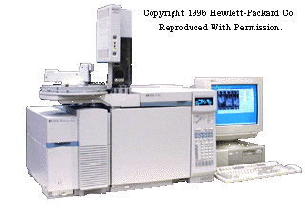
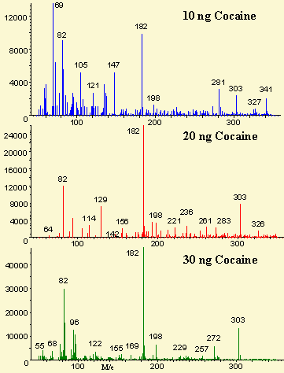
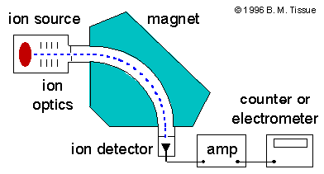
…now 1950-2010
…instrumentation rules
ASC Instrumentation lab has three of these (~80 k$ each)
Mass Spec (CSI !)
Mass spectrum of cocaine

Slide 5

Old-school analysis took 1-3 days…relied on the bench skills and savvy of the chemist
New school GC-MS analysis yields answers in a few minutes…computer matches patterns… any yahoo can feed the instrument and read the computer output
a grumpy old Doc Fong kvetch….
With every advance, we lose something
…many recent Ph.Ds in chemistry know
more about computers than classical analysis, can’t build equipment and are not `sensitive’ in the lab.

Slide 6
Chemical bookkeeping: balancing reactions old school
(on blackboard)
2
2
Cu +O₂ → CuO
Example #1:
Element combustion
Balanced !!!! ☺

Slide 7
Reaction balancing (continued)
Example #2:
Organic combustion
Balanced…at last !!!!
C₃H₈+ O₂ → CO₂+ H₂O
5
3
4
Propane=LNG
Liquid Natural Gas

Slide 8
Slightly trickier balancing…the odd/even oxygen dilemma
Internal combustion reaction
2
16
__C₈H₁₈ + __O₂→ __H₂O + __ CO₂
25
18
Octane = gasoline
balanced

Slide 9

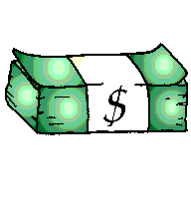
Chance to earn
Mole $$$ !!
In-class Exercise 6.2 + more…
WHITE BOARD WORK

Slide 10
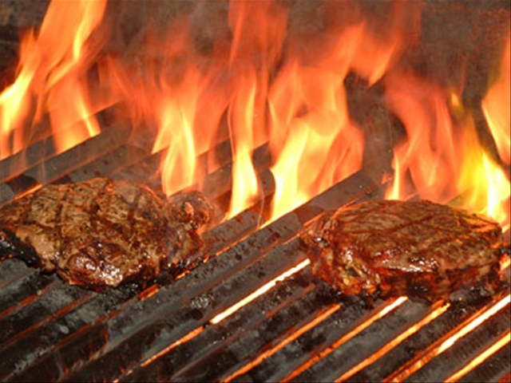
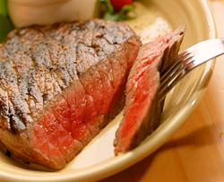
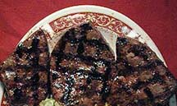
Sometimes several answers possible
Barbecuing steaks…
C₃H₈ + 5O₂ → 4H₂O +3CO₂
Complete combustion
C₃H₈ + 4O₂ → 4H₂O +2CO₂ + C
Incomplete combustion
C₃H₈ + 3O₂ → 4H₂O + CO₂ + 2C
C₃H₈ + 2O₂ → 4H₂O + 3C
Low O₂
→Low CO₂
₋→ High C
(charred)
Hi O₂
→Hi CO₂
→Low C
(no `char’)

Slide 11
From text page 143 Challenge Problem 143
…a `cumulative skills’ problem
When M₂S₃ is heated in air it converts entirely to MO₂. A 4.000 gram sample of M₂S₃ loses 0.277 grams when so heated. What is the average atomic mass in g/mol of M ?

Slide 12
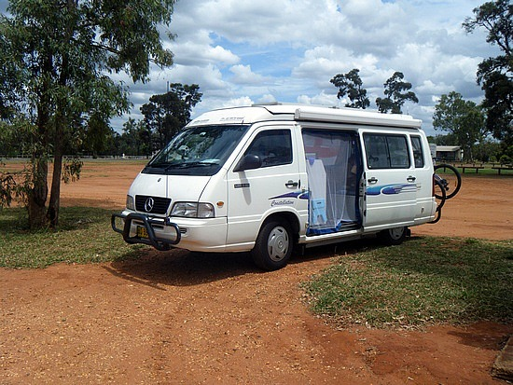
The road trip through mole land so far…
Basic mole-mass-count conversions (Bermuda triangle: exercise 5a)
Mole ratio/ stoichiometry conversion (`body parts related: exercise 5b + exceeding quantities of board practice)
% composition problems and combustion analysis
Reaction balancing

Slide 13
Mole calculations level 3
Reaction Stoichiometry problems: how chemists cook
Some Typical Reaction stoichiometry problems
C₃H₈+ 5O₂ → 3CO₂+ 4H₂O
BALANCED√
Example 1: (reactant → product)
Given 16 grams of O₂ predict the maximum molecules of CO₂ that can form.
Example 2: (products → reactants)
How many grams of C₃H₈ are needed to produce 100 grams of H2O ?
Moles or molecules
Moles or molecules
Example 3: (limiting reactant→ product)
Given 1 gram of O₂ and 1 gram of C₃H₈, what is the maximum weight of H₂O we can make ?

Slide 14

“What does reaction stoichiometry have to do with anything really important and practical ?”

Slide 15
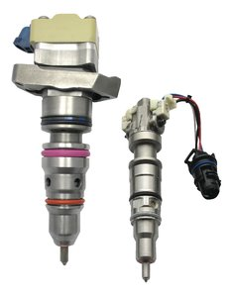
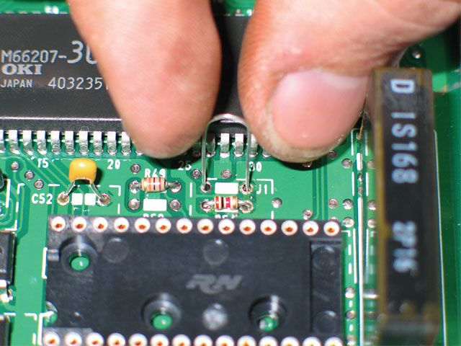
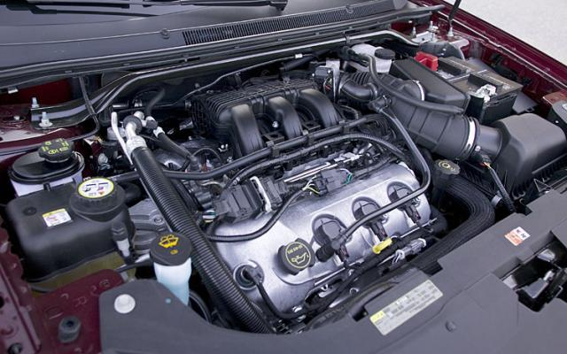
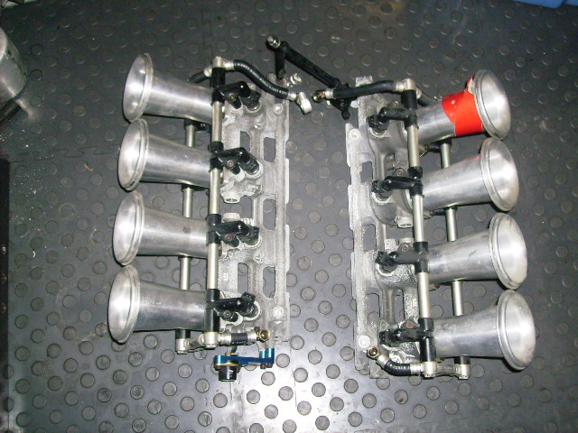
Individual fuel injectors
Stoichiometric control in the real world
Gas/O₂ ratio and flow rate to each fuel injector controlled by engine block microchip
Microchip controlling engine operation
V-8 fuel injection module
Goes under here*
Ok, ok motor heads… I know the engine shown is a V-6

Slide 16
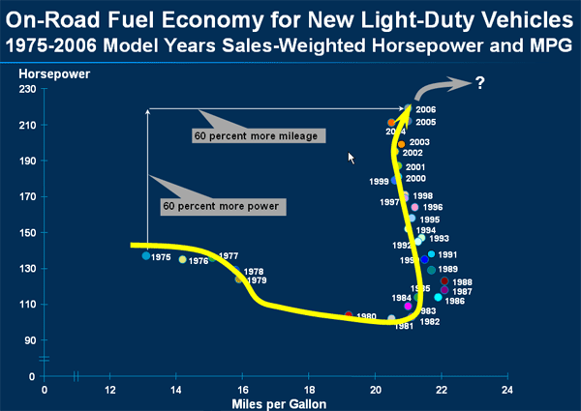
Variation of mpg and hp vs time for light-duty trucks
1975 US Congressional mandate for 23.5 mpg fleet average enacted
8 bit PROM chips become reasonably cheap

Slide 17
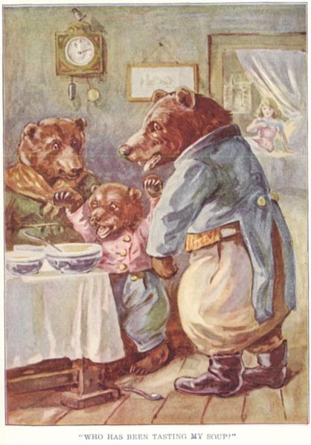

Think about …Goldilocks and the 3 Bears…….
Papa Bear
Mama Bear
Goldilocks: commits breaking and entering felony
Baby Bear

Slide 18
Simple mol-mol stoichiometry conversions
C₃H₈ + 5O₂--------→ 3CO₂ + 4H₂O
How many moles of O₂ will burn to form 1.2 moles of CO₂ ?
Method 1: factor label
given
from reaction stoichiometry
x
5 mol O₂
3 mol CO₂
1.2 mol CO₂
= 2 mol O₂

