Slide 1
2.5) moles to molecules
how many molecules of O are present in 0.13888 mol of C₆ H₁₂O₆?
=5*10²³
2.6) molecules to moles
how many moles of C₆ H₁₂O₆ are formed from 4.32*10²⁵ atoms of H ?
6 moles

Slide 2
2.7 mass to molecules:
how many molecules of C₆ H₁₂O₆ form from 84 g of C ?
7 *10²³ molecules of C₆H₁₂O₆
2.8 atoms to mass:
how many grams of H are combined with 2.7*10²⁴ atoms of O in C₆H₁₂O ₆ ?
9 grams H

Slide 3

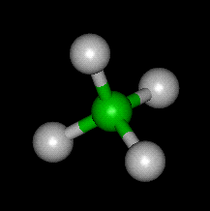
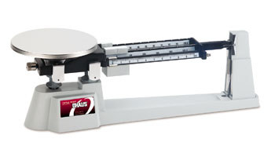
% composition problems: using mole concept to convert weights to formulas
Sample problem #1 (see also pp 93-102)
A compound of N and O contains 63.63 wt % N and 36.36 wt % O. What is the empiric formula of the compound ?
empiric formula= mole ratio of elements in compound expressed in lowest whole numbers
Definition:
Example: CH₂O = empiric formula of glucose
Actual molecular formula (what it really has in atom count)
C₆H₁₂O₆=
(CH₂O)₆
Sugar =Carbo hydrate

Slide 4
Which formulas below are empiric
(= lowest common denominator form) ??
Now EMPIRIC
C₃H₆O₃
÷ 3
NOT EMPIRIC
CH₂O
N₃F₇
EMPIRIC…3 & 7 have no shared factors

Slide 5
Which formulas below are empiric
(= lowest common denominator form) ?? (continued)
H₃P₉O₁₂S₅
Do not write HP₃O₄S_{5/3}
EMPIRIC …5 has no shared factors with 3,9 or 12
÷ ???
Cu₄(PO₄)₈*2H₂O
NOT EMPIRIC
2
ALMOST EMPIRIC
FINALLY EMPIRIC
Cu₂(PO₄)₄*H₂O
H₂ Cu₂P₄ O₁₇

Slide 6
Sample problem #1 continued
A compound of N and O contains 63.63% N and 36.36 %O. What is the empiric formula of the compound ?
=Laughing gas
table approach
=>N₂O
Dinitrogen monoxide
CORRECT NAME…
n
n_{min}
element
N
O
w(g)
AW=Atomic wt (g/mol)
n=w/AW
moles
63.63/14=
4.545
4.545 = 2
2.273
63.63
14
36.36
36.36/16=
2.273
2.273 =1
2.273
16

Slide 7
Problem 2: formula determination with a few more twists
A compound contains: 0.3158 g C, 0.0526 g H and 0.631 g O. It’s molecular weight (MW) is 228 g/mol. What is the molecular formula of the compound ?
element
C
H
O
AW (g/mol)
n=w/AWmoles
n
n _{min}
Whole # equivalent
w(g)
0.3158
0.0526
0.631
12
1
16
0.3158/12=0.0263
0.0263 =1 0.0263
1*2=2
0.0526/1=0.0526
0.0526 = 2 0.0263
2*2=4
0.631/16=0.0394
0.0394 =1.5 0.0263
2*1.5=3

Slide 8
Problem 2: formula determination with a few more twists (continued)
From table: Empirical formula…C₂H₄O₃
Empiric mass = 2*12 + 4*1 + 3*16= 76
Given Molecular mass =228 g/mol
Compute ratio of molecular mass to empiric mass (> 1)
Molecular mass = 228 = 3
Empiric mass 76
Molecular formula= C_{2*3} H_{4*3} O_{3*3}
= C₆ H₁₂ O₉

Slide 9
In-class exercise 6.1: chem 1114 Chemical Composition
Element | Weight % | Atomic mass | moles | ratio
C | 27.27 | 12 g/mol
O | 72.73 | 16
27.27/12
=2.2725
1
72.73/16
=4.5456
4.5456/2.2725 =2
Empiric formula=:
C₁O₂=CO₂
Element | Weight % | Atomic mass | moles | ratio
C | 33.3 | 12
H | 8.3 | 1
O | 44.4 | 16
33.3/12
=2.775
1
8.3/1=8.3
8.3/2.775
=3
44.4/16
=2.775
1
Empiric formula=:
C₁H₃O₁= CH₃O

Slide 10
Element | Weight % | Atomic mass | moles | ratio | X multiplier
C | 33.64 | 12
H | 1.87 | 1
O | 44.86 | 16
N | 19.63 | 14
33.64/12
=2.803
2.803/1.4=2
3*2
= 6
1.87/1
=1.87
1.87/1.4
=1.333
3*1.333
= 4
44.86/16
=2.803
2.803/1.4=2
3*2
=6
19.63/14
=1.4
1
3*1
= 3
Empiric formula=: ____________________
MW= 856 Molecular formula = _______________
C₆H₄O₆N₃
C_{6*4}H_{4*4}O_{6*4}N_{3*4} =C₂₄H₁₆O₂₄N₁₂
856/214
=4
C₆H₄O₆N₃ weighs 12*6+4*1+6*16+3*14=214

Slide 11
Chemical Compositions from Reaction Data
1) A 0.30 gram sample of carbon black is burned in a covered crucible. The collected gas weighs 0.70 grams. What is the empiric formula of the gas ? (C =12, O =16)
C ---------------------------------------→ CO_{x}
0.3 g 0.7 g
Mass O=0.7-0.3 g=0.4 g
Mol C= 0.3/12
=0.025
Mol O= 0.4/16
=0.025
Mole C/Mol O = 0.025/0.025=1=>CO

Slide 12
Chemical Compositions from Reaction Data (continued)
2) A hydrocarbon sample (C_{x} H_{y}) is burned in oxygen producing 1.0 gram of CO₂ and 0.4086 g H₂O. What is the empiric formula for the hydrocarbon ? (C=12, O=16, H=1)
Blackboard work !

Slide 13
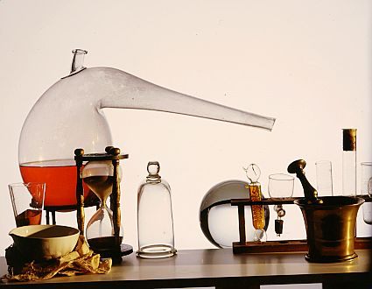
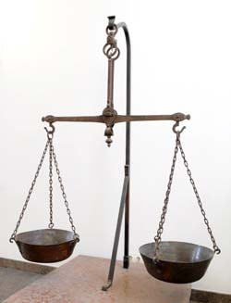
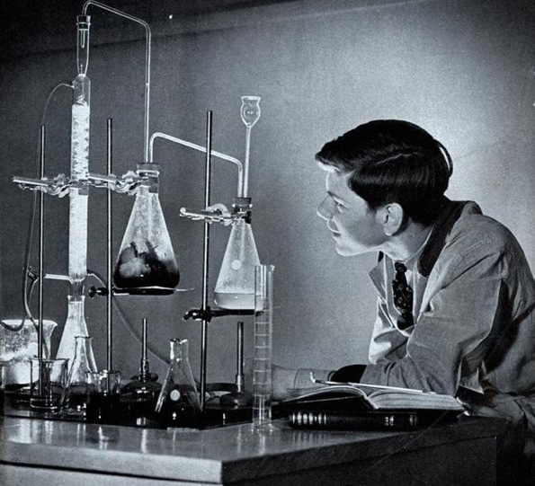
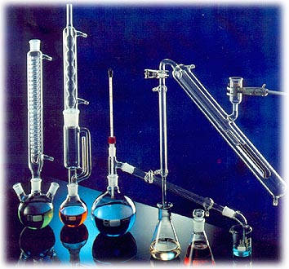
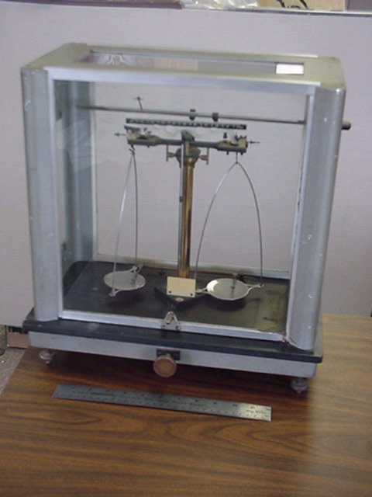

Brief historical aside:
Finding compositions: then and now
Then: ~ 1700-1950 : classical chemical methods decompose and capture elements
Glassware
+ Balance
+ Chemical Finesse
1750
1950

Slide 14
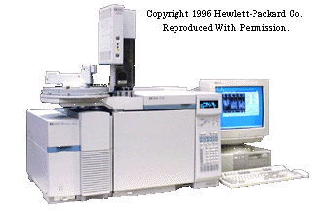
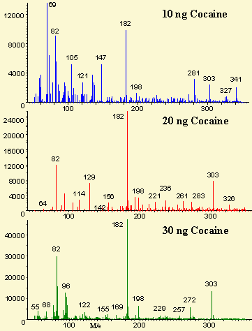
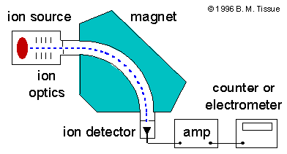
…now 1950-2010
…instrumentation rules
ASC Instrumentation lab has three of these (~80 k$ each)
Mass Spec (CSI !)
Mass spectrum of cocaine

Slide 15

Old-school analysis took 1-3 days…relied on the bench skills and savvy of the chemist
New school GC-MS analysis yields answers in a few minutes…computer matches patterns… any yahoo can feed the instrument and read the computer output
a grumpy old Doc Fong kvetch….
With every advance, we lose something
…many recent Ph.Ds in chemistry know
more about computers than classical analysis, can’t build equipment and are not `sensitive’ in the lab.

Slide 16
Chemical bookkeeping: balancing reactions old school
(on blackboard)
2
2
Cu +O₂ → CuO
Example #1:
Element combustion
Balanced !!!! ☺

Slide 17
Reaction balancing (continued)
Example #2:
Organic combustion
Balanced…at last !!!!
C₃H₈+ O₂ → CO₂+ H₂O
5
3
4
Propane=LNG
Liquid Natural Gas

Slide 18
Slightly trickier balancing…the odd/even oxygen dilemma
Internal combustion reaction
2
16
__C₈H₁₈ + __O₂→ __H₂O + __ CO₂
25
18
Octane = gasoline
balanced

Slide 19

Chance to earn
Mole $$$ !!
In-class Exercise 6.2 + more…
WHITE BOARD WORK

Slide 20
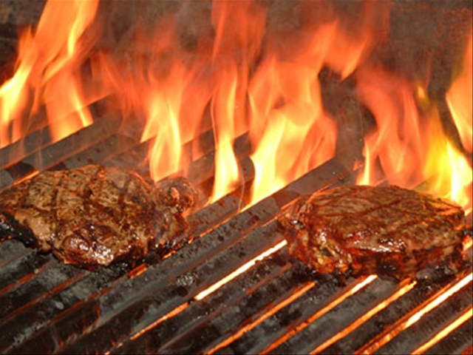
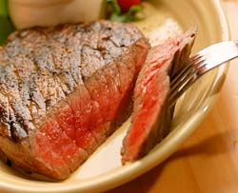
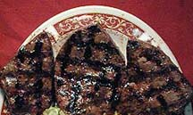
Sometimes several answers possible
Barbecuing steaks…
C₃H₈ + 5O₂ → 4H₂O +3CO₂
Complete combustion
C₃H₈ + 4O₂ → 4H₂O +2CO₂ + C
Incomplete combustion
C₃H₈ + 3O₂ → 4H₂O + CO₂ + 2C
C₃H₈ + 2O₂ → 4H₂O + 3C
Low O₂
→Low CO₂
₋→ High C
(charred)
Hi O₂
→Hi CO₂
→Low C
(no `char’)

